Slide 1
Towards assessment without levels
Assessment without levels
this way…
DD
Dominic Martin
Deputy Head Teacher
Rebecca McVittie
Head of English

Slide 2
An exciting opportunity to refocus the emphasis of school based assessment:
to build an system assessment that fitted with our school’s values and vision for curriculum, rather than a national system.
to place more emphasis on reporting assessment outcomes to parents and children as a descriptive profile, rather than numerical values.
to place greater emphasis on teachers using precise descriptions of pupil progress, gaps, next steps, rather than numerical values. An opportunity to refocus our attention on how assessment can be used to support teaching and learning for all pupils.
progress throughout curriculum to reflect breadth and depth of understanding.
background use numerical values to present overviews and trends.

Slide 3
Our Assessment Journey
Summer 2013 – new curriculum content used to assess writing, but matched against curriculum 2000 expectations.
January 2014 new curriculum mapped precisely, content allocated to specific year groups for both core and foundation subjects.
Spring / Summer 2014 – new curriculum content and expectations used to assess writing in Yrs 1,3,4 and 5 – matched to equivalent levels or APS.
Autumn 2014 – levels no longer used to assess progress in any foundation subjects, or English, Maths & Science Yrs 1,3,4,5.
Autumn 2014 New curriculum team TLR holders have developed assessment frameworks for new curriculum; pitch and expectation for new curriculum is clear and progressive.
October 2014 Existing NC levels migrated into new curriculum numerical values / stages to create new curriculum baseline.
December 2014 new formative and summative assessments completed producing first data outcomes for curriculum 2014.

Slide 4
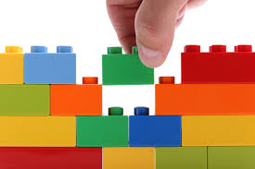
Building a new assessment system

Slide 5
Deciding upon assessment language that describes an emphasis on challenge and breadth & depth of achievement.

Slide 6
Distilling new curriculum requirements into Key Performance Indicators
Using KPIs as a key assessment focus dispensing with the need to focus on and record all of the relatively minor aspects contained within the curriculum.
KPI: Descriptors that carried significantly more ‘weight’ than other performance descriptors.

Slide 7
A framework that would support us to teach for depth and breadth in each year group, before children progressed further. A framework that would articulate progression steps in each year group clearly to staff, to children and to parents.

Slide 8
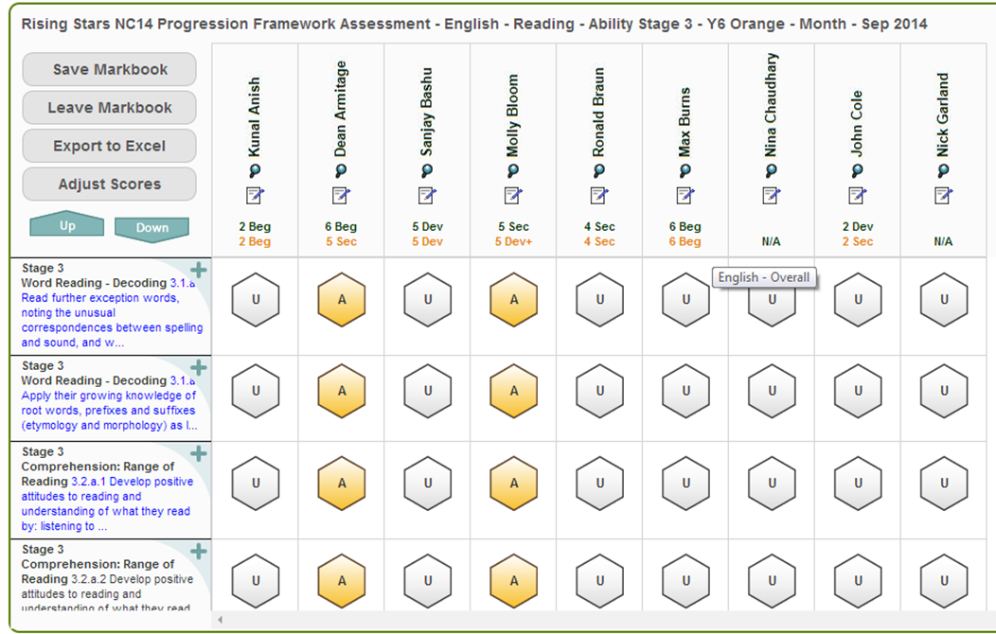
A tracking system that promotes assessment to inform teaching and learning

Slide 9
Ongoing Assessment Programme
Formative ongoing assessment against criteria using ‘cold’ and ‘warm’ pieces of writing in a ‘Writing Portfolio’. Plus, summative SPAG tests to address grammar elements of framework.
Maths summative ‘unit’ tests throughout the term, at a distance, once a unit is complete – moderated by a control group of 6 pupils who are tracked formatively. This group represent the attainment spread in each class or set.
Reading summative tests each half term – moderated by a control group of 6 pupils each representing the attainment spread in each class or set.
Ongoing assessment in science – using our own science assessment framework - against year group expectations: developing, meeting, exceeding

Slide 10
What have we learnt so far?
Some children have been reassessed at a lower level as a result of new curriculum expectations.
Assessment migration from one curriculum to another has highlighted gaps that need to be ‘back filled’ before children can progress further.
Perhaps unsurprisingly, more able children are finding shift in expectation easier and are largest definable group already to have made progress since October migration.
Level of challenge is particularly noticeable in number within mathematics and grammar within English. Expectations within reading seem much less problematic.
Using new assessment criteria has forced staff to become familiar with new curriculum content, objectives and higher expectations.
Staff have embraced new assessment positively; focused on what a child needs to do next to move on, rather than using numerical values, such as 5c etc.
Staff meeting time to work through together has been vital and created an ‘in this together’ spirit.

Slide 11
Next steps
Moderation, moderation, moderation!
Communicating assessment without levels to parents: descriptive profile accompanied by below, developing, meeting or exceeding age related expectations.
Supporting Year 5 children to meet higher expectations, in a very short space of time to be ready for new KS2 assessments next year.

