Slide 1



Senior Manager Human Resources & Corporate Affairs, Komatsu UK Ltd
Tracey Wilson
#SNEsummit15

Slide 2
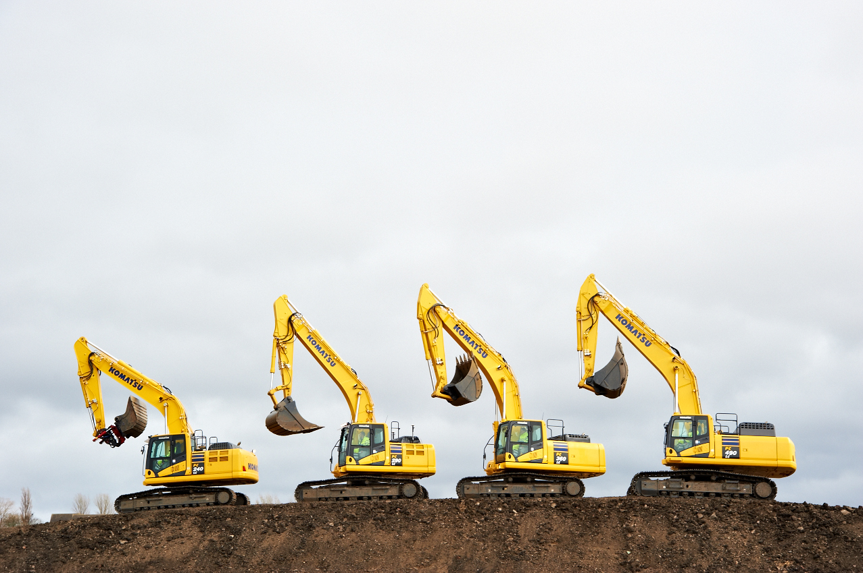
Komatsu UK
Notes:
Good Morning.
My name is Tracey Wilson, and I have responsibility for HR and Corporate Affairs at Komatsu UK.
My remit covers the usual range of HR activities, including recruitment, and also Corporate Social Responsibility – including working with schools.
It is a pleasure to have been given the opportunity to speak to you today.

Slide 3
Komatsu – Engaging With Schools
Overview of Komatsu
Apprentice and Graduate Training Opportunities
STEM Ambassadors
Our Work With Schools
Notes:
Over the next few minutes, I would like to set the context by giving a very brief introduction to Komatsu and what we do, and telling you a bit about the work we have been doing with schools.
I will also touch on the kind of entry level recruitment we undertake – mainly Apprentices and a smaller number of Graduates

Slide 4
Komatsu locations in the world today
139 companies worldwide
40 manufacturing plants
47,417 employees worldwide
China
Japan
Affiliates
Indonesia
Regional offices
Brazil
Distributors
Manufacturing
Notes:
Komatsu was founded back in 1921 in Komatsu City in Japan – it was originally a small repair shop for mining equipment. Today, Komatsu is a global company employing over 47,000 people.

Slide 5
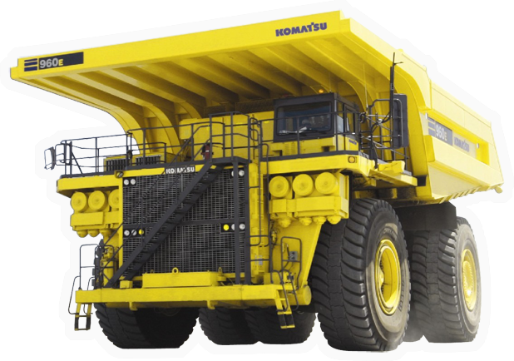
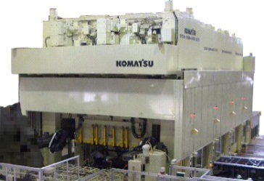
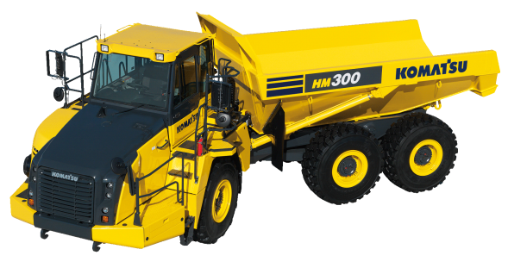
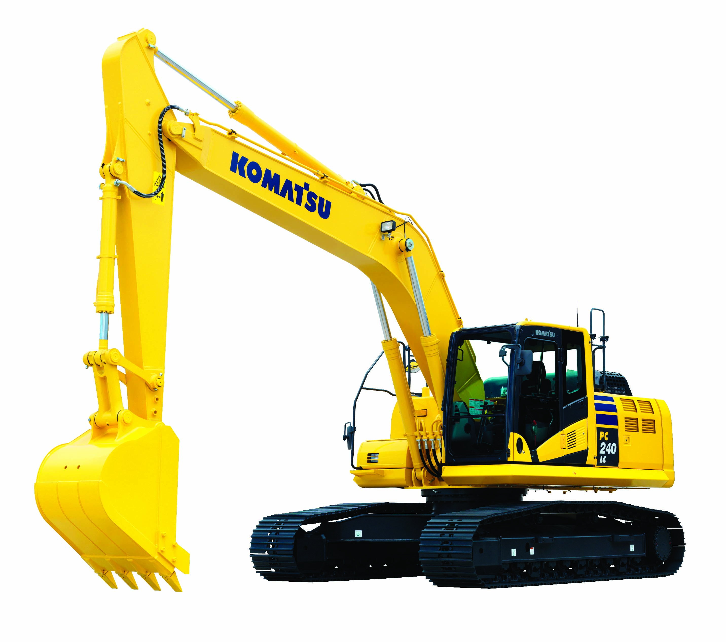
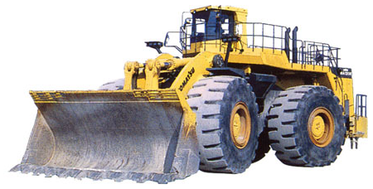

Komatsu Group Product Range
Construction & Mining Equipment
Industrial Machinery
Others
Komatsu UK product:
Hydraulic Excavators
89% of Komatsu’s business
Notes:
And this is the range of products which Komatsu produces today.
The majority of the business is construction equipment, but Komatsu also produces industrial machinery (such as welding robots and presses used in the car industry), and some electronics.
At Komatsu UK, we manufacture excavators

Slide 6
7 Apprentices completed training in September 2015
26 Apprentices currently in Training
15% of current permanent workforce commenced as an Apprentice
Notes:
We recruit around 6-8 Apprentices each year. Currently, there are 26 in training – mainly in the Direct areas.
It is a 3-year apprenticeship, and at the end of their Apprenticeship, we offer the vast majority a permanent job
And, the Apprentices don’t necessarily remain in manufacturing – they can progress to Engineer roles, where opportunities arise – and there are lots of examples where that has been the case.
Also recruit 2 Engineering graduates each year. Follow a structured 2-year programme.
Approx. 25% of our Management Team started as graduate/Apprentice trainees – including our Manufacturing Director.
We run these training schemes to develop our future workforce

Slide 7
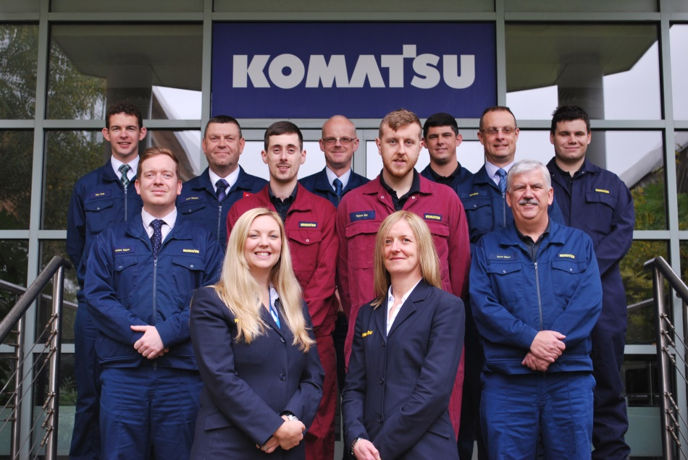
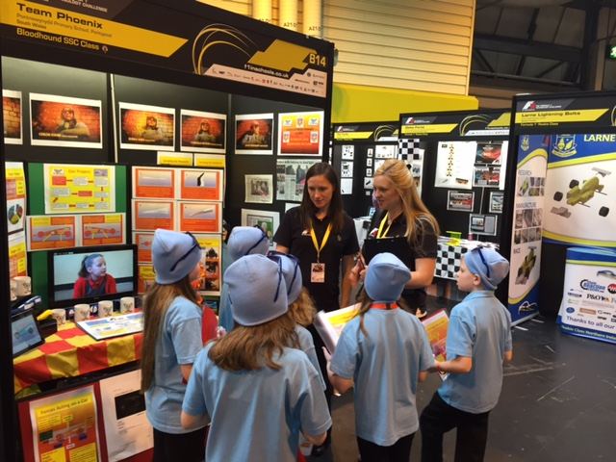
STEM Activities
17 Komatsu UK employees are STEM Ambassadors
Over the past year, our STEM Ambassadors have been involved in 25 events - variety of local schools and colleges involved
2 Komatsu Engineers were Judges in the National “Formula 1” Competition for Schools held at NEC, Birmingham
Work experience is offered to young people (approx. 20 placements provided this year)
21
Notes:
I now like to cover some of the STEM activities we are involved in, and tell you about the opportunities we have for trainees.
We currently have 17 STEM Ambassadors. They range from Apprentices just completing their training, through to experienced Production Managers.
Our support for Schools is coordinated through HR, and we involve the Ambassadors in supporting a variety of activities, including:
- Site tours – with the opportunity to try a bit of excavator driving
Supporting School Careers Events
Talking to groups of students about careers in Engineering
Most of the activities are local, but we have also been involved in national Events, such as the F1 competition
We also provide work experience and have so far this year accommodated 20 work experience placements

Slide 8
Work with Local Schools
Closer relationship with 3 local schools:
Hermitage Academy, Chester-le-Street
Oxclose Academy, Washington
Lord Lawson of Beamish Academy, Birtley
Examples include:
Introduction to continuous improvement
Introduction to health and safety
Providing a welding “taster” session
21
Notes:
There are 3 local schools that we have a special relationship with, and where we carry out more in-depth activities including introduction to continuous improvement, health and safety, and welder taster sessions.

Slide 9

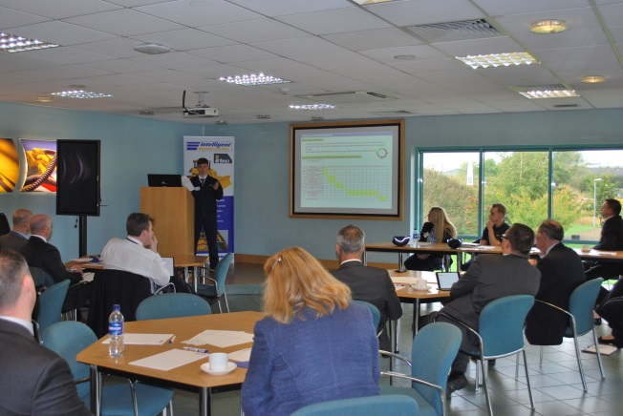
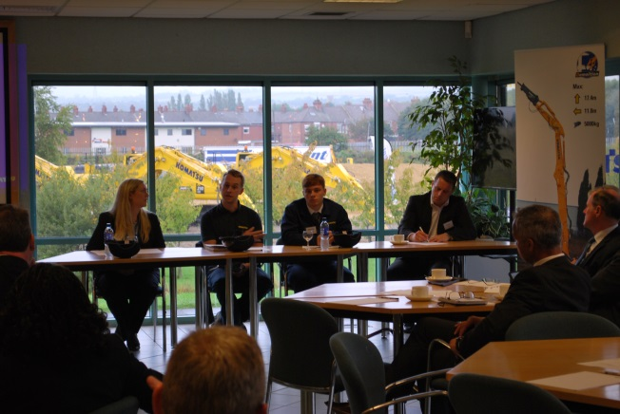
STEM Event for Head Teachers
Komatsu UK & TDR
Hosted at Komatsu UK in partnership with Training & Development Resource Ltd (TDR), working with Schools North East
Purpose: to raise awareness amongst head teachers of career opportunities in Manufacturing & Engineering. To be rolled out by TDR in partnership with other companies
Notes:
Last week, we hosted a STEM careers event for Head Teachers at Komatsu. This was in partnership with TDR. This is the first time we have held such an event, and TDR plan to roll this out across the Region and involve other companies.
The purpose was to raise awareness amongst head teachers of the types of careers available in Engineering and Manufacturing.
We had a factory tour, presentations from young people who are progressing their careers in Komatsu UK, and an opportunity for a bit of machine driving.

Slide 10
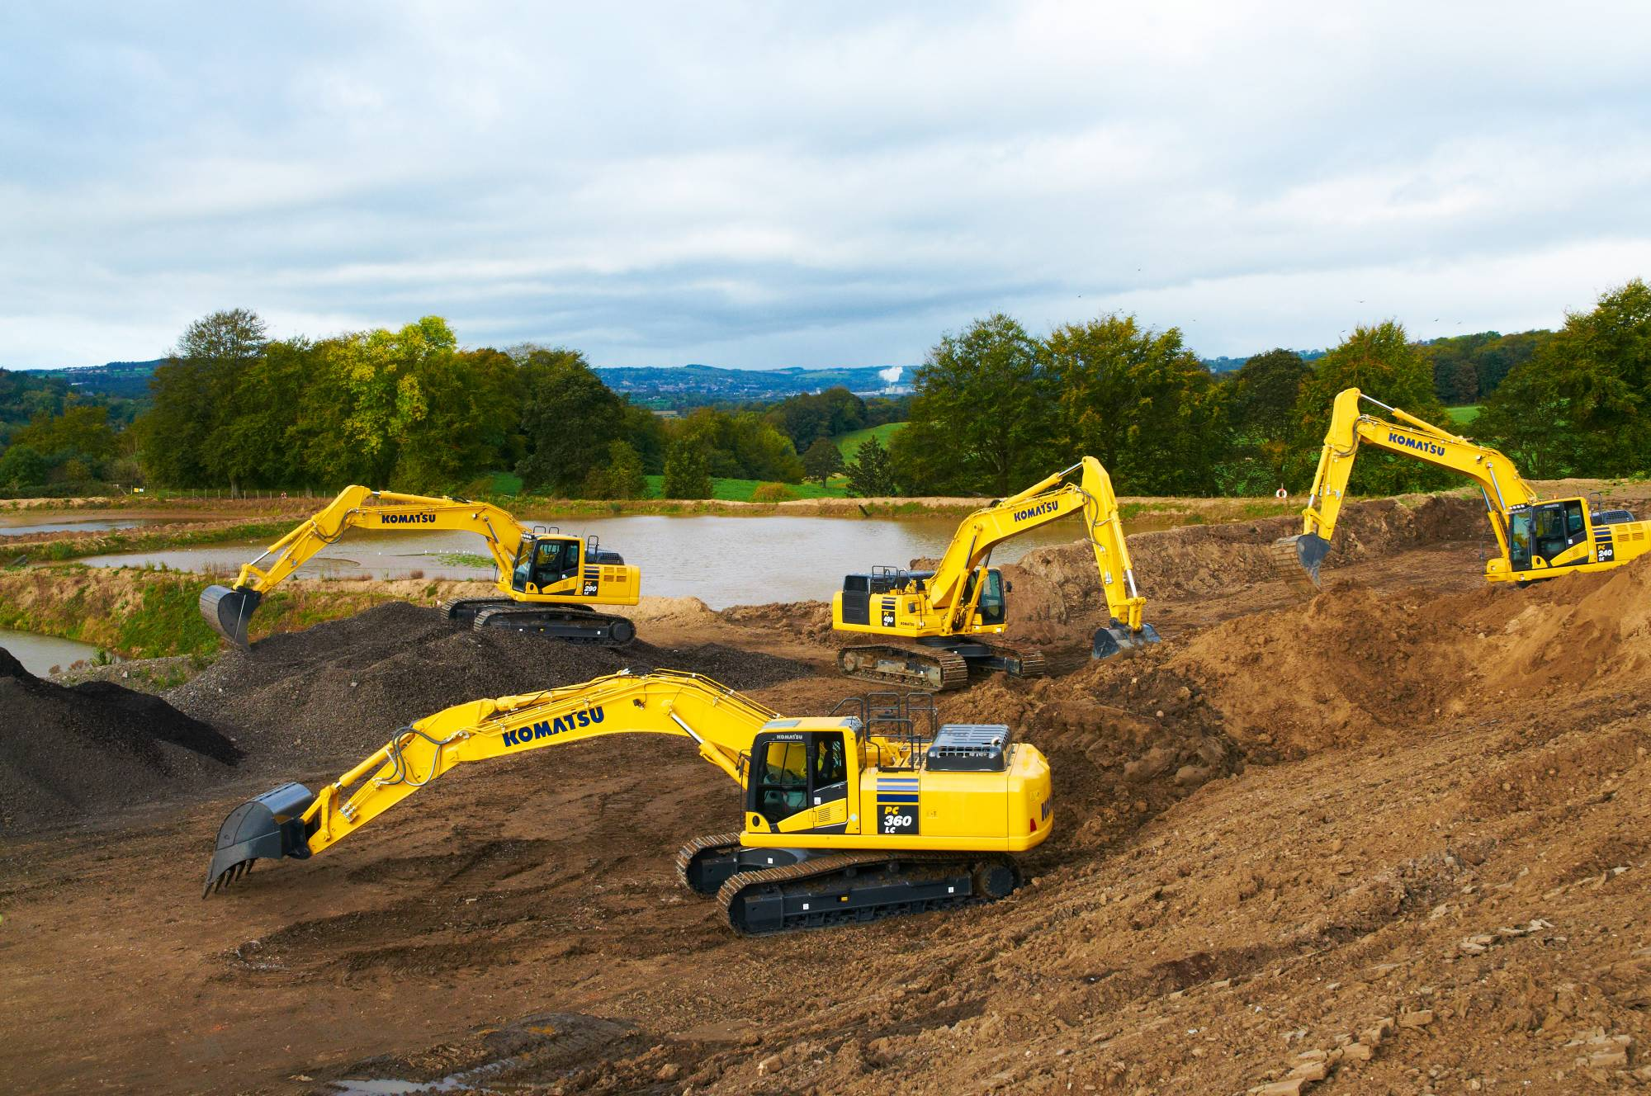
Thank You

Slide 11
Back Data

Slide 12
Komatsu UK Apprentice Training Schemes
3 Year Apprenticeship programmes
Apprentice Training Provider - TDR
Engineering
NVQ Level 2 Diploma in Performing Engineering Operations
BTEC Level 3 Diploma in Manufacturing Engineering
NVQ Level 3 Extended Diploma in Mechanical Manufacturing Engineering
Advanced Apprenticeship in Engineering Manufacture
Administration
NVQ Level 2 in Business and Administration
NVQ Level 3 in Business and Administration
Advanced Apprenticeship in Business and Administration
Notes:
In terms of the training they receive, it is a 3-year programme (for both Engineering and Administrative Apprenticeships), each leading to qualifications at NVQ level III
Many go on to study for HNC, and some take the next step to study for a degree

Slide 13
Graduate Trainees
2 Engineering Graduate Trainees recruited each year. Appointed as permanent employees.
They follow a structured programme to gain experience in the various Engineering Departments.
Currently 5 Engineering Graduates in training.
25% of the current Komatsu UK Management Team commenced as Graduate Trainees/Apprentices
1 month | 5 months spent in each area
Induction | Planning Engineering | Procurement | Production Engineering | Design Engineering | Quality Assurance
Notes:
We generally recruit 2 Engineering Graduate trainees each year
They follow a structured programme of training, and a typical training schedule is shown here
We are keen to train our own people for the future, and very much focus on entry-level recruitment. A quarter of our current management team commenced as Graduate/Apprentice trainees – including our Manufacturing Director.

