Slide 1
Securing a positive future for the SBM profession Stephen Morales Chief Executive, NASBM

Slide 2
Challenges and opportunities
The reforms set out in Educational Excellence Everywhere
Mass academisation
National funding formula
Efficiency
Professionalisation of the education workforce

Slide 3
School business management professionals – critical agents in the reform agenda
Minister for Schools states publicly that SBMs are essential frontline practitioners
Education White Paper and review of efficiency make multiple references to the importance of SBMs
Honours awarded to 6 SBMs over the last 18 months
School census shows year-on-year growth in the SBM population – now c.16k
New career development opportunities for SBMs in emerging school structures

Slide 4
SBMs positioning themselves as essential education leaders
Reflect on your own professional practice in the context of nationally recognised professional standards
Assess how closely your skills and competency are aligned with the future needs of your institution
Develop your own portfolio of skills and experience that secure your position on the leadership team
Identify development opportunities that will strengthen your professional credibility
Lead on strategic initiatives that will help secure the future of your school, i.e. 3–5-year sustainable financial planning, collaboration, organisational restructuring

Slide 5
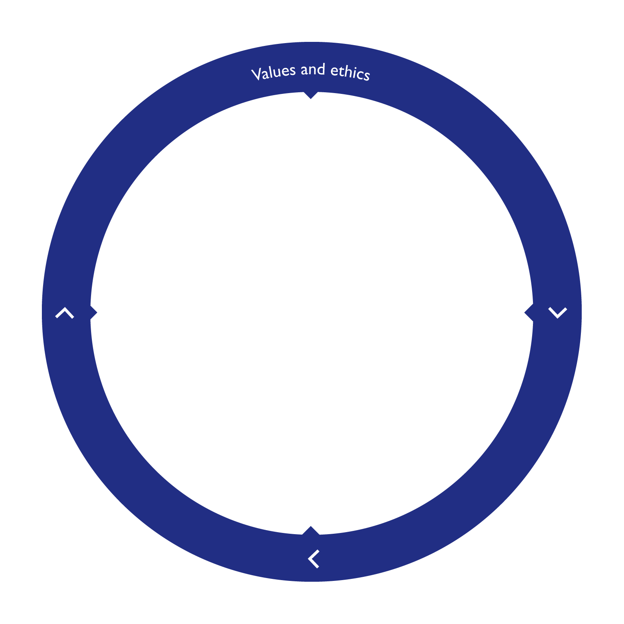
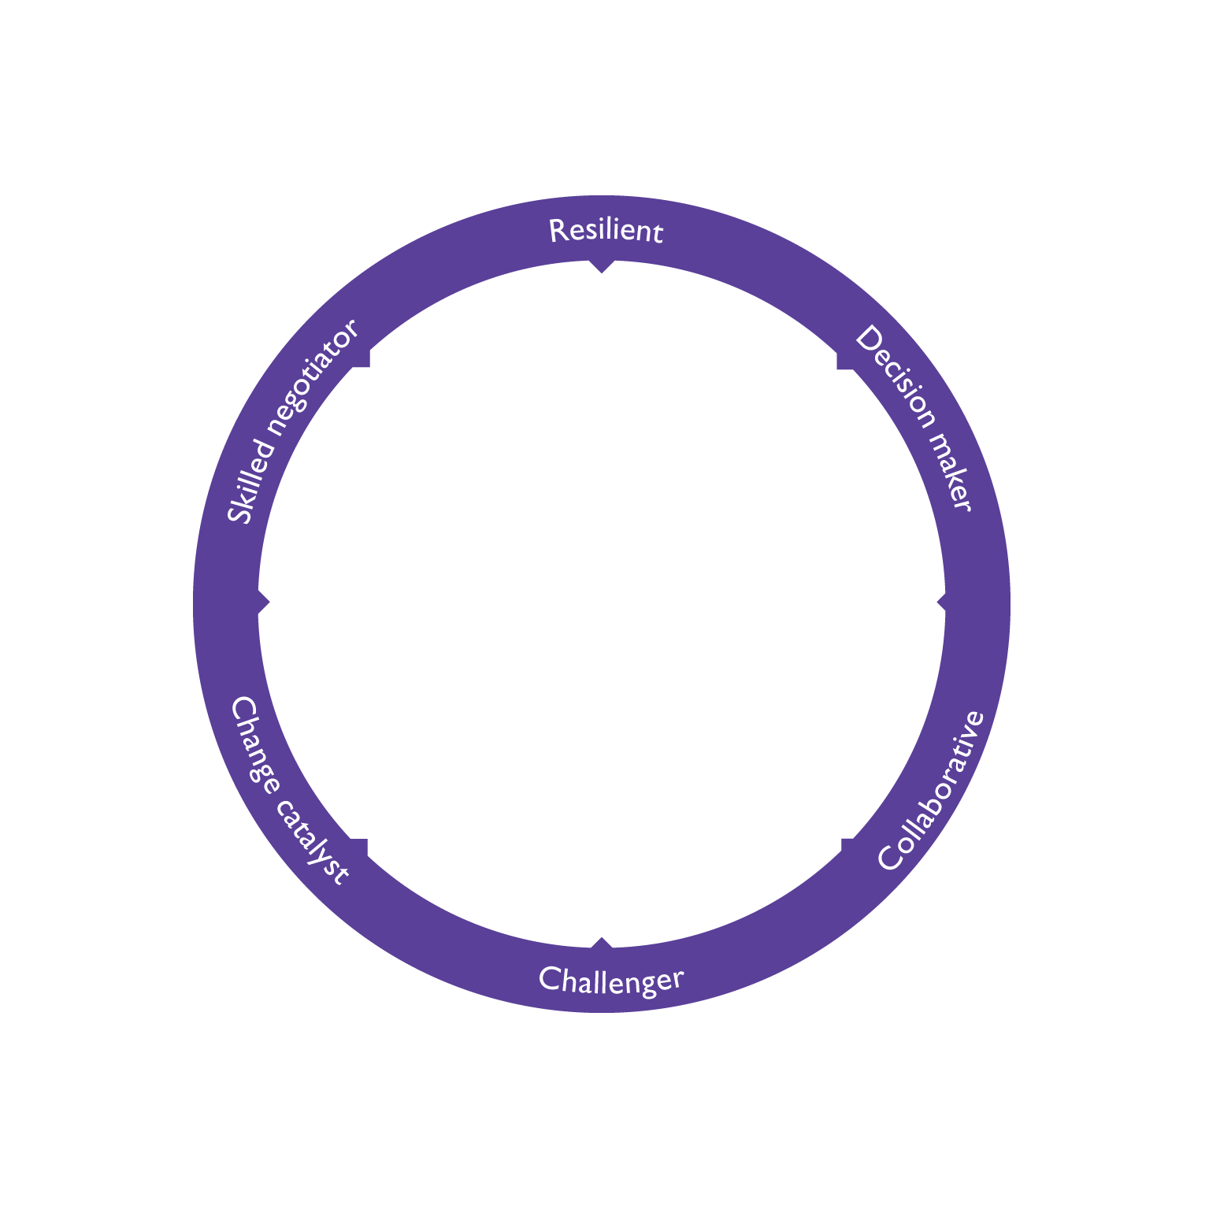
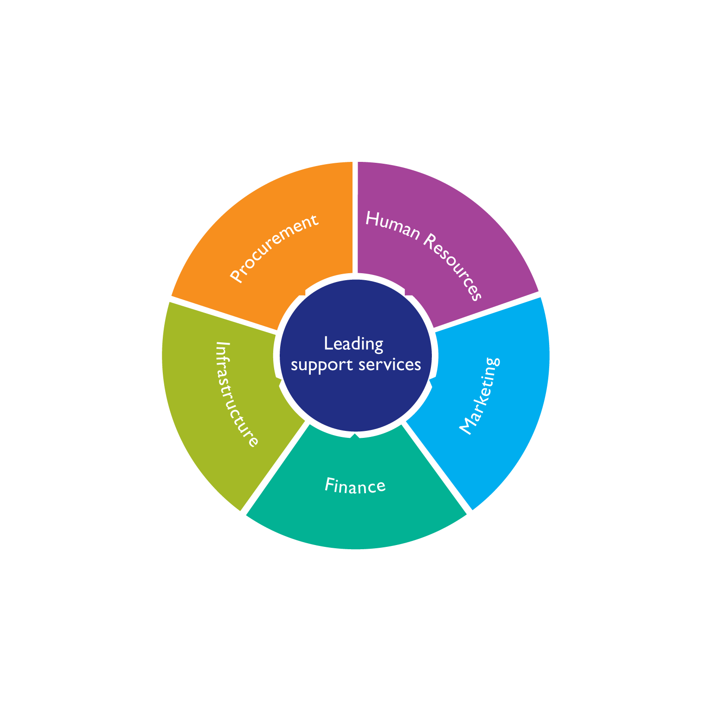
Professional Standards

Slide 6
Qualifications and training
Toolkit training, workshops, seminars and briefings
SBM quals – Dip 4, 5 & 6
Funded SBM apprentice route – level 4 to master’s level 7
COO/CFO specific qualification
APEL route to graduate level
Post-graduate programmes

Slide 7
An SBM community with a common sense of purpose
David Breashears, leader, filmmaker and Everest adventurer, suggests:
A team’s first obligation is to the mission, then the team and then to the individual
A team should never forget its core purpose
Teams should make sure they take care of each other authentically and with integrity
We should celebrate the indomitable human spirit. We are stronger and more capable than we think; we need to trust ourselves and each other.

Slide 8
Making contact
For more information on professional standards, training and qualifications, email us at info@nasbm.co.uk
To have your say on anything SBM-related, tweet us: @NASBM_news

