Slide 1
Poverty Proofing – Grangetown Primary School
Notes:
Hi my name is Stephen Jackson and I am the recently appointed Pupil premium champion at Grangetown Primary School. I am here today to dicuss the positive experiences we have had through ‘poverty proofing’ our school day and the areas we have worked on from it. I have just finished a 3 and a half week jury service stint so apologies if it doesn’t come across as organised as I would have hoped!

Slide 2
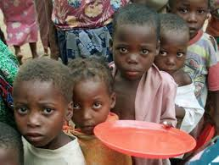
Poverty
Notes:
I said to my children ‘do we know anyone/anywhere where children are living in poverty? Their response was, as Im sure a lot of childrens would be, the children who live in Africa. So I went further and asked them ‘okay what is poverty?’ I got the usual responses no food, no clothing etc. and we delved further into are there any children in our country who live in poverty. One girl mentioned that people in poverty are homeless, and someone else said well ive seen a homeless man in Blackpool. Delving further into this I asked have we ever seen a homless person in Middlesbrough then? They answered yes and we got back onto the discussion of poverty been when children have to go without things that other families take for granted. and this is how we got onto some of them realising ‘wow, I might be living in some sort of poverty. But the positive to take from this discussion was that the children also realise that other children around the world are in a terrible position, although we do have strive poverty in the area/school. The next slide looks at some of the facts of Grangetown.

Slide 3
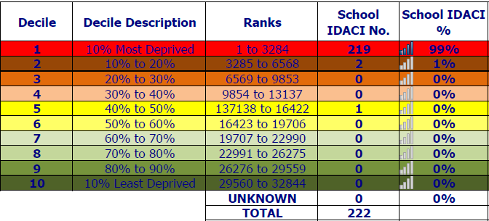
Facts about our school
Notes:
I am not here to plead poverty for my school. In this area there are lots of children within our schools living in poverty. These are just the facts from the IMD report we have been given. 99% of children at Grangetown Primary School are ranked within the 10% most deprived areas within the country, with just 1% living outside.

Slide 4
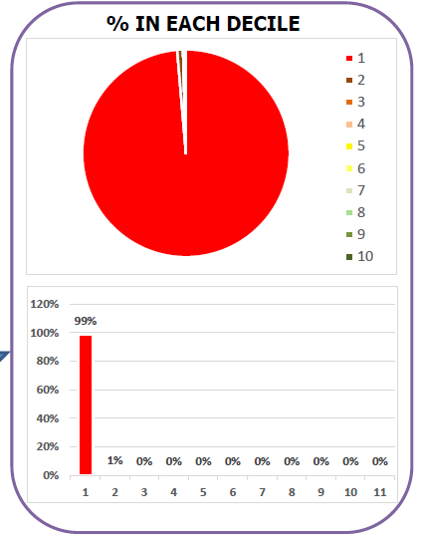
Notes:
This pie chart makes it clear the extent at which the children in our school are living in the most deprived areas around. The detailed breakdown actually shows that 98% of the children are living within the top 5% of most deprived areas in the country.

Slide 5
Notes:
We can see that the majority of children are living in areas whereby income is at the lowest point in the country, education is poorest, employment rates are extremely low, crime is very high and there are issues with health for nearly every child. One positive about the area is the barriers we have including doctors and schools such as ourselves which are within walking distance. It is the same story when we look within our year groups, where our nursery reception and Y1 children have 100% living in the worst 10% of deprivation. We have one child who has managed to scrape into the yellow in Y2! Obviously we can’t just sit back and say ‘we have all these children living in deprivation, we can’t do anything’, especially with things such as the Pupil premium grants that we are given. So we looked at ways we can enhance the lives of these children both academically and personally. We got in touch with Schools North East and in December 14 they had a ‘Poverty Proofing of the School Day’ at Grangetown.

Slide 6
Poverty Proofing the School Day
Children North East
Interviewed children in all year groups looking at their experiences alongside examining the school day.
Parent’s Experiences (what was working well/areas to improve on)
Staff Experiences
Governor Experiences

Slide 7
What’s working?
Children were aware of the anti bullying policy and felt safe within school.
All resources pupils required were provided for by the school.
All after school clubs are provided free of charge.
All trips are heavily subsidised by the school.
There was a high level of understanding about poverty and the impact of poverty on a child’s learning throughout the leadership team and staff.
The attainment gap and pupil premium spending was a regular topic of discussion.
Many staff who work at the school are from the local community.
Staff and children have positive relationships.
There is an affordable uniform within school that is plain and can be purchased at most shops.
Notes:
These are just a selection of the things that are already working within our school from the report. We celebrate all the ideas/actions that are already in place and are very proud of them. The key aim is to provide these children with as much as we can, as it is clear from the data how deprived the majority are. Alongside the working well findings in the report, there are also areas to explore which go into great detail within the report.

Slide 8
Action Plan
Created an action plan from the reports using the key findings.
Target | Desired outcome | Actions Taken | Impact to date
Ensure that during tournaments or competitions there is no pressure for families to buy new boots or shin pads to take part. | That all children can attend sporting tournaments without having to purchase new equipment. | Letters explain that no new equipment is needed. School has purchased shin pads, football boots and other equipment so that children attending have everything that they need. | No one is expected to buy equipment unless they choose to. Parents are informed that they do not need to buy anything. Children have accessed a wide range of sporting events both in and outside of school time.
Extend the period of time given for families to pay for the year six residential. This may need to begin during year 5. | That parents have time to pay for the residential and don’t feel as if they are being rushed with payments. | We send the letter out well in advance of the trip taking place. We have set up payment systems for parents so that they can pay at different times. We have continued to heavily subsidise the residential for Y5 and Y6 pupils. | We have seen increased numbers of children going on the residential. We are subsidising and speaking to parents on 1:1 basis to offer further support and assistance. Parents are being informed earlier and are given longer to pay.

Slide 9
Target | Desired outcome | Actions Taken | Impact to date
Exposure to and opportunities to learn a musical instrument is most often not available to families with less financial resources. Explore funding and programmes to increase music and access to music in the school. | That children through school get access to music tuition and experience different instruments. That children get good quality music lessons in school. | We have used our own funding to hire a company called Apollo Art to deliver our music curriculum. | All children across school will have at least 3 terms of music tuition from Apollo Arts at no cost to themselves. Apollo Arts will introduce the children to different instruments and music across the time they are with them. All activities are linked to the music curriculum. We are now looking at offering an after school club run by Apollo Arts to further develop the experience.
Consider establishing an after school Homework Club that is interesting and fun and provides all the resources children need including support from an adult to complete. Ensure all homework set can be completed without access to a computer. Consider establishing an ad hoc homework club for things like the Easter egg competition, to ensure all children have equal access to resources and support. | All children being able to access a homework club. Homework policy reviewed and discussed. Homework club being run on a weekly basis in school for children to access. Children given homework books to do their homework in all resources needed can be accessed. | School has reviewed the homework policy and it is now consistent across school with all children having a homework book. School has introduced a weekly homework club into the extra-curricular programme. | All children can access the homework club and it has been well attended by pupils. The homework book is working really well and no one needs special equipment from home. |Homework is consistent across school.

Slide 10
Target | Desired outcome | Actions Taken | Impact to date
Children who do not have a jumper are clearly visible. This could act as an early warning sign to staff that a family may be struggling | All staff to be aware of children without school jumpers. Information passed to pastoral manager who will investigate reasons. Jumpers given to those children who need them. | Staff have informed Pastoral manager and HT with concerns. Each concern has been looked at separately and discreetly with specific outcomes. | Several families have been supported and helped with uniform discreetly. (One boy who was given a jumper would not take it home in case it got ruined.)
Notes:
The impact from the report and subsequent action plan has helped the school greatly. We have linked the poverty proofing report to the Pupil Premium spending to enhance opportunities further for the children in our school.

Slide 11
Pupil Premium
83% of children are on FSM.
Because of the huge percentage of poverty we strive to use the money to enhance opportunities for all the children living in such a deprived area. It would be unfair to single out one or two in the whole school due to sheer numbers on FSM and living in a highly deprived area.
Alongside academic support, we also strive to give the children as many wider life experiences as possible and aid the parents in any way we can.

Slide 12
PP spending
Breakfast Club massively subsidised
Free Parental courses in school (English, Maths, Computing, Nail Technician course)
10 Things to Do
Parent Passport
Notes:
We do spend a huge amount of the PP on teachers and creating smaller class sizes for a bigger focus as well as lots of smaller interventions in class. In this slide I just want to focus on the spending around life oppourtinies and supporting parents.

Slide 13
Any questions???

