Slide 1
Data protection in the Education Sector - understanding the impact of GDPR
Tuesday 23rd January 2018

Slide 2
Agenda
Data Protection Law is changing – why is this?
Three Key Principles you must know….
Preparing to be a compliant organisation – key steps
Appointing a Data Protection Officer
Your people and their role in assuring compliance
Governance considerations – how to demonstrate you take data protection seriously

Slide 3
Data Protection Law is changing – why is this?
Legislation should ideally be uniform across Europe;
The extent to which personal data is captured and used has grown dramatically over the past decade;
Real harm can occur if personal data is misused or is not kept in up to date form;
Data breach reporting and penalties for data breaches will benefit from being uniform.

Slide 4
Three Key Principles you must know….
Understanding when you are a data controller (and the responsibilities this brings);
Understanding what is meant by processing data (and how to ensure you have compliant relationships with third parties who do the processing for you);
Understanding the legal basis upon which you are entitled to store and process data (and being transparent in your relationship with the data subject).

Slide 5
Ability to work with personal data is not always based on consent
There are times when you should not rely on consent!;
Avoid relying on consent where possible as operating on a consent basis has become more complicated;
The basis upon which you process data may be:-
Consent;
Legitimate interest;
Performing a function in the public interest;
To protect the vital interests of the data subject.

Slide 6
Preparing to be a compliant organisation
Appointing a Data Protection Officer
Your people and their role in assuring compliance
Governance considerations – how to demonstrate you take data protection seriously

Slide 7
Appointing a Data Protection Officer
All organisations in the public sector must appoint a Data Protection Officer;
The role can be outsourced but this approach is likely to leave considerable risk with the organization;
The DPO must be free from conflict of interest. Conflict is regarded as leading to the exclusion of:-
The Chief Executive/Executive Principal
Director of Finance
Head of Technology
The DPO must have reporting access directly to the Board/Governing Body.

Slide 8
Your people and their role in assuring compliance
Staff behaviour is a vital element of compliance
The process of accessing personal data is regulated – data looked at must be reviewed for a legitimate reason

Slide 9
Governance considerations – how to demonstrate you take data protection seriously
Ownership of oversight/monitoring and management of compliance is with the Data Protection Officer
How good is your Board/Governing Body understanding of Data Protection issues – are there any experts within the group?
Develop a clear reporting regime for the DPO directly to the Board
Integrate data protection training into your induction and providing easy access to refresher/updated training (online products are likely to become available)
Make sure there is genuine challenge from the Board!
Ensure that the DPO is fully supported in his/her role.

Slide 10
Are you ready to develop an action plan?
Some excellent resources on the ICO website;
Guidance should be forthcoming from DfE (scope and timing is unclear);
Do find a way of ensuring access to professional advice;
Explore collaboration with other schools to achieve cost sharing for activities involved;
Start an audit of personal data held;
Ensure there is a Board/Governing Body briefing this term!;
Make your decision on the Data Protection Officer appointment and (for MATs leads at each school);
Start to raise awareness within the School;
Make sure your privacy policies are updated.
Keep in close touch with developments and spend time understanding good practice!

Slide 11
Your Questions

Slide 12
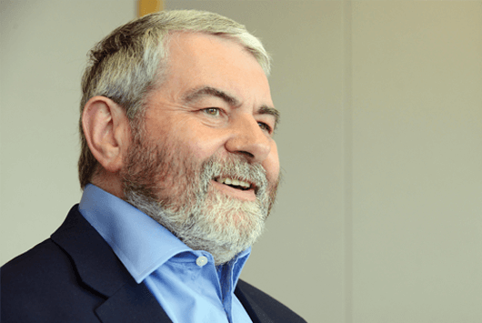
Your speaker
Frank Suttie
Partner | Commercial
E: frank.suttie@wardhadaway.com
T: 0113 205 6783

