Slide 1
Poverty Proofing the School Day
Sara Bryson
Policy & Research Manager
Children North East
Sara.bryson@children-ne.org.uk
@sarabryson1
www.children-ne.org.uk

Slide 2
What do we mean by ‘child poverty’?
Government defines a household as being in poverty if:
“its equivalised net income for the financial year is less than 60% of median equivalised net household income for the financial year”
Peter Townsend provided an alternative definition which is:
“Individuals, families and groups in the population can be said to be in poverty when they lack the resources to obtain the types of diet, participate in the activities, and have the living conditions and amenities which are customary, or at least widely encouraged or approved, in the societies to which they belong. Their resources are so seriously below those commanded by the average individual or family that they are, in effect, excluded from ordinary patterns, customs and activities” (Townsend, 1979)

Slide 3
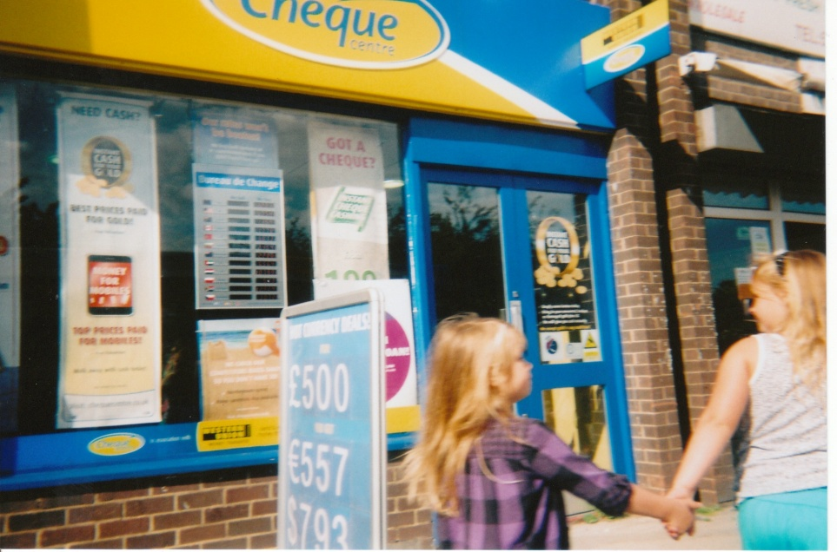
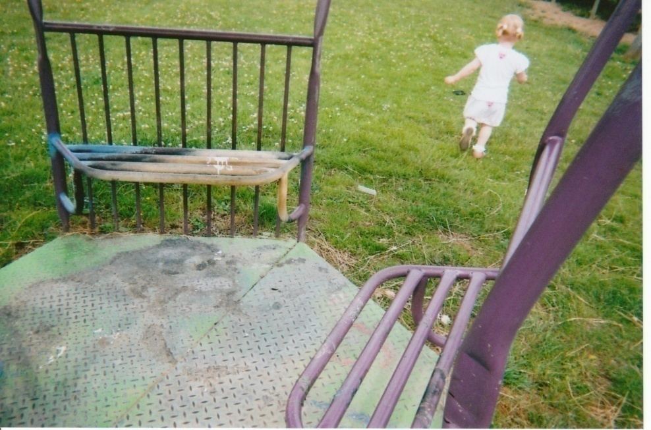
Why Poverty Proof the school day?
Notes:
Photography project – all Sunderland images

Slide 4
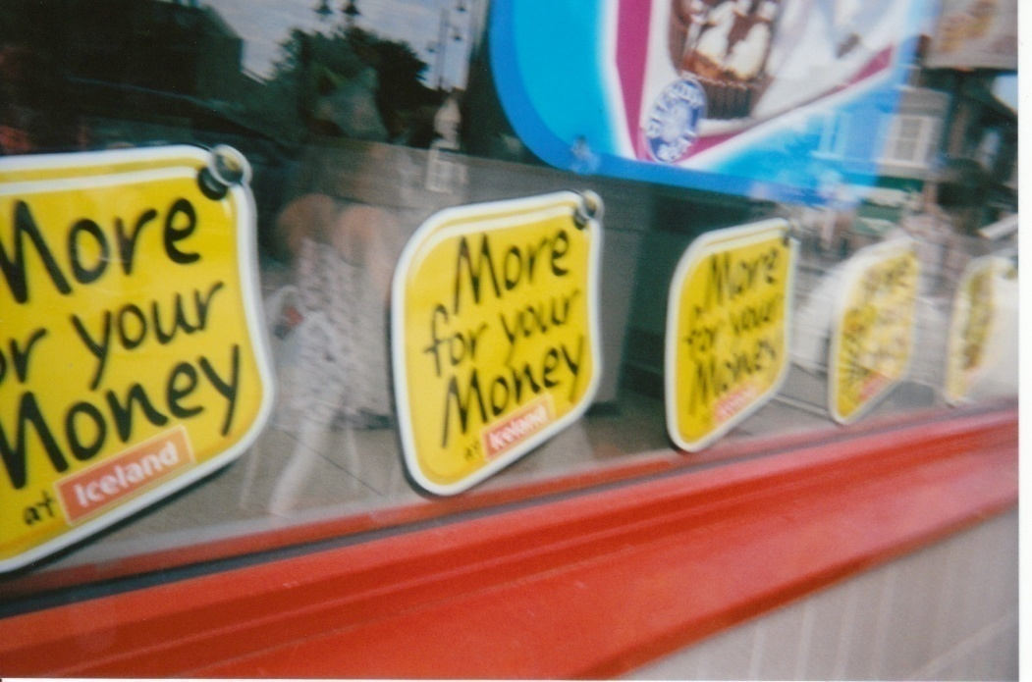

Slide 5
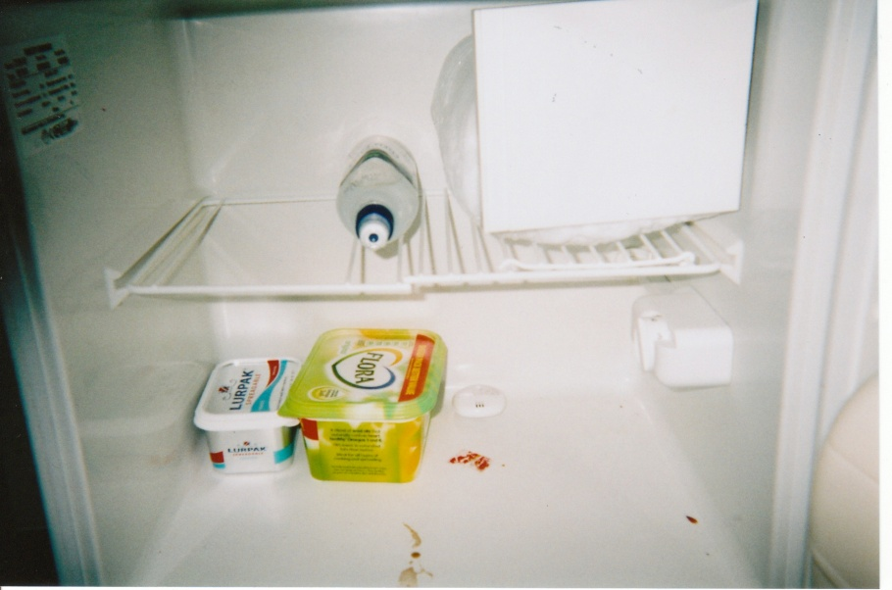
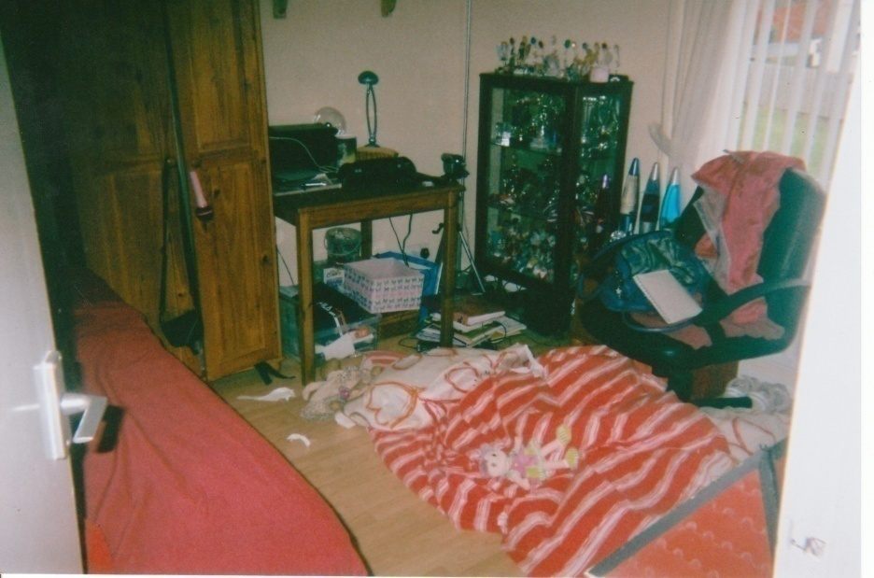
‘Look there’s Hope, She’s got holes in her shoes, Pays nothing for dinners, And holds up the queue’s, Going home with a face full of sorrow, But don’t worry Hope, We’ll get you tomorrow’
Notes:
Source HBAI

Slide 6
Challenges
IFS predictions 2020 4.7m children in poverty
In work poverty 66%
Hunger & Food Poverty
Low pay, no pay economy
Perfect Storm –Increase in needs, decline in support services
Notes:
Data not due until 25th June 2015
Not yet taking into account impact of welfare reform
Further 12 billion to come out of welfare budget (benefit cap, leaked memo – know a further 40 000 children to be affected)
Short changed – parents cutting back on food and hrating because of non uprating of child benefits (in line with cost of living, over past 3 years)
Triple lock protection same as pensioners?! Twice as likely to be in poverty than pensioners.

Slide 7
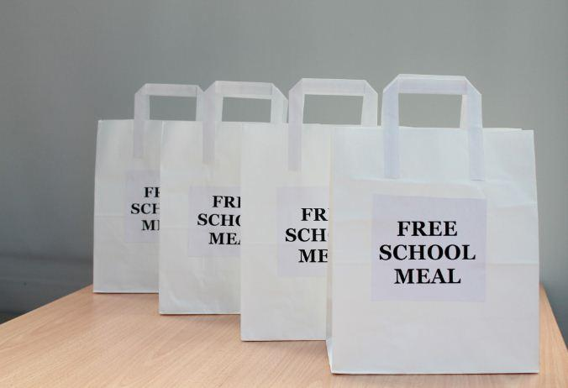
Children’s Commission on Poverty:
Cost of the School Day Inquiry
http://childrenscommission.org.uk/report
-70% of parents say they have struggled with
the cost of school. This rises to 95% of parents
Who live in families that are ‘not well off at all’.
-51% of parents said they had cut
back on clothing, food or heating to
afford school costs.
-25% of parents (and more
than half of those in families which
were ‘not well off at all’) said they had
borrowed money in order to afford the
cost of school.
Notes:
Children are acutely aware that their parents struggle
with the cost of school:
• More than half of children have avoided
asking their parents or guardian for
something school related because they
thought they would struggle to afford it.
• Nearly two-thirds (63%) of children in
families who are ‘not well off at all’ said
they had been embarrassed because
they could not afford a cost of school.
• More than a quarter (27%) said they had
been bullied as a result.

Slide 8
NASUWT
Cost of Education survey
“The Union has been surveying parents for the last two years and there is no doubt that they are facing increasing costs in supporting their children’s education.
The NASUWT has been warning that for many children access to critical educational opportunities, which are key entitlements, are increasingly becoming based on parents’ ability to pay.”
Notes:
Key findings included:
Over half of parents spent more than £100 on school uniform for their eldest child alone. Two thirds of parents were required to purchase uniform from a particular supplier;
Over a quarter of parents were required to spend in excess of £50 per year per child on PE clothing and footwear;
A third of parents were required to purchase textbooks and reference books. Parents also reported an expectation that they would provide access to IT equipment to support children’s learning;
A third of schools request regular financial contributions to a school fund and in more than half of these schools the payments are considered to be compulsory;
Over a third of parents were required to pay for field trips which are compulsory elements of examination courses;
One in seven parents said that cost had prevented their one or more of their children taking part in educational trips and visits.

Slide 9
Poverty & Shame
‘Schools broadened horizons but the stark differences it exposed were a source of shaming: smartly dressed or not, more than one set of uniform or not, hungry or not, pocket money or not, calculator or not, the list was endless’
Walker et al (2013)
Notes:
Walker, R. et al (2013) "Poverty in Global Perspective: Is Shame a Common Denominator?", Journal of Social Policy, 42: 2 215-233

Slide 10
‘children identify free school meals as a very specific and visible difference, which clearly leads to fears of them being labelled and bullied’
‘Several parents talked about their fears of their children being stigmatised, especially where they themselves had painful memories of receiving free school meals’
Ridge (2002)

Slide 12
The Attainment Gap
Notes:
Low income is a strong predictor of low educational performance
There are ‘strong associations between poverty and young children’s intellectual and behavioural development’
By the age of 3, poor students can lag as much as 9 months behind their better off peers.
The gap between children from richer and poorer backgrounds widens especially quickly during primary school
Children who do badly at primary school are less likely to improve at secondary school if they are poor

Slide 13
Notes:
Poverty is policy responsive

Slide 14
‘Remove the barriers to learning’
No activity and planned activity in schools should identify, exclude, treat differently or make assumptions about those children whose household income or resources are lower than others.
Notes:
Can education compensate for society? No but...

Slide 15
Do you know who is poor in your school?
Notes:
Outline process: 4 partner schools/asking CYP do you know who is poor here? How? Explored in depth from a child and young persons perspective/with aim to produce a toolkit to poverty proof the day.
What is poverty? Who is poor? How do you know? Walked and talked the school day. Explored policy and practice to work out how we could test schools to see if they did discriminate?
Drew up the audit questions.
Audited one another's schools/refined the process/ made recommendations.
Met with staff, parents and govenors too.

Slide 16
Challenging Policy & Practice
Unintentional stigma & discrimination
Ability sets & behaviour
Bullying
Exams and resources
Extra-Curricular activity
Food and the administration of FSM
Governance & School Leadership
Homework
Resources
Transport
Tutor Groups
Uniform
Notes:
Findings explore:
Need to address the stigmatisation and discrimination/to remove the barriers to learning that exist.
-Pencil case examples
-Revision breakfasts
-No children on FSM play an instrument/prom/trips
-FSM administration (what can you get for 1.90? Sodexho?
-Awareness of attainment gap? How often discussed/addressed/link governor?
-How set/need for computers/clubs etc
-Cost across whole school/Art & Home economics examples
-Qs over summer/xmas
-Costs and rising costs/school issues trainers/purple t-shirt? Access to store without cars

Slide 17
What are we doing?
Digital toolkit for schools
www.povertyproofing.co.uk
Audit the school day
Teacher & Governor training
Support to implement an action plan
Support to plan pupil premium spending and monitor impact
Quality Assurance & Kite Mark
Newcastle University Evaluation
Early Years Development

Slide 18
www.povertyproofing.co.uk

Slide 19
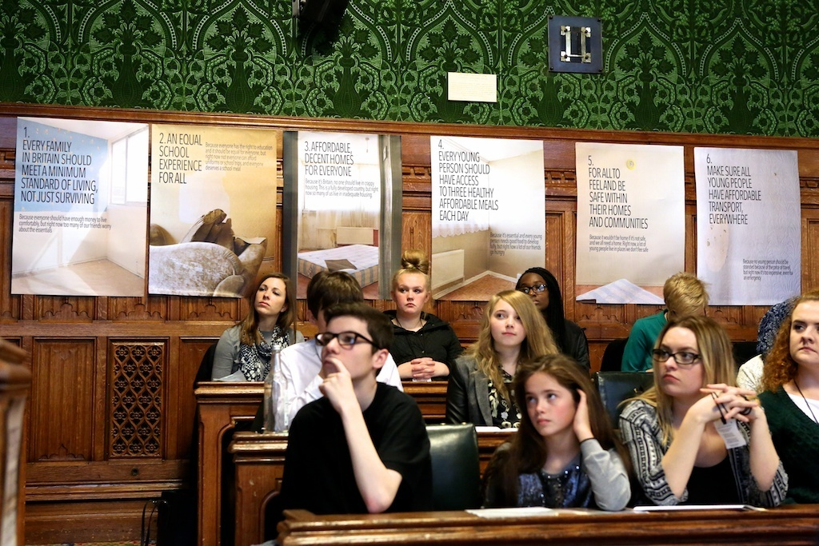
Impact
Notes:
National & School level: training and awareness for staff “most impactful thing our school has taken part in” Change in practice – introduction of cashless systems, affordable uniforms, policy changes about letters are written out. Change that children tell us that they see. Access to a trusted adult etc. Nationally APPG manifesto, holiday hunger pathway, APPG school food & change with Sharon Hodgson MP.

Slide 20
Questions?
Sara Bryson
Policy & Research Manager
Children North East
Sara.bryson@children-ne.org.uk
@sarabryson1
www.children-ne.org.uk
@ChildrenNE
www.facebook.com/ChildrenNorthEast

