Slide 1



National Facilitator, Career Benchmarks Pilot
Ryan Gibson
#SNEsummit15

Slide 2
Career Benchmarks National Pilot
National Facilitator
The Gatsby Foundation’s
‘Good Career Guidance’
National Pilot
Ryan Gibson

Slide 3
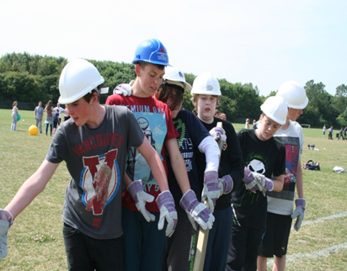

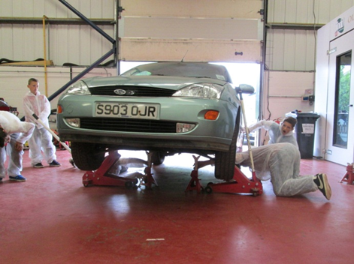
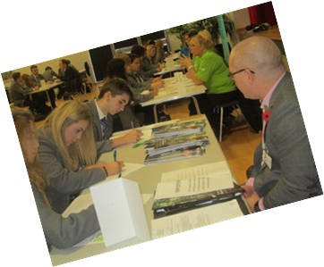
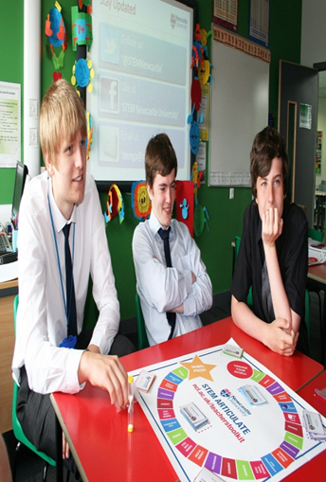

St Joseph’s Catholic Academy
How can we build skills, experience and employer engagement into the curriculum to promote progression?

Slide 4

E = (S + Q + WE)P x C
What is the formula for maximising progression:

Slide 5

E = (S + Q + WE)P x C
OMG!

Slide 6

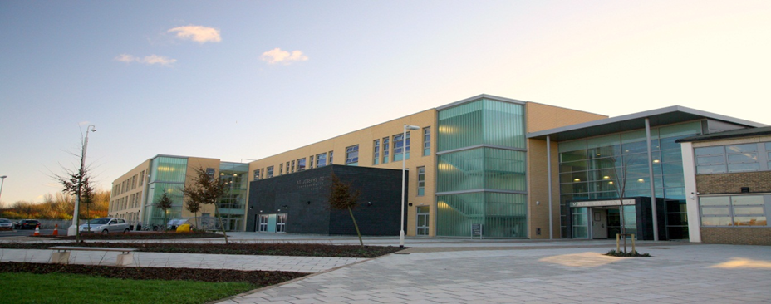
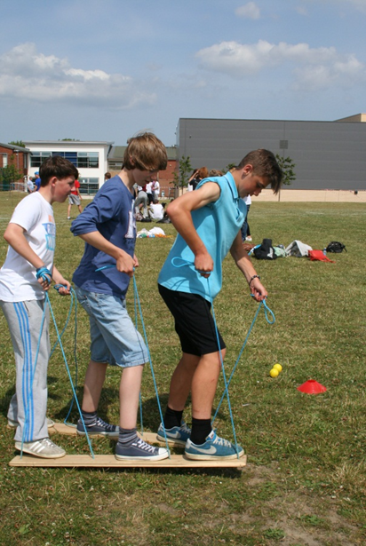
Overview
11-19 Catholic Academy in a very deprived area of South Tyneside. South Tyneside itself being the 52nd most deprived LA in England.
1400 students, 400 in Sixth Form.
Specialist Technology College 1996, Leading Edge School 2001, Applied Learning Specialism 2007.
Recognised by Prime Minister’s Talent and Enterprise Taskforce for effective employer and community engagement.
Designated Nationally as ‘Transforming and Leading’ in Applied Vocational Learning and Training Sept 2012 and part of the National Innovation Group

Slide 7
Why change Post 16?
“Skills shortage” in a number of sectors with “employers unable to fill vacancies.”
Consistent message in National Press that “Schools are not preparing young people for the world of work.”
Recognise the growing trend of students wishing to stay on into Sixth Form but with the aim of securing an apprenticeship, rather than a place at University.
Reduce NEET figure and improve progression.
Prepare for new post 16 programmes of study.
Increase opportunities for employer engagement.

Slide 8
Opportunities for Employers
To engage with education at whatever level they wish:
  Curriculum design
  Project development
  Workshop delivery
  Visits
  Work experience (ideally extended)
  To use our students as a ‘talent pool’ and ‘try before you buy’
  To update and influence teaching / industry staff (staff placements)
ESTABLISH A STRUCTURE OF MUTUALLY BENEFICIAL AND SUSTAINABLE PARTNERSHIPS

Slide 9
An Outstanding Curriculum
Provide and exciting and responsive curriculum that both inspires and challenges all learners
A Coherent Curriculum comprising a blend of applied and sector related learning within applied settings and contexts, combining practical skill development with theoretical understanding.
Increased focus on personal development in a curriculum that places skills at the centre.
Different Providers who can provide different learning experiences
Provide a curriculum that enables the student to make connections between different areas of the curriculum in relation to the world of work
Provide opportunities for students to learn on their own, in a team, in a large group and with virtual collaborators.
Allow students to learn in a range of places…benefit from local community resources…and use expertise from outside the teaching staff to enrich the learning experience.

Slide 10
The St Joseph’s ‘Be Competitive’ Programme –
A Blended Learning Route
A-Levels
(Qualifications in School)
NVQ/Vocational (Qualification Outside School)
The Be Competitive Programme:
Matching Student Aspirations to the Needs of Employers
Extended Work Experience
Enterprising Behaviours / Attitudes Programme
A programme that will help you secure higher level apprenticeships, employment or training at 18

Slide 11
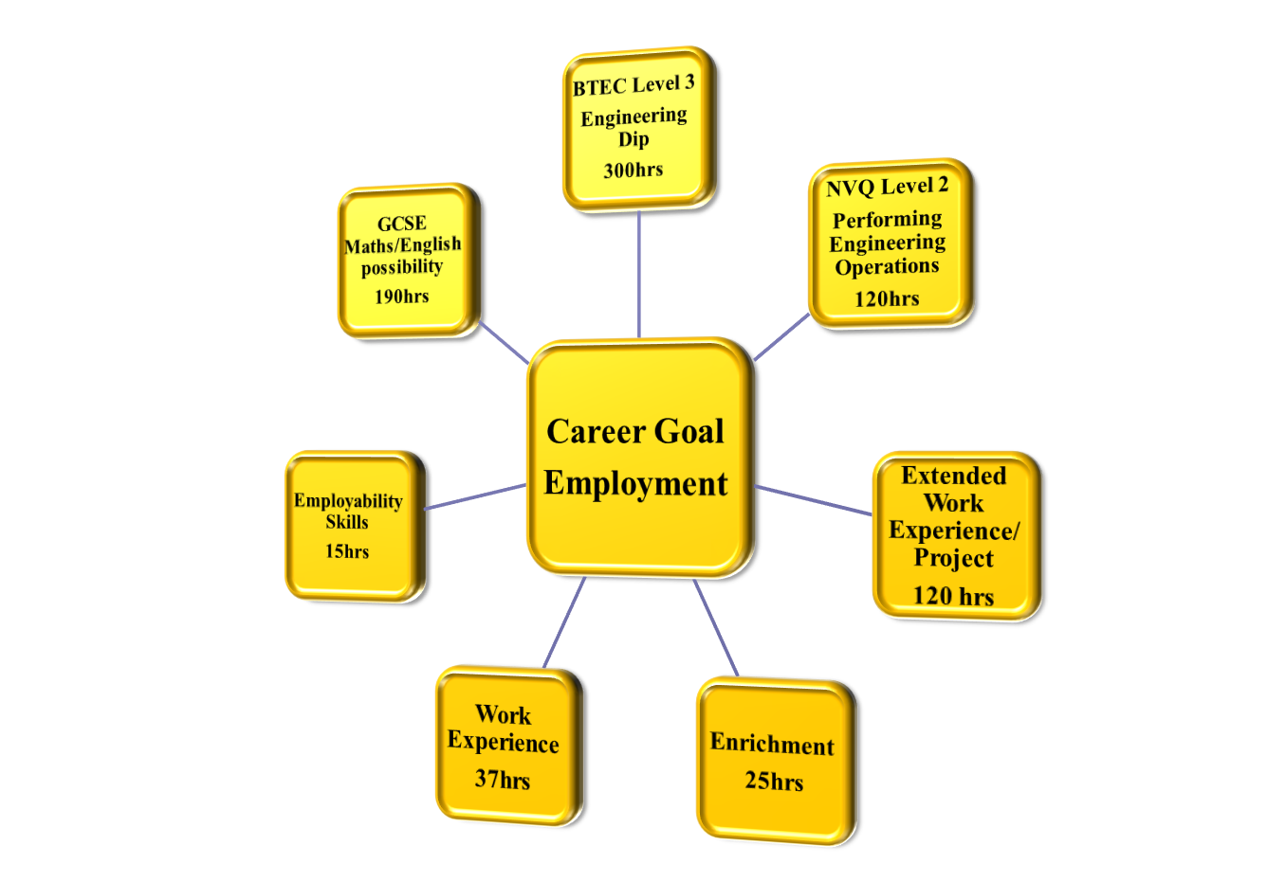
Example of Study Programme

Slide 12
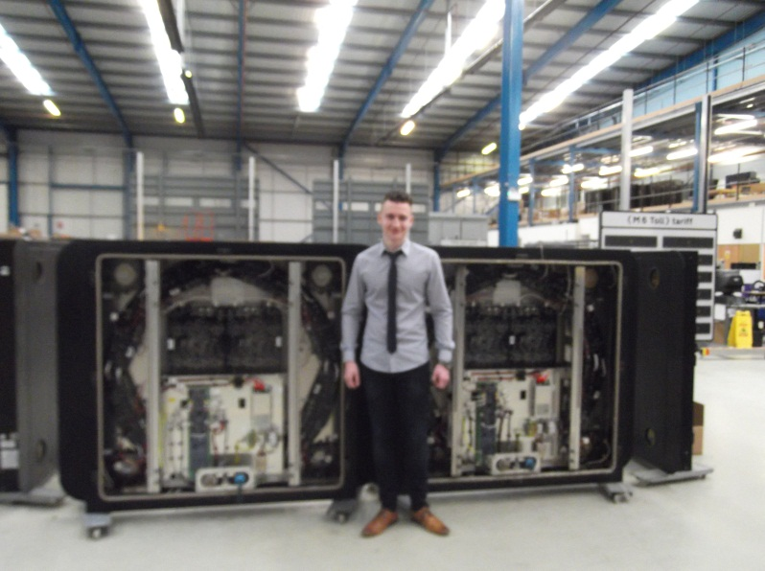
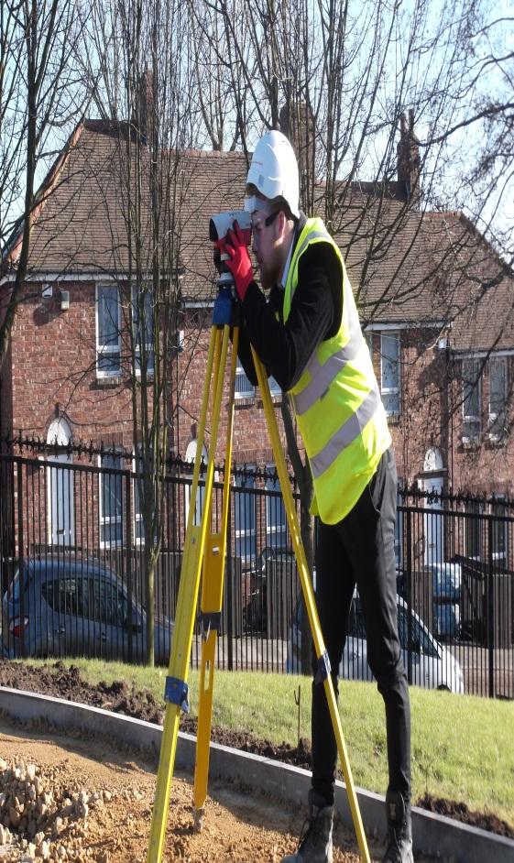
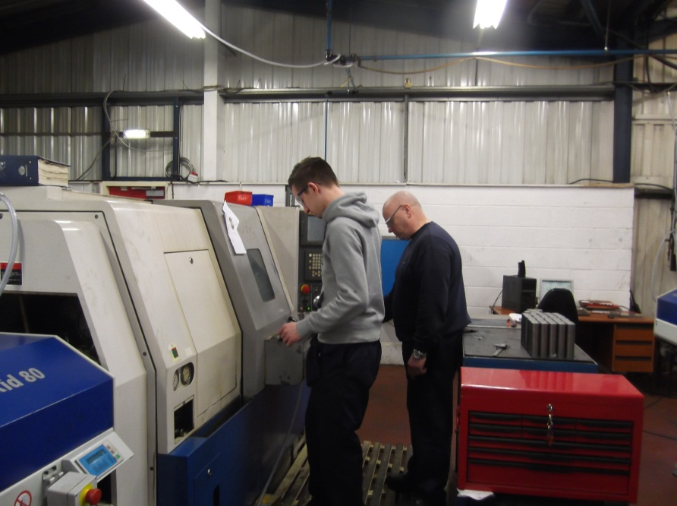
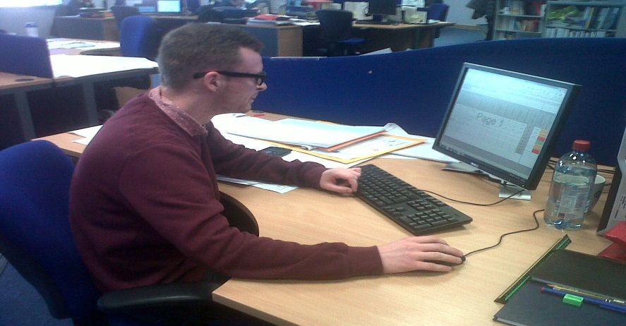
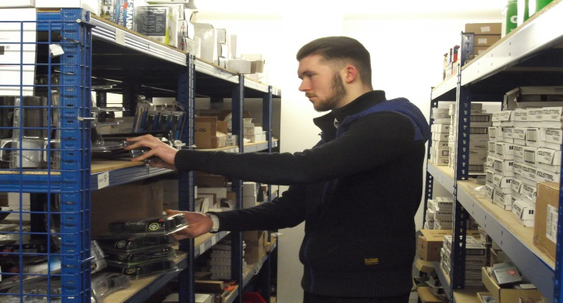
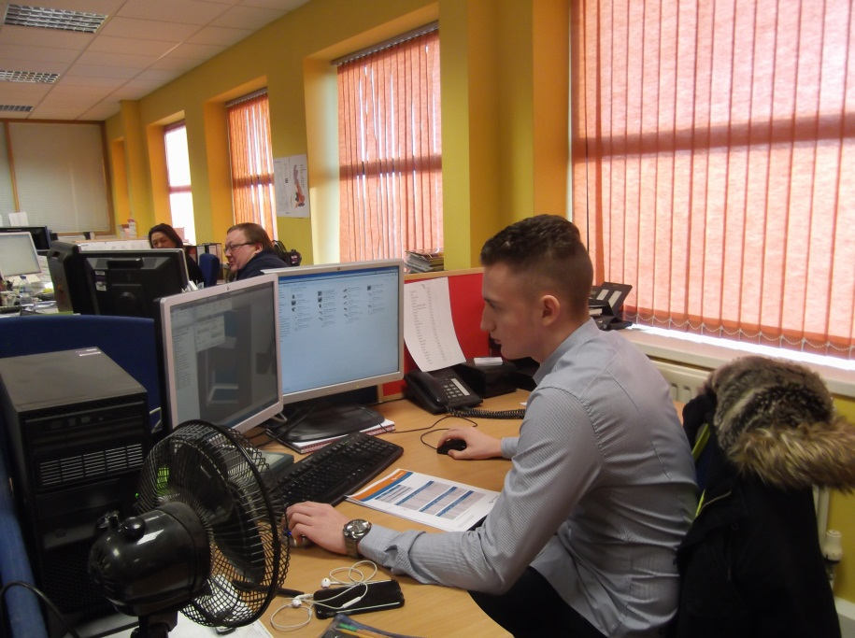
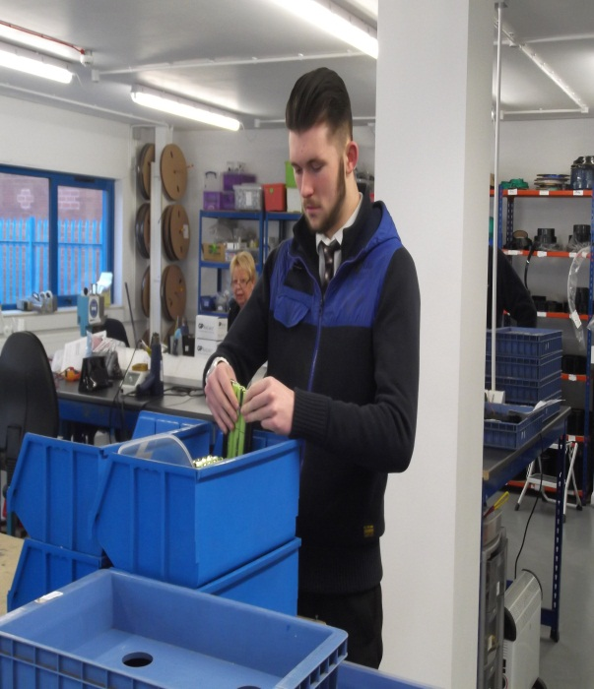
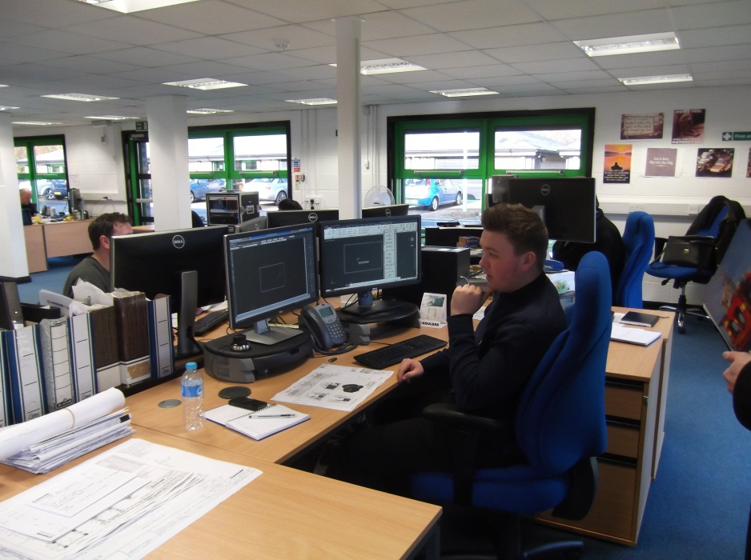

Slide 13





Unique Partnerships with Industry
Business in the Community – providing direct access to over 400 businesses and 22,000 employer volunteers.
Lloyds Bank – a strategic partnership with Lloyds Banking Group, supporting Careers Education, Labour Market Information and Student Placement.
Advanced Manufacturing Forum – curriculum, apprenticeship and work experience support for Engineering students.
South Tyneside Business Forum – access to over 100 local employers.
Sunderland University – access to experts in the field, latest equipment and techniques, employer links and graduate / academic mentors.

Slide 14






Making Informed Decisions
U-Explore– access to 2,000 written and video job profiles across 14 industry sectors, real work environments and 360-degree Virtual Tours. The ability to 'like' specific jobs / businesses and qualifications, all feeds into an individual profile, allowing students to personalise their experience and enabling them to track their progression towards future goals in a fun and engaging way. .
Services for Young People – all students have a 1:1 guidance interview with a L7 qualified independent advisor. An action plan is produced for each student.
Economic Development – Employment and Skills Development Group, working with employers to provide the students they need both now and in the future.
National Citizens Service – participating in community projects and volunteering that build skills for work and life.
Skillforce – Leadership development programme focussing on the development of key employability skills.
Zenith Rising Star – employment preparation, CV writing, application forms, interview techniques, presentation skills

Slide 15

An Example of Success – Employer Recruitment
SCHAWK!
“We tend to bring in people who have similar skills to those we need but we always need to retrain them to do it our way” explains Christian Palmer from Schawk. “We thought that bringing in really keen, bright, interested and motivated young people from an outstanding local school was an innovative way of creating exceptional employees”.

Slide 16
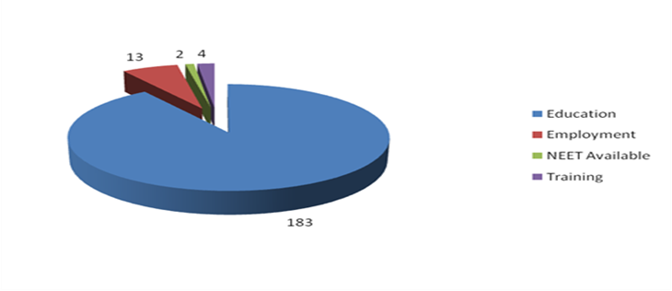
An Example of Success - Destinations
Our Not in Education Employment and Training (NEET) figure has decreased from 4.7% in 2008 to 0% in 2014. This recognises our outstanding Careers, Education, Information, Advice and Guidance procedures.
The % of students securing apprenticeships is the highest it has been since 2008.
The % of KS4 students who have continued in Education has increased from 76.3% in 2008 to 89.7% in 2014. Internally, this recognises our personalised curriculum, designed to meet the needs of all of our students.
86% of our Sixth Form students secured places at Universities, with over 10% securing apprenticeships.
93% sustained destination

Slide 17
E = (S + Q + WE)P x C
Employability
Skills
Qualifications
Work Experience
Personality
Contacts

Slide 18
Career Benchmarks National Pilot
National Facilitator
‘Establishing strong relationships between schools and employers’
Ryan Gibson

Slide 19

Good Career Guidance

Slide 20
The ‘Good Career Guidance’ Report
www.gatsby.org.uk/GoodCareerGuidance

Slide 21
Participating School and Colleges
Berwick Academy
Northumberland Church of England Academy
King Edward VI School, Morpeth
St Joseph’s Catholic Academy
Harton Technology College
Kenton School
Excelsior Academy
Churchill Community College
Shotton Hall Academy
Greenfield School
Park View Academy
Castle View Enterprise Academy
The Link School, Sunderland
Bishop Auckland College
Sunderland College
East Durham College

Slide 22
Career Benchmarks National Pilot: Aims
To embed the ‘Good Career Guidance Benchmarks’ in 16 schools and colleges in the North East Local Enterprise Partnership area.
To test the benchmarks in action – documenting the conditions, support and capacity needed by schools and colleges to make measurable and rapid progress towards the achievement of the benchmarks .

Slide 23






Sir John Holman visited six countries where career guidance is considered to be good
The Netherlands
Germany
Hong Kong
Finland
Canada
Ireland
Monitor

Slide 24
The benchmarks
Our work suggests that there is no single ‘magic bullet’ for good career guidance: it is about doing
a number of things, identified in our benchmarks, consistently and well.
Monitor

Slide 25
The Eight benchmarks for providing good career guidance
A stable careers programme
Learning from career and labour market information
Addressing the needs of each pupil
Linking curriculum learning to careers
Encounters with employers and employees
Experiences of workplaces
Encounters with further and higher education
Personal guidance
Monitor

Slide 26
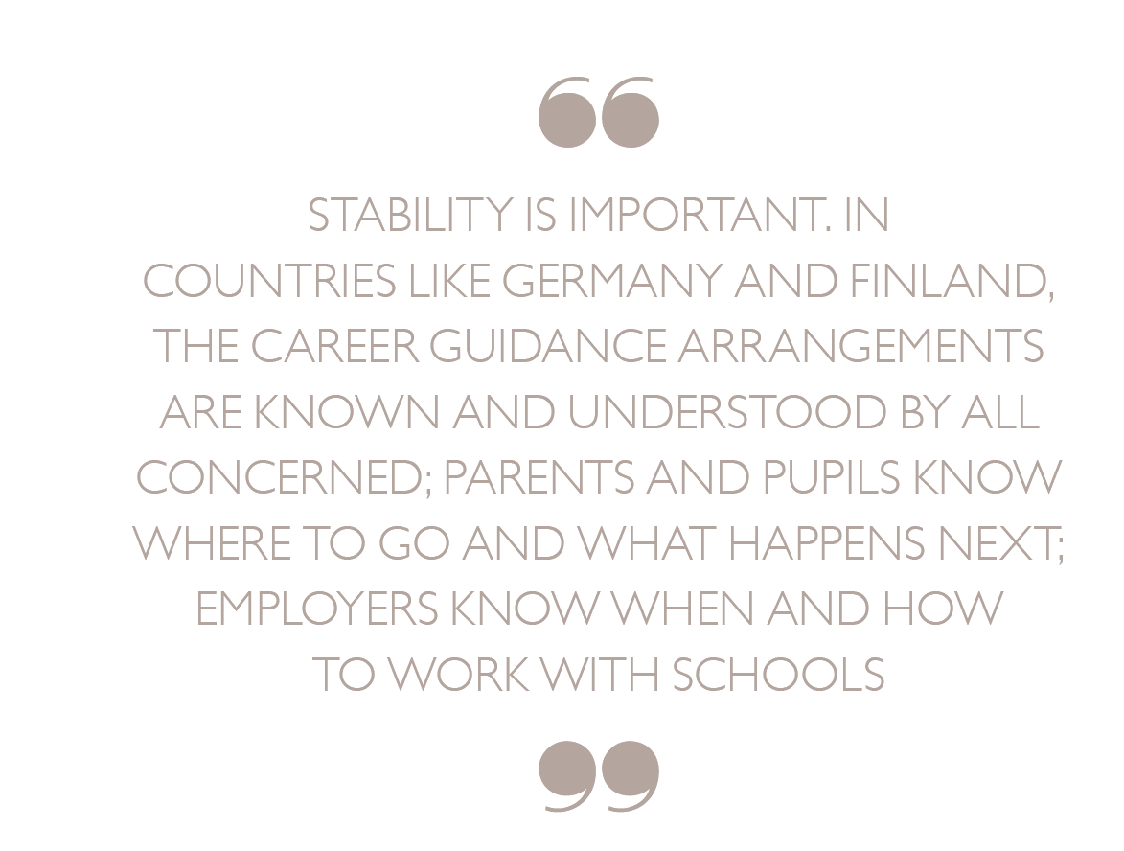
International visits - findings
Manage/
Increase Interest
Manage/
Maintain Interest
Monitor
Keep Informed

Slide 27
LMI FOR ALL
Free dynamic data feed straight off the Labour Force Survey and other government data sources
http://www.lmiforall.org.uk/

Slide 28
International visits - findings
Manage/
Increase Interest
Manage/
Maintain Interest
Monitor
Keep Informed

Slide 29
What do we want from the pilot?
To test the benchmarks from Good Career Guidance.
To identify barriers to embedding the benchmarks into schools’ and colleges’ practice, and to see how these barriers are best overcome.
To provide case studies that could be used to influence school leaders and policymakers.
To build capacity and provide a model for supporting schools in a LEP area that could be replicated elsewhere.
To find and support a cadre of school/ college leaders and employers to become champions for good career guidance around the country.
Monitor

Slide 30
Good career guidance benchmarks – what next?
Pilot of the benchmarks in 13 schools and 3 colleges in NE region
Collaboration with Career and Enterprise Company CEC
Looking at how destinations data can be collected in a way that is useful to schools
What can we do to promote the use of LMI for All in schools?
Questions for Governors on careers (Wellcome Trust)
Monitor

Slide 31
Interest in the benchmarks from …..
Department for Education
The Career and Enterprise Company
Teach First
The Sutton Trust
British Chambers of Commerce
Creative Industries Federation
Many individual schools, employers, LAs and Academy Trusts

