Slide 1
TO DEVELOP GREAT TEACHING?
What will it take…
#SNEsummit15

Slide 2
What will it take…to develop great teaching?
Robert Coe
SCHOOLS NorthEast Summit 2015

Slide 3
My argument …
If you make decisions about education, you should be informed by a sound understanding of research
If you want to promote great teaching you need to understand what great teaching is
Developing both kinds of understanding requires substantial professional learning

Slide 4
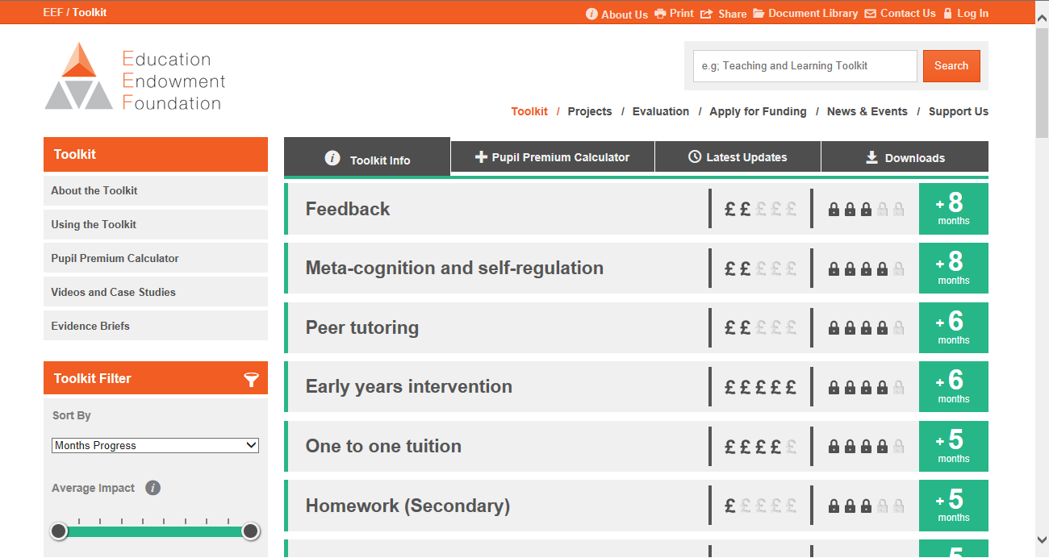
eef toolkit
improving education
What makes great teaching
Developing great teaching
Notes:
Higgins, S., Katsipataki, M., Kokotsaki, D., Coleman, R., Major, L.E., & Coe, R. (2013). The Sutton Trust-Education Endowment Foundation Teaching and Learning Toolkit. London: Education Endowment Foundation. [Available at http://www.educationendowmentfoundation.org.uk/toolkit]
Coe, R. (2013) Improving Education: A triumph of hope over experience. Inaugural Lecture of Professor Robert Coe, Durham University, 18 June 2013. Essay version available at http://www.cem.org/attachments/publications/ImprovingEducation2013.pdf Video at https://vimeo.com/70471076
Coe, R., Aloisi, C., Higgins, S. and Elliot Major, L. (2014) ‘What makes great teaching? Review of the underpinning research’. Sutton Trust, October 2014 http://www.suttontrust.com/researcharchive/great-teaching/
Cordingley, P., Higgins, S., Greany, T., Buckler, N., Coles-Jordan, D., Crisp, B., Saunders, L., Coe, R. (2015) Developing Great Teaching: Lessons from the international reviews into effective professional development. Teacher Development Trust. http://tdtrust.org/about/dgt/

Slide 5
Should people who make ‘policy’ understand research?
Any generalised advice or constraint (incl at school level)

Slide 6
True or false?
Reducing class size is one of the most effective ways to increase learning [evidence]
Learning is optimised by differentiating and personalising resources [evidence]
Generous praise helps learners persist with hard tasks [evidence]
Technology supports learning by engaging and motivating learners [evidence]
Enhancing motivation and interest leads to significantly improved attainment [evidence]
Notes:
Rob Coe EMC blog on class size: http://educationmediacentre.org/researchnews/whats-the-evidence-on-class-size/
John Hattie on individualisation (eg https://cdn.auckland.ac.nz/assets/education/about/research/documents/influences-on-student-learning.pdf).
See also Harry Webb’s blog: ‘The Evidence on Differentiation’ http://websofsubstance.wordpress.com/2014/07/
Deborah Stipek on praise: How Do Teachers' Expectations Affect Student Learning http://www.education.com/reference/article/teachers-expectations-affect-learning/
Steve Higgins et al’s summary for EEF: The Impact of Digital Technology on Learning http://educationendowmentfoundation.org.uk/uploads/pdf/The_Impact_of_Digital_Technologies_on_Learning_FULL_REPORT_(2012).pdf
Stephen Gorard et al for JRF on aspirations: The impact of attitudes and aspirations on educational attainment and participation http://www.jrf.org.uk/sites/files/jrf/education-young-people-parents-full.pdf

Slide 7
Knowledge of research
Put these in order of effectiveness:
A one-to-one numeracy intervention (two 15-minute sessions per week, delivered by teaching assistants) for Year 2-6 pupils who are struggling with numeracy (outcome: maths)
Nine weekly one-hour sessions where Y7 pupils below L4 read and discuss an age-appropriate book, with tools and resources to encourage reading for pleasure (outcome: reading)
A four-week summer school programme (between Y6 & 7) for pupils who had been predicted to achieve KS2 below Level 4b in English, focussed on poetry and writing (outcome: writing).
Y6 & 7 teachers trained to deliver a programme to help low attaining pupils plan, monitor and evaluate their writing using memorable experiences, eg trips and visitors (outcome: writing).
Notes:
A: Catch up numeracy ES = 0.21 (estimate from Toolkit: 0.22)
B: Chatterbooks ES= -0.14 (estimate from Toolkit: 0.1)
C: Discover summer school ES= 0.24 (estimate from Toolkit: 0.24)
D: Self regulation to improve writing: ES= 0.74 (estimate from Toolkit: 0.62)

Slide 8
Efficient marking?
“Tick and flick” – tick and a brief, general comment
Detailed, right-wrong by question
Detailed, close marking
Two stars and a wish – specific, constructive comments
Positive comments only
Make only comments that require specific action – and follow up
Time consuming
Low impact on learning
High impact on learning
Quick

Slide 9
Impact vs cost
www.educationendowmentfoundation.org.uk/toolkit
Most promising for raising attainment
8
Feedback
May be worth it
Meta-cognitive
Mastery
Homework (Secondary)
Peer tutoring
1-1 tuition
Early Years
Effect Size (months gain)
Reading comprn
Collaborative
Behaviour
Phonics
Small gp tuition
Parental involvement
Smaller classes
Social
ICT
Individualised learning
Summer schools
After school
Small effects / high cost
Homework (Primary)
Mentoring
Teaching assistants
0
Performance pay
Aspirations
£0
Ability grouping
£1000
Cost per pupil
Repeating a year

Slide 10
Clear, simple advice:
Choose from the top left
Go back to school and do it
For every complex problem there is an answer that is clear, simple, and wrong
H.L. Mencken

Slide 11
Why not?
Research evidence is problematic
complex, equivocal, artificial, incomplete, inapplicable ...
Most things that work are complex and subtle
Not just compliance, but understanding and skill
Changing teachers’ practice is very hard
Especially in ways that are faithful, effective and sustainable, at scale

Slide 12
Making assessment work The need for understanding and skill
Criteria cannot define a standard
Criteria often trivialise learning aims
Formative ‘hinge questions’ are equivocal
Judging performance requires standardisation
Teacher assessment is biased/stereotyped
Accountability drives improvement but is often dysfunctional

Slide 13
Notes:
http://www.cem.org/blog/would-you-let-this-test-into-your-classroom/

Slide 14
Poor Proxies for Learning
Students are busy: lots of work is done (especially written work)
Students are engaged, interested, motivated
Students are getting attention: feedback, explanations
Classroom is ordered, calm, under control
Curriculum has been ‘covered’ (ie presented to students in some form)
(At least some) students have supplied correct answers, even if they
Have not really understood them
Could not reproduce them independently
Will have forgotten it by next week (tomorrow?)
Already knew how to do this anyway

Slide 15
A better proxy for learning?
Learning happens when people have to think hard

Slide 16
Understanding research
Explain why children in small classes typically learn only slightly more than they would in big classes
In what ways does understanding depend on knowledge? In what ways does knowledge depend on understanding?
When does praise support learning?
Explain why grouping learners by ‘ability’ (setting, streaming, or in-class grouping) does not seem to make much difference to how much they learn?
What determines whether learners remember things?

Slide 17
Applying research
What can teachers do to increase the amount of time students spend thinking hard about the material we want them to learn?
How can teachers make it most likely that students will remember what they have taught?
What kinds of marking convey effective feedback?
How can teachers give effective feedback to classes of 30 (without killing themselves)?

Slide 18
Do we know what ‘great teaching’ is?

Slide 19
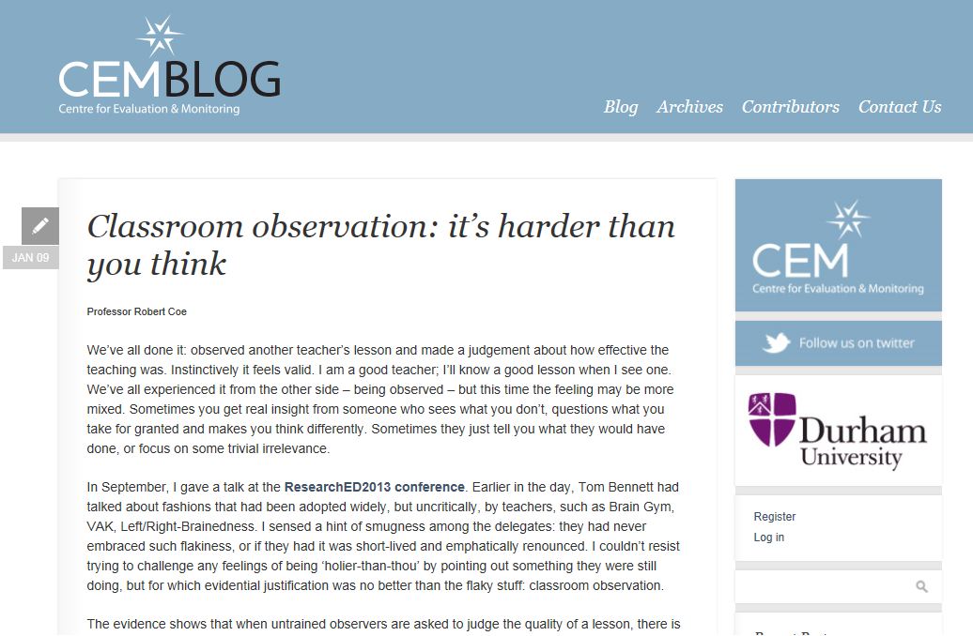
Do we know a good lesson when we see one?
Notes:
http://www.cem.org/blog/414/

Slide 21
Dimensions of great teaching
(Pedagogical) content knowledge (PCK)
Quality of instruction
Classroom management / behaviour / control
Classroom climate / relationships / expectations
Beliefs (theory) about subject, learning & teaching
Wider professional elements: collegiality, PD, stakeholder relationships
Notes:
Coe, R., Aloisi, C., Higgins, S. and Elliot Major, L. (2014) ‘What makes great teaching? Review of the underpinning research’. Sutton Trust, October 2014 http://www.suttontrust.com/researcharchive/great-teaching/

Slide 22
1. We do that already (don’t we?)
Reviewing previous learning
Setting high expectations
Using higher-order questions
Giving feedback to learners
Having deep subject knowledge
Understanding student misconceptions
Managing time and resources
Building relationships of trust and challenge
Dealing with disruption

Slide 23
2. Do we always do that?
Challenging students to identify the reason why an activity is taking place in the lesson
Asking a large number of questions and checking the responses of all students
Raising different types of questions (i.e., process and product) at appropriate difficulty level
Giving time for students to respond to questions
Spacing-out study or practice on a given topic, with gaps in between for forgetting
Making students take tests or generate answers, even before they have been taught the material
Engaging students in weekly and monthly review

Slide 24
3. We don’t do that (hopefully)
Use praise lavishly
Allow learners to discover key ideas for themselves
Group learners by ability
Encourage re-reading and highlighting to memorise key ideas
Address issues of confidence and low aspirations before you try to teach content
Present information to learners in their preferred learning style
Ensure learners are always active, rather than listening passively, if you want them to remember

Slide 25
What will it take…to develop great teaching?

Slide 26
Improving Teaching
Teacher quality is what matters
We need to focus on teacher learning
Teachers learn just like other people
Be clear what you want them to learn
Get good information about where they are at
Provide appropriate instruction and give good feedback

Slide 27
Why monitor teaching quality?
Good evidence of (potential) benefit from
Performance feedback (Coe, 2002)
Target setting (Locke & Latham, 2006)
Accountability (Coe & Sahlgren, 2014)
Individual teachers matter most
Teachers typically stop improving after 3-5 years
Everyone can improve
Assessment is an essential part of learning (including teacher learning)
Notes:
Coe, R. (2002) ‘Evidence on the Role and Impact of Performance Feedback in Schools’ in A.J.Visscher and R. Coe (eds.) School Improvement Through Performance Feedback. Rotterdam: Swets and Zeitlinger
Locke, E. A., & Latham, G. P. (2006). New directions in goal-setting theory. Current directions in psychological science, 15(5), 265-268.
Lee J. (2008), ‘Is Test-Driven External Accountability Effective? Synthesizing the Evidence From Cross-State Causal-Comparative and Correlational Studies’, Review of Educational Research 78(3):608–644
Coe, R. and Sahgren G.H, (2014) “Incentives and ignorance in qualifications, assessment, and accountability”. In G.H. Sahlgren (ed.) Tests worth teaching to: incentivising quality in qualifications and accountability. Centre for Market Reform of Education http://www.cmre.org.uk/sites/default/files/Tests%20worth%20teaching%20to_web%20text.pdf
WILIAM, D. (2010) 'Standardized Testing and School Accountability', Educational Psychologist, 45: 2, 107 — 122
Rockoff, J. E. (2004). The impact of individual teachers on student achievement: Evidence from panel data. The American Economic Review, 94(2), 247-252.
Kukla-Acevedo, S. (2009). Do teacher characteristics matter? New results on the effects of teacher preparation on student achievement. Economics of Education Review, 28(1), 49-57.
Murphy, R. (2013) ‘Testing Teachers: What works best for teacher evaluation and appraisal’. Sutton Trust. http://www.suttontrust.com/news/publications/testing-teachers-what-works-best-for-teacher-evaluation/

Slide 28
How to monitor teaching quality?
High-quality assessment
Not levels (generalised descriptors/criteria)
Convergent with learning goals & other evidence
Check for bias & confounds
Lesson observation
Be very cautious! (no grades or consequences)
Based on ‘Great Teaching’ evidence
Trust teachers with consistently good outcomes
Student feedback
Use validated instruments

Slide 29
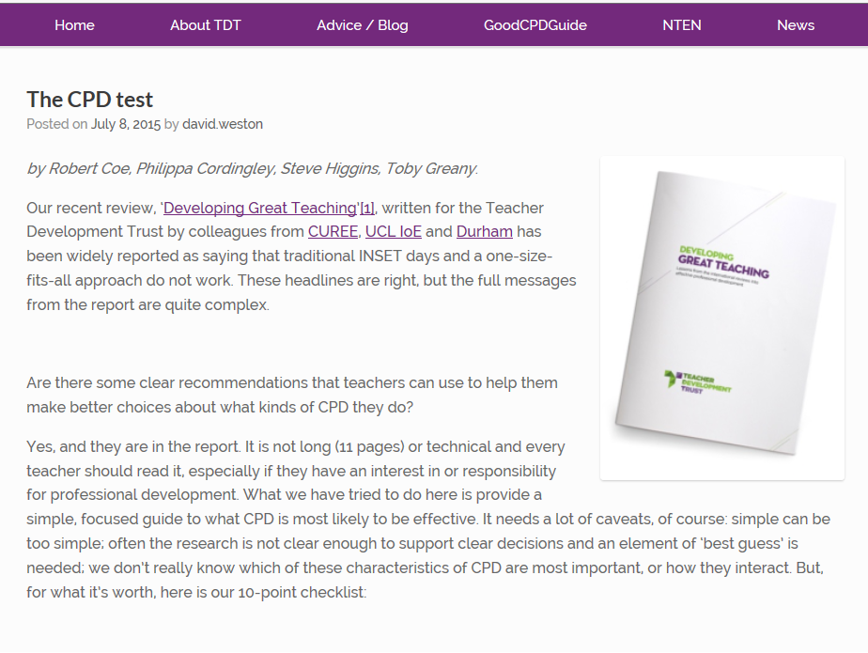
Cordingley et al 2015
http://tdtrust.org/about/dgt/
Notes:
Cordingley, P., Higgins, S., Greany, T., Buckler, N., Coles-Jordan, D., Crisp, B., Saunders, L., Coe, R. (2015) Developing Great Teaching: Lessons from the international reviews into effective professional development. Teacher Development Trust. http://tdtrust.org/about/dgt/
The CPD Test: http://tdtrust.org/cpdtest/

Slide 30
In your CPD have you …
Yes No
Tried to learn to do something that is relevant and supported by research evidence?
Focused on (and evaluated success against) students’ learning outcomes?
Engaged in activity that
Surfaced, challenged and developed your thinking about learning and teaching
Modelled/demonstrated new approaches
Allowed experimentation to adapt/apply approaches to your classroom
Included observation and feedback?
Took place at least fortnightly over two terms?
Drawn on explicit support from
External experts
Peer networks
Coaches / mentors
School/college leaders
Notes:
The CPD Test: http://tdtrust.org/cpdtest/
Cordingley, P., Higgins, S., Greany, T., Buckler, N., Coles-Jordan, D., Crisp, B., Saunders, L., Coe, R. (2015) Developing Great Teaching: Lessons from the international reviews into effective professional development. Teacher Development Trust. http://tdtrust.org/about/dgt/
Timperley, H., Wilson, A., Barrar, H. & Fung, I. (2007) Teacher professional learning and development: Best evidence synthesis iteration. Wellington, New Zealand: Ministry of Education. http://www.educationcounts.govt.nz/publications/series/2515/15341

Slide 31
https://www.gov.uk/government/consultations/teachers-professional-development-standard-call-for-evidence

Slide 32
And that is all there is to it …
Understand research evidence
Promote evidence-based pedagogy
Support teacher learning
Robert.Coe@cem.dur.ac.uk @ProfCoe
www.cem.org

