Slide 1
Progress 8
Accountability, assessment and learning
Robert Coe, Durham University

Slide 2
Outline
Progress 8: Why is it a better measure?
Accountability: Intended and unintended effects
Tracking and progress: dos and don’ts
Actual progress (learning): How do we get more of it?

Slide 3
Progress 8
Progress is not an illusion, it happens, but it is slow and invariably disappointing.
George Orwell

Slide 4

https://www.gov.uk/government/publications/progress-8-school-performance-measure

Slide 5
What is good about Progress 8?
All students & grades count
Reduces incentive/reward for recruiting ‘better’ students
Fairer to schools with challenging intakes
  Helps get the best teachers/leaders in most difficult schools
Requires an academic foundation for all
Allows flexibility in qualification choices

Slide 6
What could still be improved
‘Interchangeable’ qualifications should be made comparable or corrected
Bias against low SES schools should be corrected
Dichotomous ‘floor standards’ & school level analysis

Slide 7
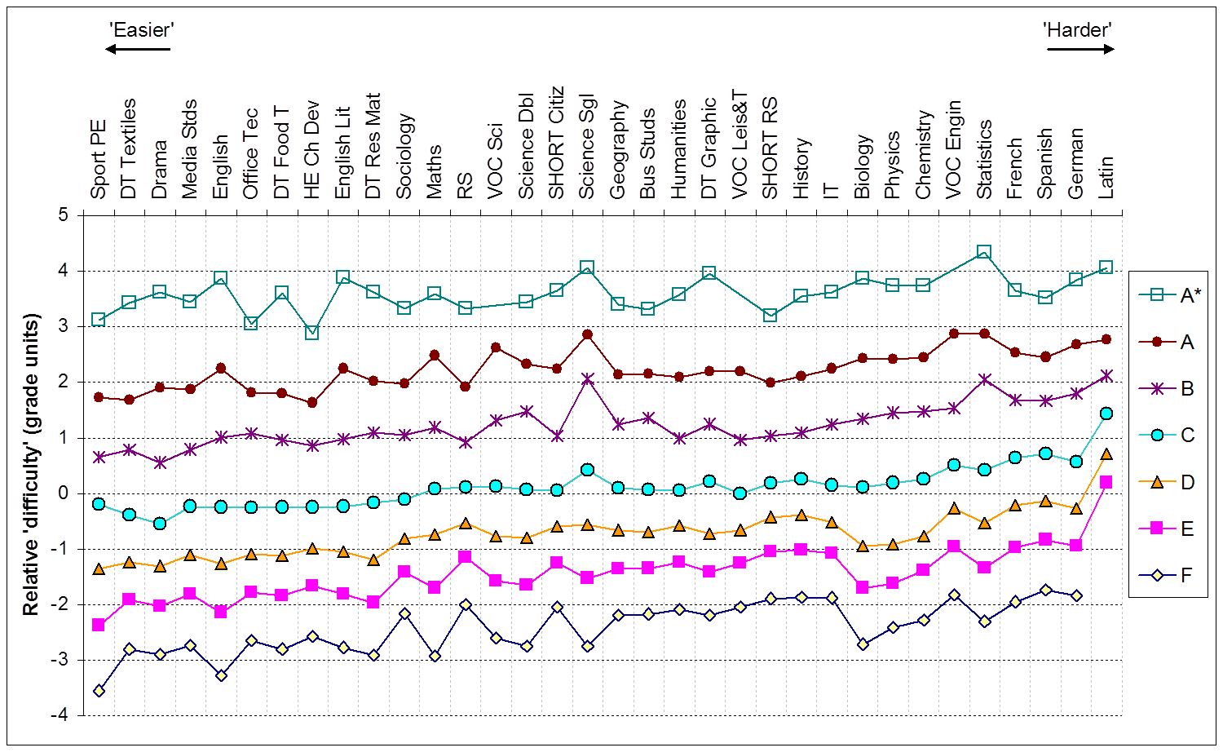
Comparability of GCSE grades
From Coe (2008)
Notes:
Coe, R (2008) ‘Comparability of GCSE examinations in different subjects: an application of the Rasch model’ Oxford Review of Education, 34, 5, (October 2008)

Slide 8
Value-added and school composition
r = 0.58
(from Yellis 2004 data)

Slide 9
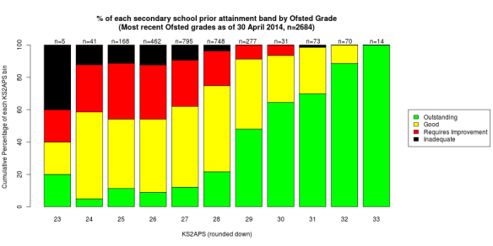
What’s the easiest way to a secondary Ofsted Outstanding?
From Trevor Burton’s blog ‘Eating Elephants’
‘Ofsted has not disputed the figures but insists that its inspectors pay “close attention” to prior pupil attainment and take a broad view of schools.’ (TES)
Notes:
What’s the easiest way to a secondary Ofsted Outstanding?
https://jtbeducation.wordpress.com/2014/06/29/whats-the-easiest-way-to-a-secondary-ofsted-outstanding/
Quotation from William Stewart, TES, 22 Aug 2014, Is Ofsted’s grading ‘scandalous’? https://www.tes.co.uk/article.aspx?storycode=6440390

Slide 10
Accountability
Foul-tasting medicine?

Slide 11
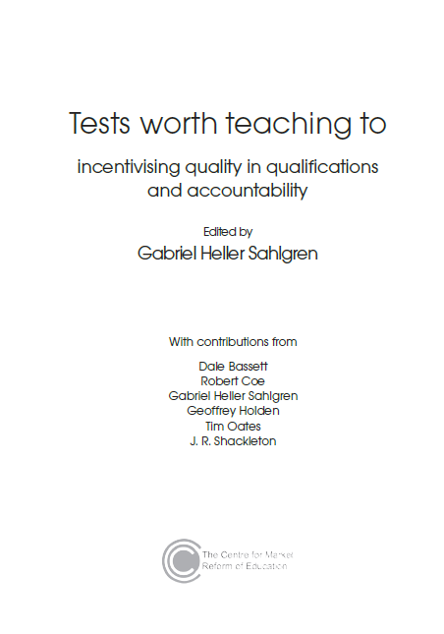
Research on accountability
Meta-analysis of US studies
by Lee (2008)
  Small positive effects on
  attainment (ES=0.08)
Impact of publishing league
tables (England vs Wales)
(Burgess et al 2013)
  Overall small positive effect (ES=0.09)
  Reduces rich/poor gap
  No impact on school segregation
Other reviews: mostly agree, but mixed findings
Lack of evidence about long-term, important outcomes
Notes:
Coe, R. and Sahgren G.H, (2014) “Incentives and ignorance in qualifications, assessment, and accountability”. In G.H. Sahlgren (ed.) Tests worth teaching to: incentivising quality in qualifications and accountability. Centre for Market Reform of Education http://www.cmre.org.uk/sites/default/files/Tests%20worth%20teaching%20to_web%20text.pdf

Slide 12
Dysfunctional side effects
Extrinsic replaces intrinsic motivation
Narrowing focus on measures
Gaming (playing silly games)
Cheating (actual cheating)
Helplessness: giving up
Risk avoidance: playing it safe
Pressure: stress undermines performance
Competition: sub-optimal for system
Some evidence
for all these, but mostly selective and anecdotal

Slide 13
Hard questions
Imagine there was no accountability. What would you do differently?
Would students be better off as a result?
  No – I wouldn’t do anything at all differently
  Not significantly – minor presentational changes only
  Yes – students would be better off without accountability
3. What actually stops you doing this?

Slide 14
Accountability cultures
Distrust
Controlled
Fear
Threat
Competitive
Target-focus
Image presentation
Quick fix
Tick-list quality
Sanctions
Trust
Autonomous
Confidence
Challenge
Supportive
Improvement-focus
Problem-solving
Long-term
Genuine quality
Evaluation

Slide 15
Trust
Trust: “a willingness to be vulnerable to another party based on the confidence that that party is benevolent, reliable, competent, honest, and open” (Hoy et al, 2006)
Schools “with weak trust reports … had virtually no chance of showing improvement” (Bryk & Schneider, 2002, p. 111).
‘Academic Optimism’ (Hoy et al, 2006)
  Academic Emphasis: press for high academic achievement
  Collective Efficacy: teachers’ belief in capacity to have positive effects on students
  Trust: teachers’ trust in parents and students
If what you are doing isn’t good, do you want to
  Cover it up, ignore, hide, minimise its importance
  Expose it, shine a light, maximise the learning opportunity
Notes:
Bryk, A., & Schneider, B. (2002). Trust in schools. New York: Russell Sage.
Hoy, W. K., Tarter, C. J., & Hoy, A. W. (2006). Academic optimism of schools: A force for student achievement. American educational research journal, 43(3), 425-446.

Slide 16
Assessment issues
Harder than you think?

Slide 17
Problems with levels
“Assessment should focus on whether children have understood these key concepts rather than achieved a particular level.” Tim Oates
“… pursuit of levels (or sub-levels!) of achievement displaced the learning that the levels were meant to represent” Dylan Wiliam
Three meanings of levels
  Summary of ‘average’ performance
  Best fit judgement
  Thresholds for criteria met

Slide 18
Can criteria define the standard?
Eg KS1 Performance Descriptors: Writing Composition
working below national standard
  “capital letters for some names of people, places and days of the week”
working towards national standard
  “capital letters for some proper nouns and for the personal pronoun ‘I’ ”
working at national standard
  “capital letters for almost all proper nouns”
working at mastery standard
  “a variety of sentences with different structures and functions, correctly punctuated”

Slide 19
Can teaching to criteria promote good learning?
1 | Understanding of quality | Essay A is better than essay B
2 | Description of characteristics of quality | Essay A has a richer vocabulary and more varied sentence structure
3 | Characteristics used to indicate quality | Aspects such as the use of less common vocabulary and a range of sentence openings
4 | Characteristics used to define quality explicitly | “Some variation in sentence structure through a range of openings, e.g. adverbials (some time later, as we ran, once we had arrived...), subject reference (they, the boys, our gang...), speech.”
5 | Advice given to students | Use a range of openings, e.g. …
6 | Writing by numbers
Notes:
2014 Key stage 2 writing – moderation. Exemplification materials for teacher assessment. STA

Slide 20
How good is teacher assessment?
“The literature on teachers' qualitative judgments contains many depressing accounts of the fallibility of teachers' judgments. … A number of effects have been identified, including unreliability (both inter-rater discrepancies, and the inconsistencies of one rater over time), order effects (the carry-over of positive or negative impressions from one appraisal to the next, or from one item to the next on a test paper), the halo effect (letting one's personal impression of a student interfere with the appraisal of that student's achievement), a general tendency towards leniency or severity on the part of certain assessors, and the influence of extraneous factors (such as neatness or handwriting).”
(Sadler, 1987, p194)
Notes:
Sadler, D.R (1987) "Specifying and promulgating achievement standards". Oxford Review of Education Vol 13. No 2, pp191-207. [http://dx.doi.org/10.1080/0305498870130207]

Slide 21
Reliability of portfolio assessment
‘The positive news about the reported effects of the assessment program contrasted sharply with the empirical findings about the quality of the performance data it yielded. The unreliability of scoring alone was sufficient to preclude most of the intended uses of the scores’ (Koretz et al., 1994, p 7) “the lack of reliability, as measured by inter-rated reliability, was thought to be due to insufficient specification of tasks to be included in the portfolios and inadequate training of the teachers”
‘Shapley and Bush concluded that, after three years of development, the portfolio assessment did not provide high quality information about student achievements for either instructional or informational purposes.’ (Harlen, 2004, p39)

Slide 22
Bias in TA vs standardised tests
Teacher assessment is biased against
  Pupils with SEN
  Pupils with challenging behaviour
  EAL & FSM pupils
  Pupils whose personality is different from the teacher’s
Teacher assessment tends to reinforce stereotypes
  Eg boys perceived to be better at maths
  ethnic minority vs subject
Notes:
Harlen W (2004) A systematic review of the evidence of reliability and validity of assessment by teachers used for summative purposes. In: Research Evidence in Education Library. London: EPPI-Centre, Social Science Research Unit, Institute of Education, University of London. [http://eppi.ioe.ac.uk/cms/Default.aspx?tabid=116&language=en-US]
Bennett et al., 1993
Peter Tymms: ‘Teachers show bias to pupils who share their personality’. The Conversation 25 Feb 2015 https://theconversation.com/teachers-show-bias-to-pupils-who-share-their-personality-38018
Burgess, S. and Greaves, E (2009) Test Scores, Subjective Assessment and Stereotyping. Centre for Market and Public Organisation, Bristol University. Working Paper No. 09/221. http://www.bristol.ac.uk/media-library/sites/cmpo/migrated/documents/wp221.pdf
of Ethnic Minorities

Slide 23
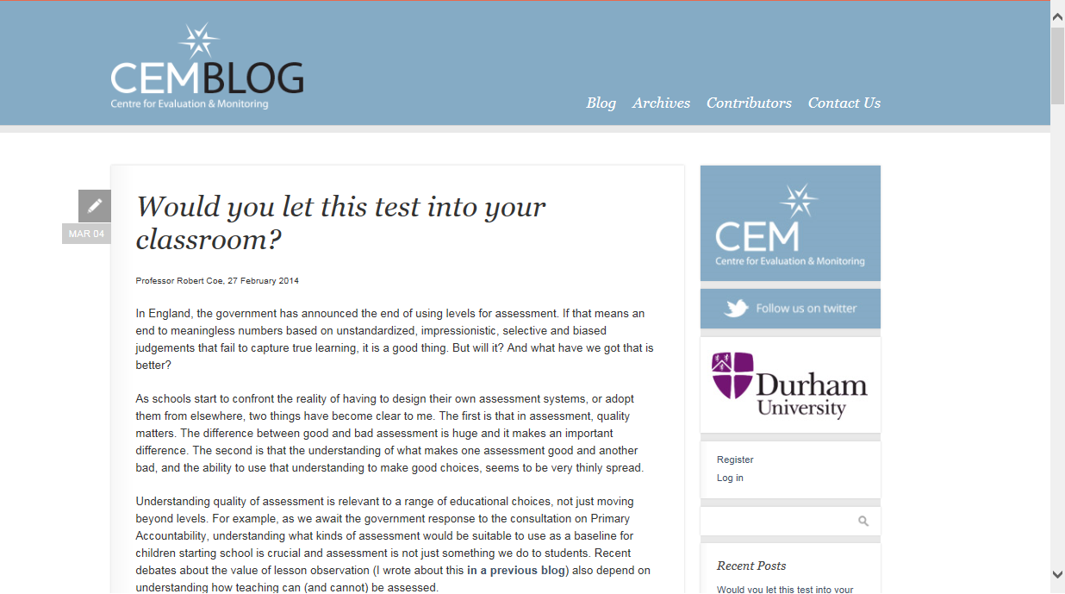

Slide 24
Quality criteria for assessments (1)
Construct validity
  What does the test measure? What uses of these scores are appropriate/inappropriate?
Criterion-related validity
  Correlations with other assessments or measures of the same construct. Correlations may be concurrent or predictive.
Reliability
  Eg test-retest, internal consistency, person-separation
Freedom from biases
  Evidence of testing for specific bias in the test, such as gender, social class, race/ethnicity.
Range
  For what ranges (age, abilities, etc) is the test appropriate? Is it free from ceiling/floor effects?
Notes:
Would you let this test into your classroom?

Slide 25
Quality criteria for assessments (2)
Robustness
  Is the test 'objective', in the sense that it cannot be influenced by the expectations or desires of the judge or assessor?
Educational value
  Does the process of taking the test, or the feedback it generates, have direct value to teachers and learners? Is it perceived positively?
Testing time required
  How long does the test (or each element of it) take each student? Is any additional time required to set it up?
Workload/admin requirements
  Does the test have to be invigilated or administered by a qualified person? Do the responses have to be marked? How much time is needed for this?

Slide 26
How do we get learners to progress?
(According to the evidence)

Slide 27

Notes:
Coe, R., Aloisi, C., Higgins, S. and Elliot Major, L. (2014) ‘What makes great teaching? Review of the underpinning research’. Sutton Trust, October 2014 http://www.suttontrust.com/researcharchive/great-teaching/

Slide 28

1. We do that already (don’t we?)
Reviewing previous learning
Setting high expectations
Using higher-order questions
Giving feedback to learners
Having deep subject knowledge
Understanding student misconceptions
Managing time and resources
Building relationships of trust and challenge
Dealing with disruption

Slide 29

2. Do we always do that?
Challenging students to identify the reason why an activity is taking place in the lesson
Asking a large number of questions and checking the responses of all students
Raising different types of questions (i.e., process and product) at appropriate difficulty level
Giving time for students to respond to questions
Spacing-out study or practice on a given topic, with gaps in between for forgetting
Making students take tests or generate answers, even before they have been taught the material
Engaging students in weekly and monthly review

Slide 30

3. We don’t do that (hopefully)
Use praise lavishly
Allow learners to discover
key ideas for themselves
Group learners by ability
Encourage re-reading and highlighting to memorise key ideas
Address issues of confidence and low aspirations before you try to teach content
Present information to learners in their preferred learning style
Ensure learners are always active, rather than listening passively, if you want them to remember

Slide 31
What CPD benefits students?
Promotes ‘great teaching’
  PCK, assessment, learning, high expectations, collective responsibility
  Focuses on student outcomes
Supported by
  External input: challenge and expertise
  Peer networks: communities of practice
  School leaders must actively lead
Builds teacher understanding and skills
  Challenges and engages teachers
  Integrates theory and active skills practice
  Enough learning time (monthly for min 6 months: 30hrs+)
Timperley et al 2007
Notes:
Timperley, H., Wilson, A., Barrar, H. & Fung, I. (2007) Teacher professional learning and development: Best evidence synthesis iteration. Wellington, New Zealand: Ministry of Education. http://www.educationcounts.govt.nz/publications/series/2515/15341

Slide 32
Advice …
No one wants advice, only corroboration
John Steinbeck

Slide 33
Advice
Study and learn about assessment: just because you do it doesn’t mean you really understand it
Monitor and critically evaluate everything you do against hard outcomes. If it’s great, be pleased, but not everything will be
Do what is right, whether or not it is rewarded by accountability systems
Be willing to challenge assumptions about what great teaching looks like: take the evidence seriously
Invest in the kind of CPD that makes a difference

