Slide 1
What makes good
careers education?
Nicki Moore
International Centre
for Guidance Studies
University of Derby

Slide 2
What makes good career education?
Create a whole school ethos
This starts right from the top…..
How can you encourage young people to aspire if you and your organisation do not embed this culture in everything you do?
What is your schools mission? How does career development fit in with this?
Are you an aspirational professional (for yourself and your students)?
What processes are in place to enable you to take notice of your own career plans and aspirations and to manage your career aspirations?
Do these processes encourage your own CPD based on sound reflective practice and supportive conversations about quality enhancement?

Slide 3
What makes good career education?
Start early
Remember that the transition from primary to secondary offers a really good opportunity to reflect on change and change management. Encourage young people to be empowered during this process.
School staff and visitors are all role models- Engage the help of your visitors to reinforce positive messages about active citizenship and the world of work.
The school is a workplace. Young people have this as the main context for understanding the world of work.
Capture learning from all areas of a young persons life- Remember that computer games and social media are providing more social development and career learning than we can possibly imagine.
Older students are also role models

Slide 4
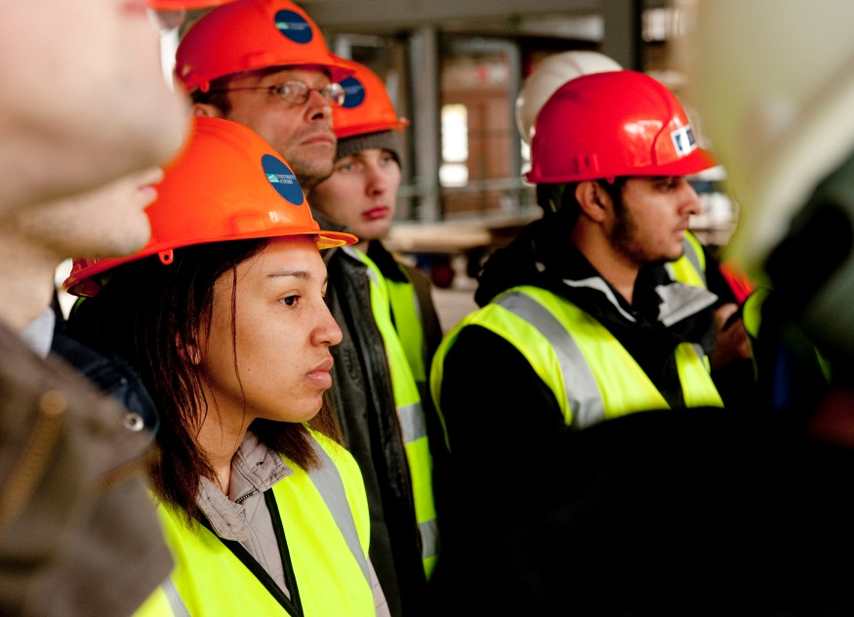
What makes good career education?
Make it everyone's responsibility
Embed career learning in all
curriculum subjects
(and make sure that teaching staff have the
necessary training and support to do this!)
Listen to young people and find out what they want and need to support them through this.
Ensure that digital literacy is encouraged and use ‘Career’ as a context for this.

Slide 5
What makes good career education?
Make it everyone's responsibility
Engage parents
(Role models, what’s my line, skills
fairs……….)
Encourage school governors, trustees and stakeholders to get involved
Make sure that young people have the correct language to undertake conversations and research in career

Slide 6
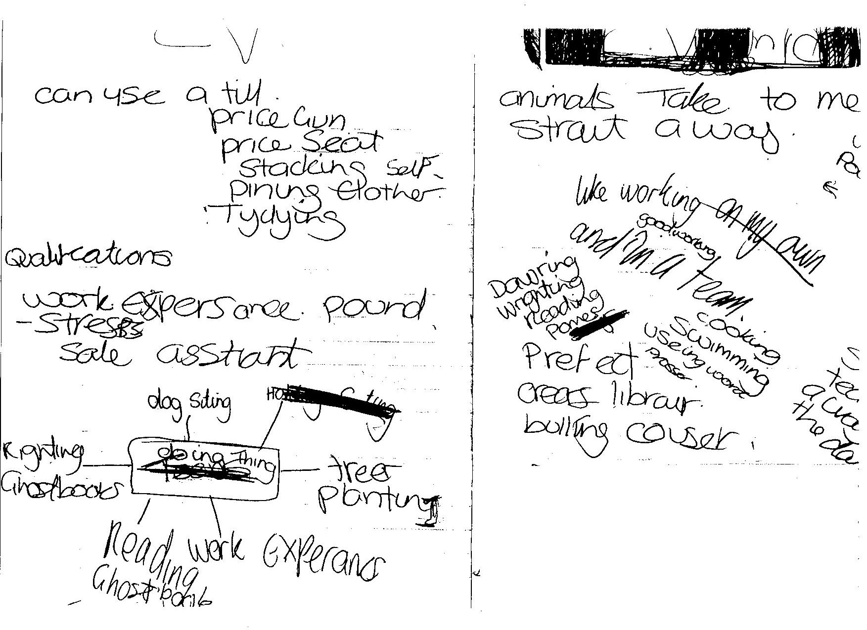
Career development is a personal journey
People need to be ready to embark
Make sure that your programme deals with engagement in career development- this is the platform on which everything else rests.
Career is enacted within the context of the rest of a persons life- adolescents are often chaotic.
Little and often is good
Accessibility- ‘At a time and a place of their choosing’

Slide 7
Thank you!
Contact us – n.moore@derby.ac.uk

