Slide 1
Jennifer Barrett
Managing Director
This is Creative Enterprise CIC
www.thisiscreativeenterprise.com

Slide 2
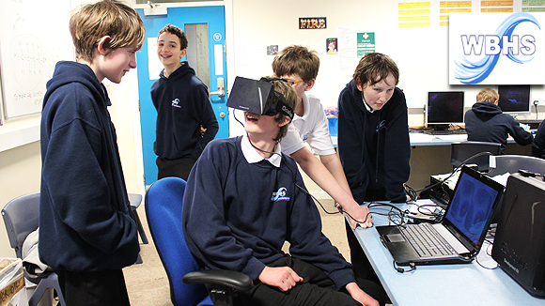
TICE Background…
Began in 2008
Projects and programmes specialising in creative industry awareness, knowledge and skills.
Behind the scenes in industries such as Fashion, Music, Computer Science, Photography, Graphics.
Actively promote how STEM subjects and Creative Industries work together and not at opposite ends of the spectrum.
180 projects completed to date.
Introducing virtual reality through Computer Science at Whitley Bay High School

Slide 3
The TICE programme…
3 Tier Programme
Bronze: 1 day in School
Silver: 2 days on business tours
Gold: 3 days completing a ‘Live Brief’
Final Show: 25th June 2015 (Northumbria University)
Students at a workshop exploring graphics and brand identity at creative agency Different.

Slide 4
Why has this worked?
Students are mentored by industry professionals
It allows them to put core subjects into an industry context
They meet a huge range of employers on visits
Have access to academic and vocational pathways
Builds confidence in decision making
Students interested in fashion at Northumbria University… tour of facilities and talks from current students and staff.

Slide 5
Our Work Experience Programmes…
Many students return to us in sixth form
Mentor younger students
Access to our networks/work experience placement offered by employers

Slide 6
Who we work with…
Educational Support:
Creative Industry Sponsorship:
Over 250 industry supporters
Networks:
Students complete a project for their portfolios with feedback from employers

Slide 7
“Longbenton Community College have taken part in the TICE programme for the last five years, giving all of our year 10 students the opportunity to take part. It has proved to be one of the most inspiring projects that our pupils experience, opening their minds to a whole world of potential pathways in the creative industry sector. Our Gold students (we had 29 reach Gold this year) – return to college knowing that they can work well under pressure, using current industry standard technology, producing work of real professional quality, that they are immensely proud of. Transferrable skills such as working in a team, leadership and problem-solving are all employed and look fantastic on their C.V.s! I cannot praise the team at TICE highly enough for the efforts and patience they put into working with our pupils”

Slide 8
Jennifer Barrett
Email: hello@thisiscreativeenterprise.com
www.thisiscreativeenterprise.com

