Slide 1

Fishburn Primary
‘Life After Levels’
John Stubbins & Danny Eason

Slide 2
Issues
25 years of levels, gone, essentially we have to find a new standard.
Some staff were not even born when levels were introduced, its new and not the same.
OFSTED/DFE still want the same type of info.
Now the entire system is disenfranchised you lose ‘national standard’ which has to be redefined.
In a school led system idea is school lead schools, but each area may have a different standard. (With EYFS assessment, initially each authority defined success in different ways.)

Slide 3
Priorities
Children need to know what they need to learn next.
Teachers need to know what to teach next
Need to be able to measure it so as to keep the wolves at bay!
Need to demonstrate progress in each year group and across school, the task as such remains the same.
Not to be swayed by trend, keep it realistic and functional.

Slide 4

Key features
Utilises the best of what we already do
Protects us re OFSTED requirements i.e. progress of groups/ gives us data without wasting our time.
Reading Writing
Maths

Slide 5
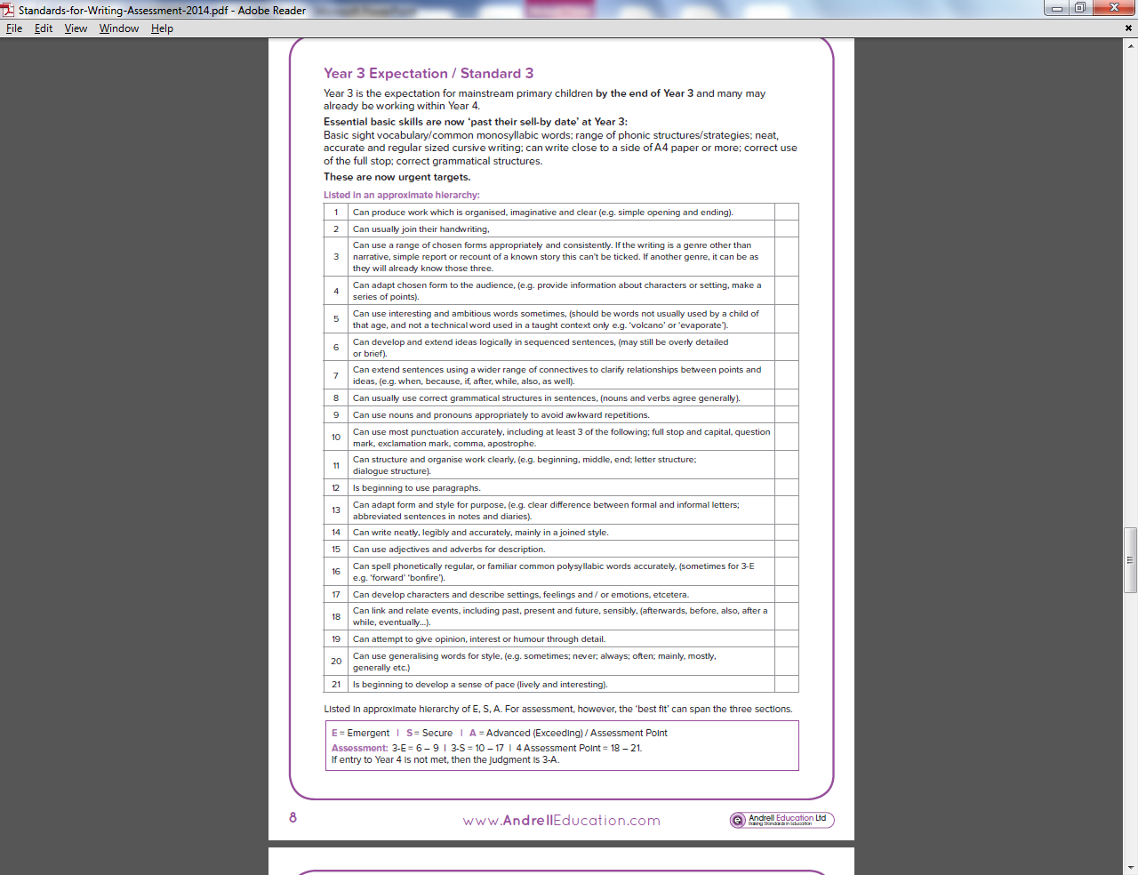

Slide 6
Key Learning in Mathematics – Year 5 Level 3, Level 4, Level 5, Level 6
Notes:
Moderation built in Maths an issue, will it turn into APP?

Slide 7
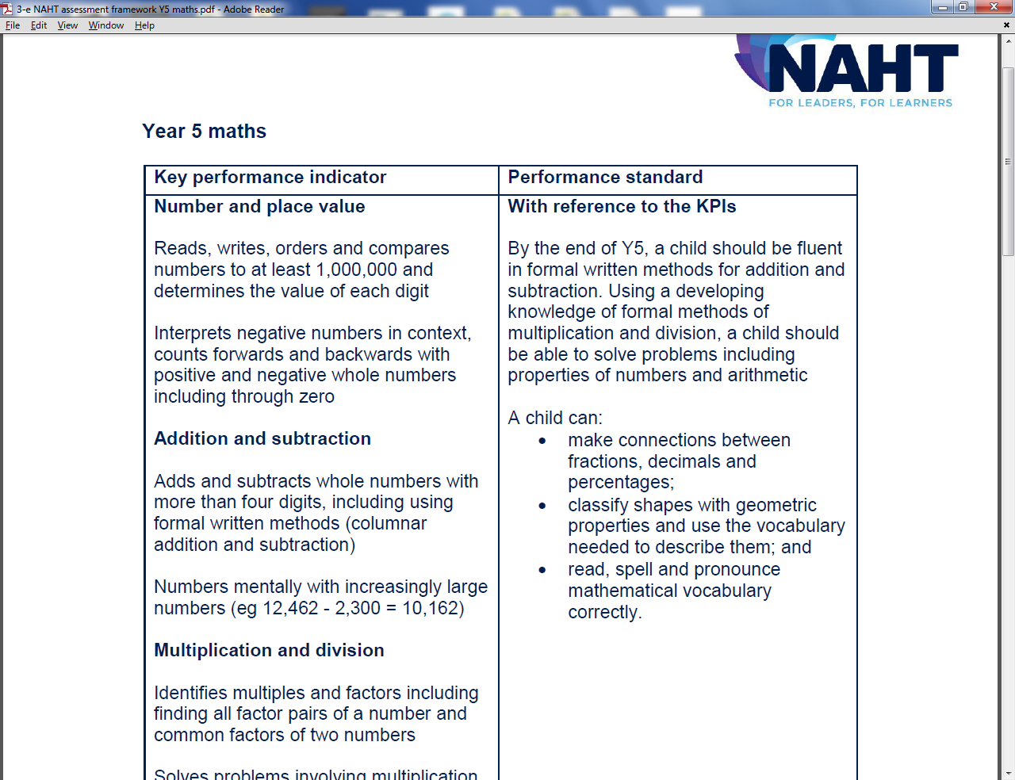

Slide 8


Implementation
Use existing knowledge of levels, recognise rise in expectation and use what we know to ‘tune in ’ to ‘strands.
Use what we know works and adapt.
Empower subject leaders to check standards.
Plan as a staff to ensure continuity of approach.
Feed into ‘Lesson Study’ approach to T and L.

Slide 9
Tips
Don’t Panic.
Wait for Performance descriptors to define what we are aiming for.
Publishing companies are churning out ‘get rich quick solutions’ they are not always good or fit for purpose.
Make it manageable and keep great teachers teaching, not filling in forms.

Slide 10

Thanks!
Danny Eason – d.eason100@durhamlearning.net
Twitter : @dandan7171
John Stubbins j.stubbins200@durhamlearning.net

