Slide 1
Policy, impact, and paperwork: Accounting for your Pupil Premium spend Dominic Martin West Jesmond Primary

Slide 2
Clarity around starting points
Pupil Premium Policy: a clear rationale about your pupil premium spend
Principles, Values, Vision:
Linking back to School vision; quality first ‘wave’ education for all
Defining ‘vulnerability’:
Individual
Group
‘Socially Disadvantaged’? Parental response…
‘Equality of Opportunity’ beyond Socio Economic labels
Needs analysis: data and tracking, social need,
dialogue with parents (how can we help?)

Slide 3
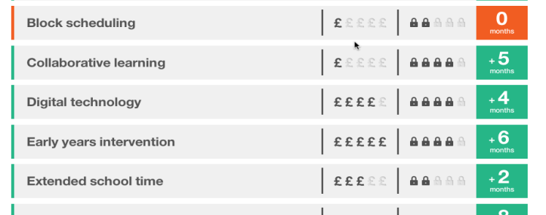
Developing Provision
What is research telling us
about cost vs impact? EEF etc.
Learning from other practitioners; research into best practice Twitter etc.

Slide 4
Strands of Provision – ‘Equality of Opportunity’
Achievement and Standards (accelerated learning)
Learning support
Pastoral Work
Out of Hours and Enrichment
Continuous provision development / investment in staff to achieve and sustain quality first wave teaching.

Slide 5
Reporting outcomes to Parents and the General Public
Spend ‘plan’ – flexible intentions
‘Funding Area’ ‘Detailed School Programme’ (what we’ll do) ‘Allocation from Fund (various ways in which we’ll spend money) ‘Total Allocation’
Spend ‘statement’ – what did we actually spend the money on.
Academic outcomes – levels / progress etc.

Slide 6
Scrutinising outcomes, the evidence trail; accountability to Governors, Ofsted etc.
Overview of ‘quantitative’ outcomes – raw data (framed in different ways)
Overview of ‘qualitative’ impact – pupil voice, pass survey etc.

Slide 7
Overview of provision & impact ‘qualitative’ and ‘quantitative’ linked to research – evidence we are following suggested best practice.

Slide 8
Accounting for individualised provision
Overview of individualised provision and hours allocated.
Individualised provision and hours allocated; reviewing outcomes and resetting targets – progress meetings with staff

Slide 9
Any questions?

