Slide 1
Head of Corporate Responsibility & Added Value, Esh Group
Darush Dodds
#SNEsummit15

Slide 2
Partnership in Practice
BUILDING MY SKILLS
SCHOOLS NorthEast Summit
Thursday 15th October 2015
Darush Dodds - Head of CR & Added Value
BUILDING MY SKILLS 2014/15
BUSINESS INTRODUCTION
Tees Valley Unlimited| Tuesday 15th July 2014

Slide 3
BMS IN BRIEF
Structured year long employability skills programme
Engaging with an entire year group
Delivered solely by business guests, as part of the timetable
Free of charge to all stakeholders
Focus on softer skills employers look for
Supports the development of the ‘employability portfolio’
Interview experience
Rewards & employment opportunities
Managed by Esh Group’s Added Value team
BITC’s National School Partnership Award 2015

Slide 4
DELIVERY
Introduction
September 2015
Business Sessions & Checkpoints
October 2015 to April 2016
Mock Interviews
June/July 2016
Opportunities
August 2016

Slide 5
DELIVERY PARTNERS

Slide 6
DELIVERY
Icebreaker
5 mins
Sector
Explosion
15 mins
Skills for Learning,
Life & Work
15 mins
Checkpoint
Support
10 mins
Q&A
5 mins

Slide 7
CHECKPOINTS
Pathway Poster
Online Appearance
Workplace Conduct
CV & Cover Letter
Interview
Preparation

Slide 8
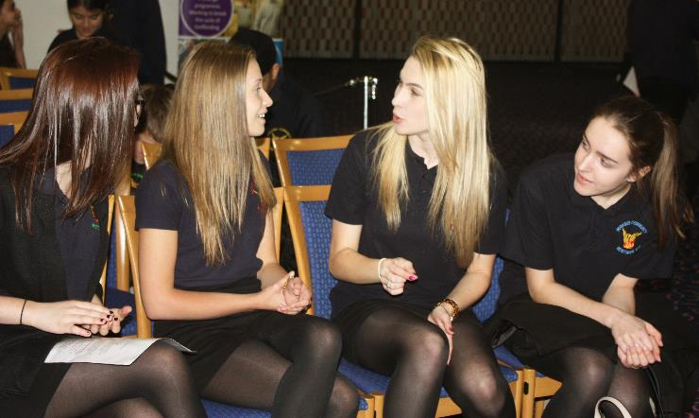
MOCK INTERVIEWS
All interviews delivered in ‘1 day’ at a neutral venue
Places shared between schools based on final retention
Ideally each business provide 1 panel
15-20min interview per student
Generic employability skills + folder content
Panel of 2 business guests
School in/out within 40mins
Standardised format
Standard feedback form

Slide 9
2015/16 SNAPSHOT
74
Education Partners
11,500
Students
60,000+
Learner Hours
110
Businesses
444
Sessions
27
LA Areas
1-6
Per LA
20+
Sectors
£0
Charge
£250k
Investment

Slide 10
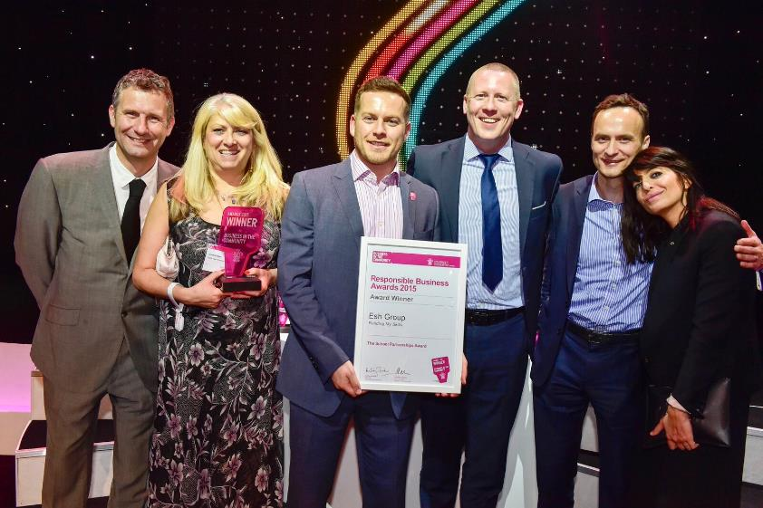
PARTNERSHIP
Entire year group
Guarantee a learner number
Structured vs ad-hoc
Create the win/win
Free of charge
Teachers teach, businesses show
Pick your partners carefully
Be ready to receive your deliverer
Warm welcome, tea & biscuit go a long way!

Slide 11
CONTACT & USEFUL LINKS
addedvalue@esh.uk.com
@eshaddedvalue
Business in the Community Online Case Study
Business in the Community Interview
Awards Dinner Video (07/15)
Interview Day Video (07/15)

