Slide 1
TO GET PARENTAL ENGAGEMENT RIGHT?
What will it take…
#SNEsummit15

Slide 2
What will it take…to get parental engagement right?
Alan Cowley - CEO, Engagement in Education
Darren Kidger – Deputy Head Teacher, Throckley Primary School

Slide 3
Why isn’t Parental Engagement working?
What do we want to achieve from Parental
Engagement, and why?
2. Why is it hard to find evidence of consistent
good practice in schools?
3. How does our current practice inhibit those
aims?
4. What can I do to improve Parental Engagement in my school?

Slide 4
1. What do we want to achieve from Parental Engagement, and why?
“The effect of parental engagement over a student’s school career is equivalent to adding an extra two or three years to that student’s education.”
Professor John Hattie
First Steps: A new approach for our schools, CBI, November 2012
Meta-analysis of more than 50,000 studies
covering more than 80 million pupils

Slide 5
The Sutton Trust Toolkit 2012
Effective feedback +9 months
Meta-cognition +8 months
Peer-tutoring +6 months
Early intervention +6 months
One-to-one tutoring +5 months
Homework +5 months
ICT +4 months
AfL +3 months
Parental involvement +3 months

Slide 6
But………..
"Although most schools embrace the concepts of partnership and parent involvement, few have translated their beliefs into plans or their plans into action“
Joyce Epstein (1991)

Slide 7
Government Response
SSAT
EPRA Campaign (Engaging Parents in Raising
Achievement) 2006/7
Becta
Online Reporting to Parents 2007/8
Manageable, meaningful and sustainable
Ofsted
Inspection Framework 2012

Slide 8
Activity 1
2. Why is it hard to find evidence of consistent
good practice in schools?
You have a lead Ofsted inspector in front of you and you are asked to list 3 parental engagement activities in your school.
Task: create that list.
Time: 20 seconds

Slide 9
Activity 1a
How do you evaluate the effectiveness of that good practice?
Task: create that list.
Time: 20 seconds

Slide 10
3. How does our current practice inhibit those aims?
‘To be precise, the most significant factor was ‘home discussion’. Regardless of social class, the more parents and children conversed with each other in the home, the more the pupils achieved in school’.
Sui-Chu and Willms, 1996

Slide 11
A crucial difference in function
Parental Involvement
Parents participate in school as:
governors, mentors,
PTA members, reading partners etc
Parental Engagement
Enabling parents to support their child’s learning in the home.

Slide 12
Activity 2
How many of your activities from Activity 1 were Parental Involvement and how many were Parental Engagement?

Slide 13
Where are we going wrong?
Research informs us WHAT works, but not HOW to make it work
Remove institutional and societal barriers by creating a professional understanding of the benefits of Parental Engagement
Need for a school-wide strategy to enable meaningful Parental Engagement, to include:
School staff
Parents and carers
Pupils

Slide 14
Recognising a balance

Slide 15
Wilshaw and Gove blame the ‘feckless’ parents
Michael Wilshaw, the chief inspector of schools, wants to fine parents who don’t read to their children, don't turn up to parents' evenings, or fail to make sure homework gets
done.
http://www.theguardian.com/commentisfree/2014/jun/17/michael-wilshaw-gove-school-parents-fines
“One of our problems is engaging with parents who found learning difficult themselves. These are different from the 'hard to reach' group - the former engage with school, attend consultations etc, but low aspirations and their own experience of school mean that they find it hard to help their child at home - their own confidence is often low, especially in maths.”

Slide 17
“Parents have the greatest influence on the achievement of pupils through supporting their learning in the home rather than supporting activities in the school. It is their support of learning within the home environment that makes the maximum difference to achievement.”
’Do Parents Know they Matter?’
Prof. Alma Harris & Dr J. Goodall 2008

Slide 18
Many schools involve parents in school-based or
school related activities. This constitutes
parental involvement rather than parental
engagement. Parental involvement can
encompass a whole range of activities with or
within the school. Where these activities are not
directly connected to learning they have little
impact on pupil achievement.
’Do Parents Know they Matter?’
Prof. Alma Harris & Dr J. Goodall 2008

Slide 19
New Thinking - New Methodology
How do we:
eradicate the lack of understanding between home and school?
overcome the ‘complex patterns of relationship’ between parents and school staff?
provide parents with a regular supply of meaningful material to form the basis of positive conversations about school between parents and their children, in a way that is manageable and sustainable for teachers?

Slide 20
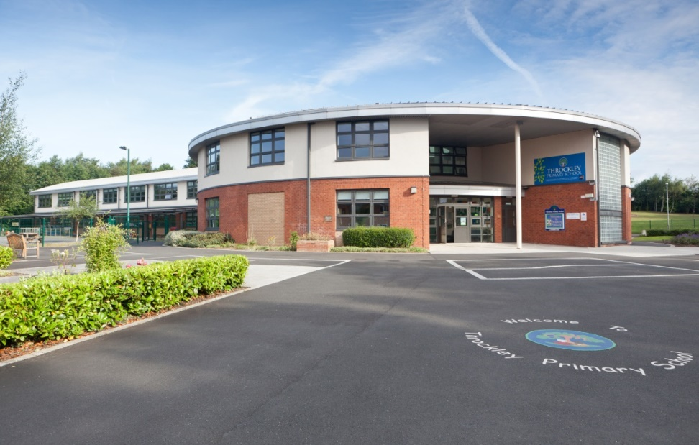
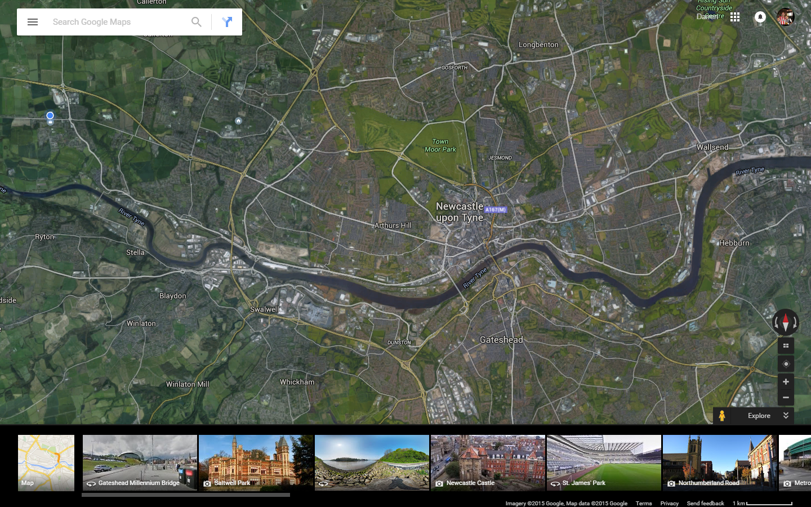

Slide 21
Parental Involvement
VS
Parental Engagement

Slide 22
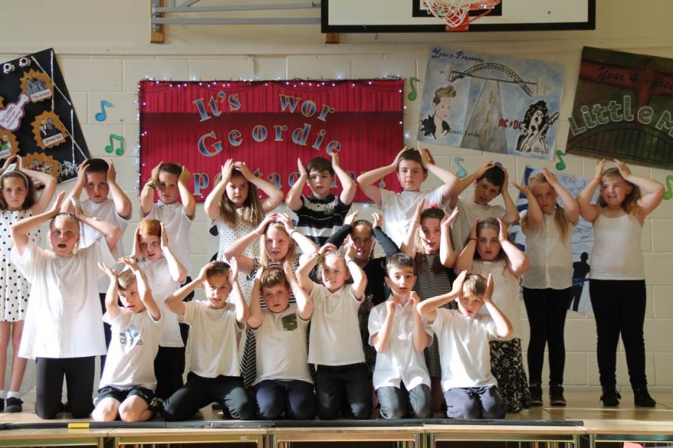
Why not at parents’ evening?

Slide 23
Parental Consultation
I understand how my child is making progress in
school.
“What Year 6 are expected to do is like what I did in high school.”
“I’m was never very good at maths / reading / writing at school.”
“I didn’t like school I found it boring.”

Slide 24
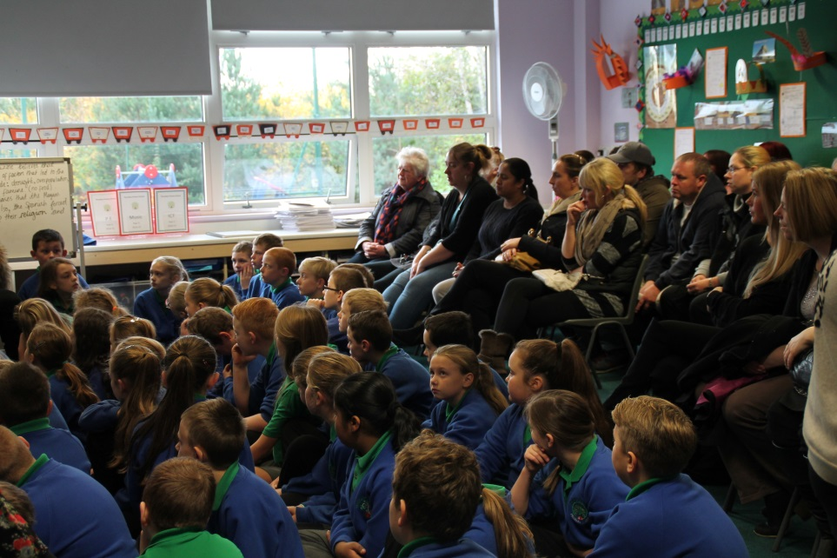
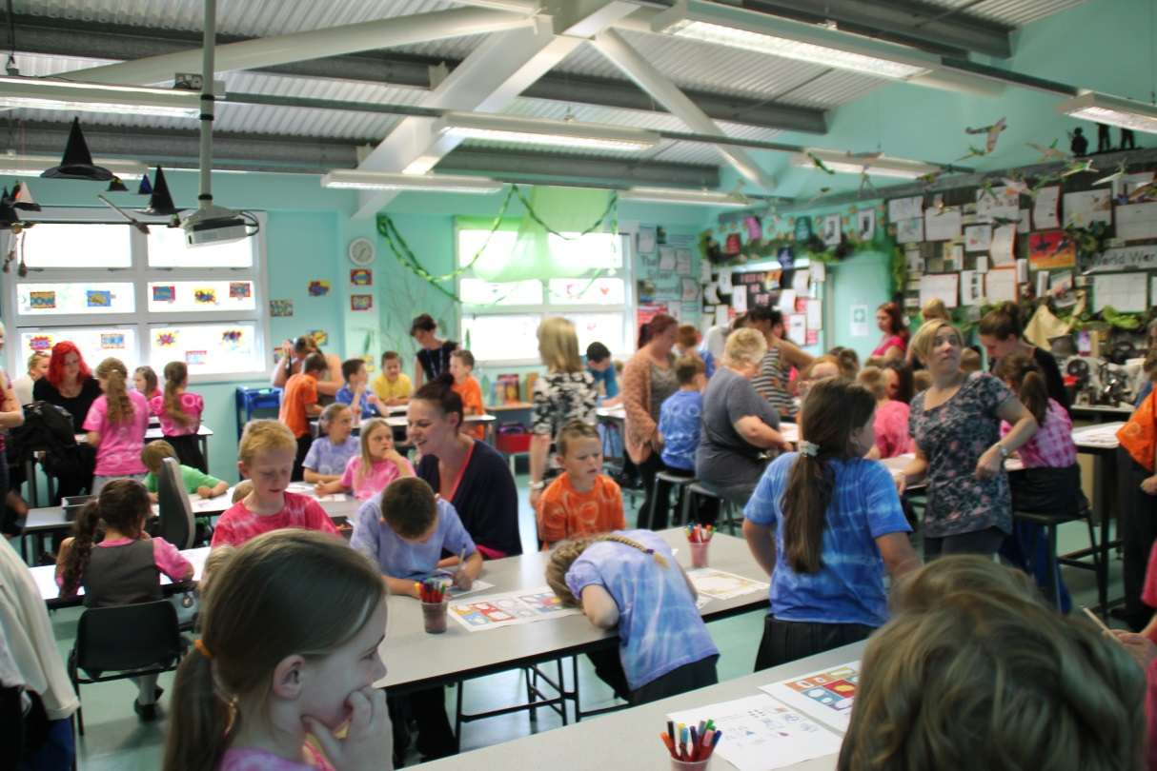
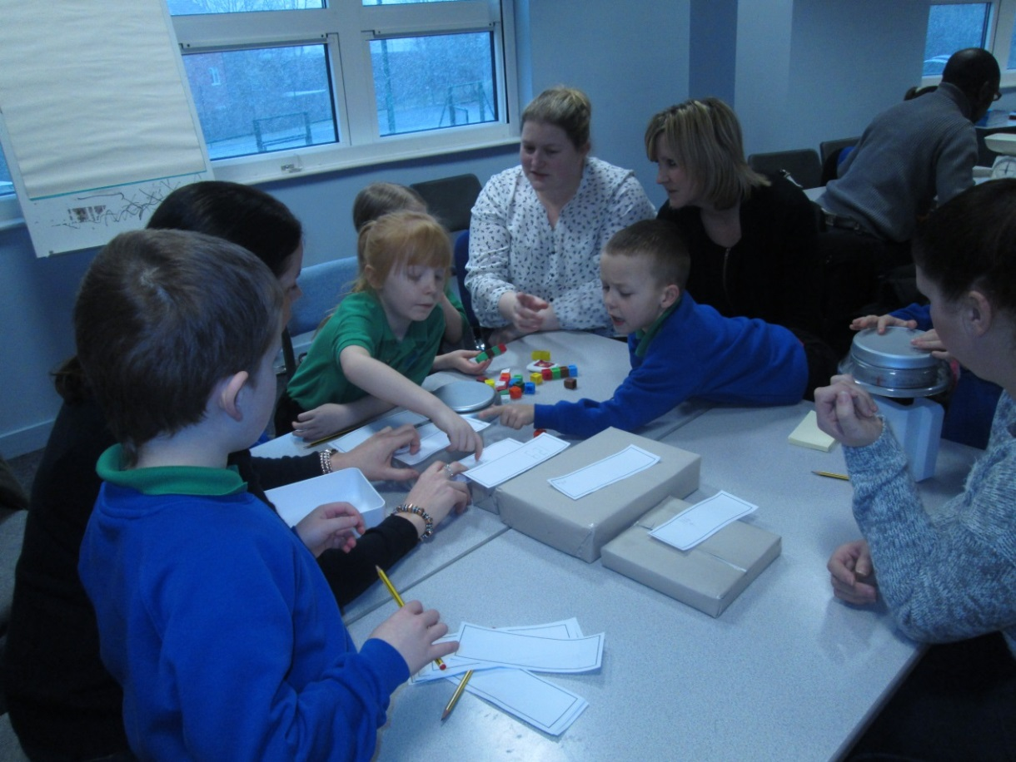
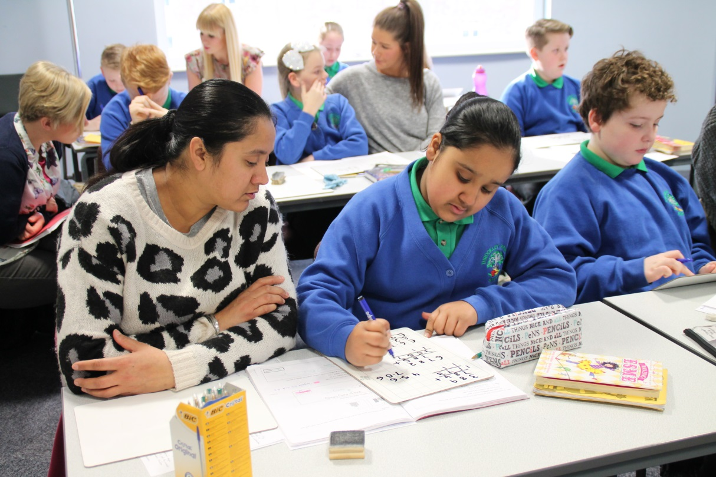

Slide 25
Proof of concept was started in our school and ran for 6
weeks
It involved Year 2, Year 4 and Year 6
50% of the children were part of the test,
50% control group

Slide 26
Evolution of proof of concept at Throckley
School decided to share work with parents via photocopy. This
resulted in a high workload for teachers particularly on a Friday
when work was either photocopied or scanned and sent home.
Little involvement from the pupils, at first teachers were choosing
the work.
The teaching staff who were running the trial bought into the
concept and thought it was a good idea but hated the
photocopying.
Word was getting around about the sharing of work. Parents in
control group wanted to be involved.

Slide 27
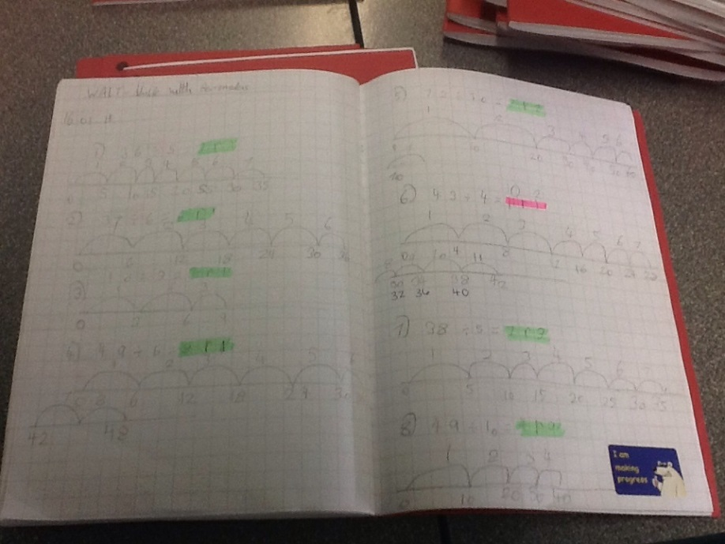
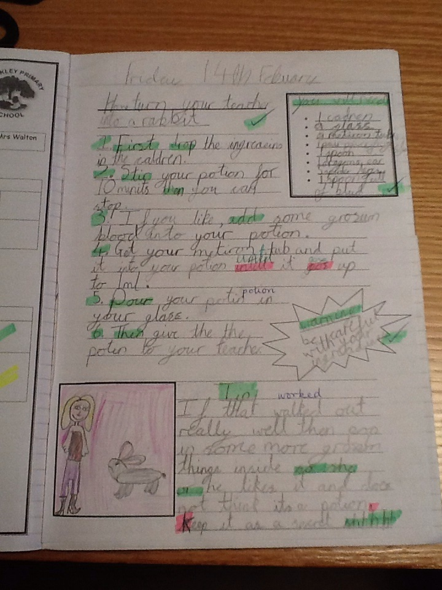
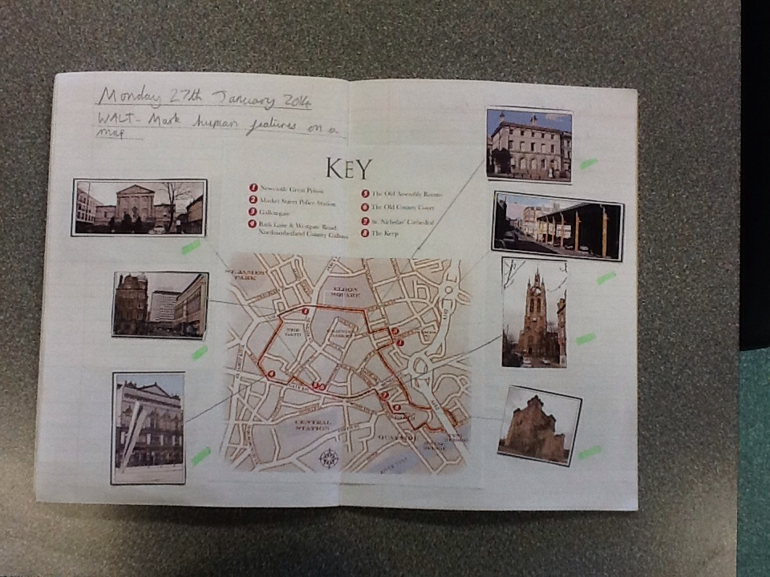
The next steps:
-hand scanners
-iPads and a web based site

Slide 28
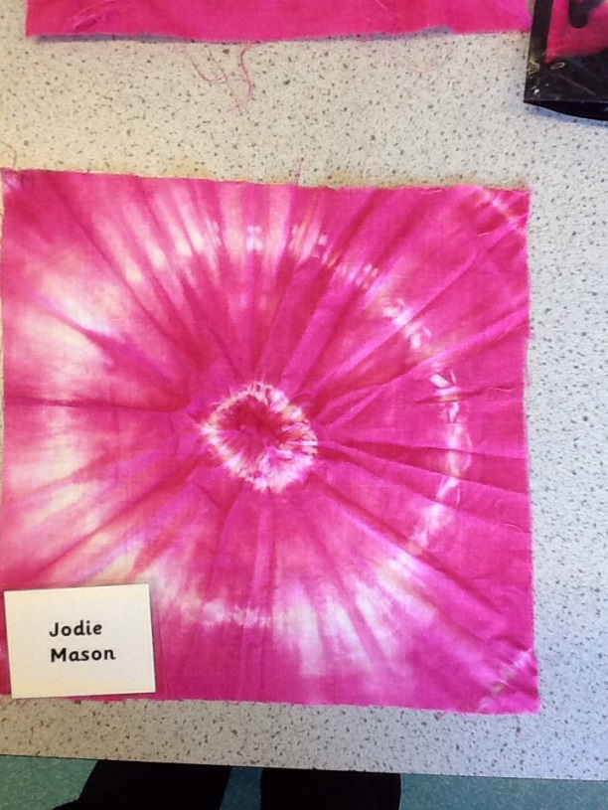
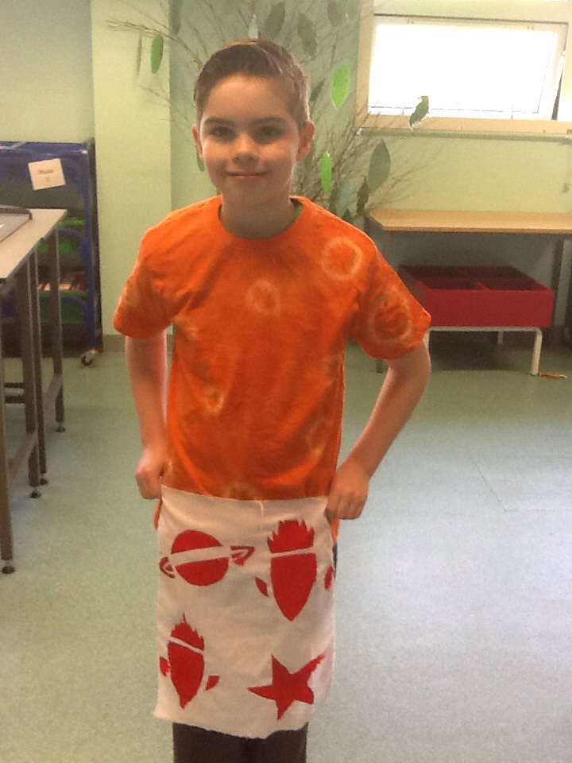
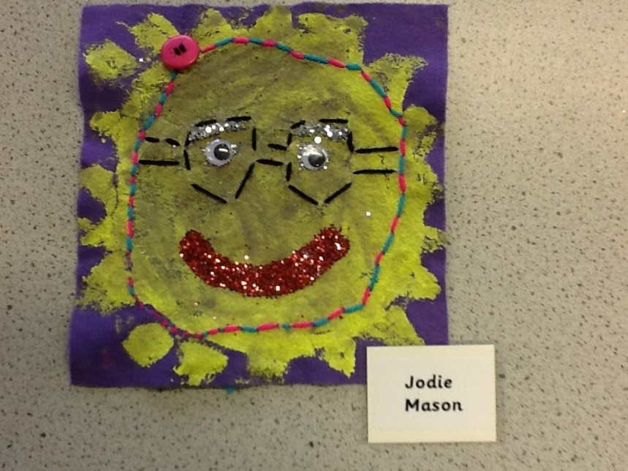

Slide 29
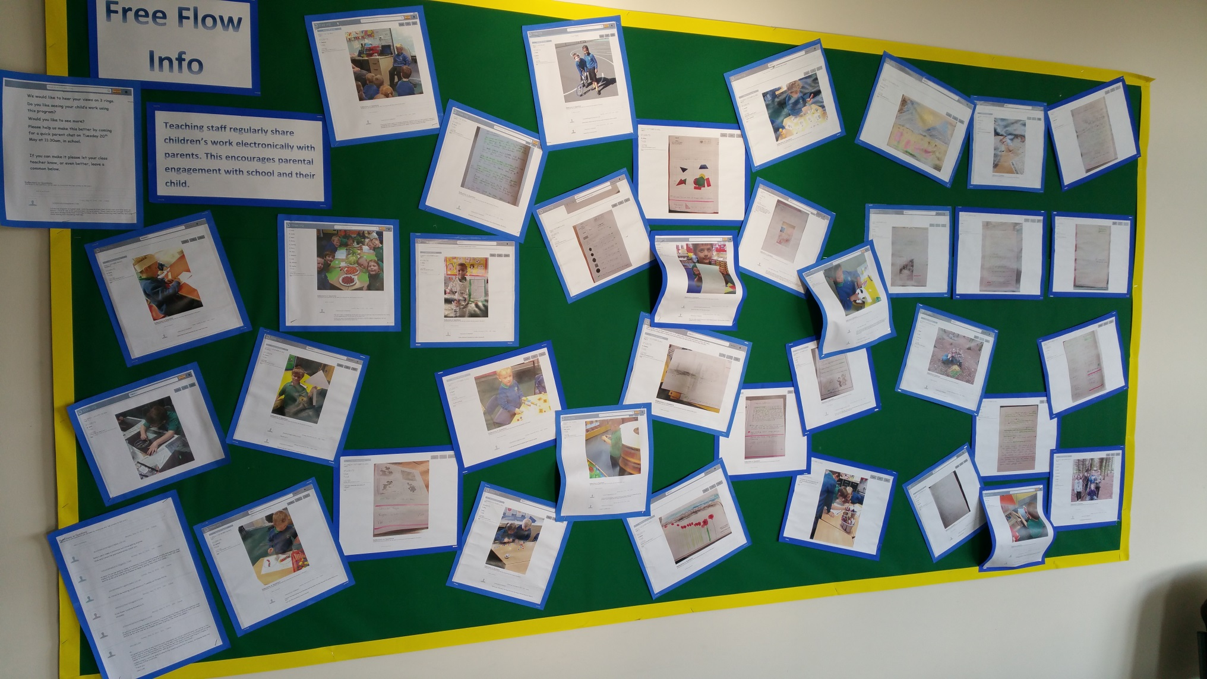

Slide 30
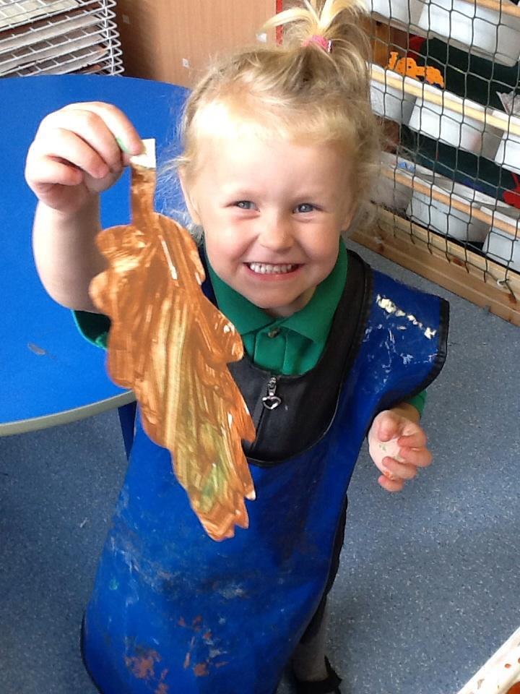
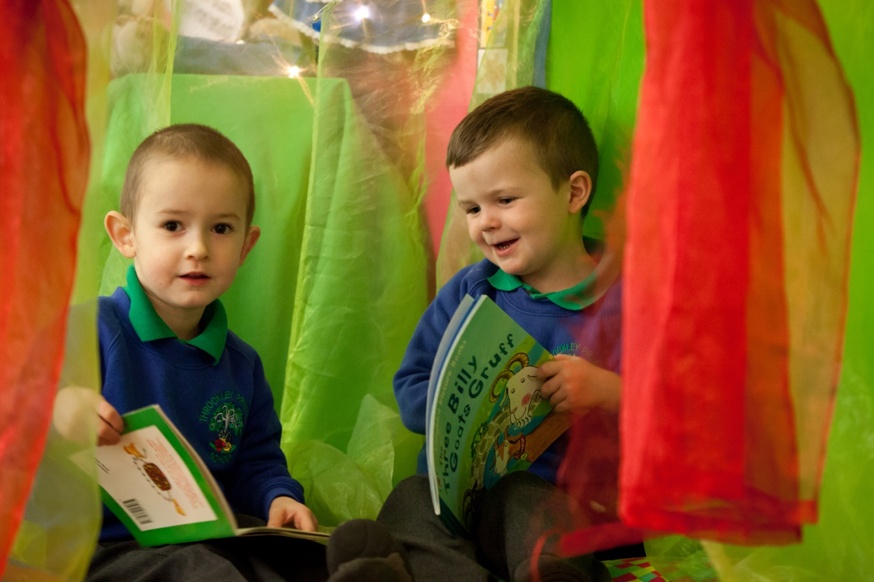
Spin offs:
-Early Years
-Self sufficient UKS2
-Transition

Slide 31
Comments from Teachers:
“I had to show you how much independent work Harry produced in literacy this morning. I am so impressed! We are continuing to work on his presentation, but with the brilliant attitude to his learning at the moment, I am sure we will see great progress. Keep this up, Harry!”
“This photo doesn't really do the task justice but I wanted to
show you the increase in Steven's confidence. He
volunteered himself to sit in front of the whole class and gave
some wonderful answers to some questions during our ICT
lesson. Fantastic progress this year!”

Slide 32
Comments from Parents 1:
“We love it ;-)”
“Great work Riley. I am very proud of you.”
“Well done Sophie.”
“It's brilliant to see what he does at school. Thank you for
sharing.”
“Love your detail, well done James. So proud.”

Slide 33
Comments from Parents 2:
“I love seeing what he does at school. Pleased he is
becoming more confident with his writing. Thank you.”
“I think we will have a little quiz tonight with a little prize.”
“Really pleased with Isla's progress since starting
reception!”
“I am very proud of Emma, she loves to practice her times
tables at home and her hard work is showing here.”
“Absolutely thrilled! That's fantastic. Helping me with the
shopping seems to be paying off! “

Slide 34
Comments from Parents 3:
“Brilliant! Very impressive - nothing like participation to
help them remember a history lesson. “
“Lee spent the entire way home yesterday looking at
where his shadow was compared to the sun, now I
understand why. “
“Mason too :-) while driving I had a back seat explanation
of why you don't have a shadow in front of you when you’re
facing the sun..... I love his enthusiasm. He is fascinated with
the moon now too, will have to get his big brother’s telescope
out!”

Slide 35
Comments from Parents 4:
“Very interesting work - get it done whilst the
weather's here I say!! It's nice to see that they're
improving their understanding of maths and applying
their learned skills in practical exercises. I hope their
write up of what they've done reflects this great
activity – I'm looking forward to talking to him about it
later on.”

Slide 36
Comments from Parents 5:
“Hi. sorry I'll not be able to make it tomorrow. I love receiving
these emails and seeing what Kaitlyn and Zoe have been
doing in school. They both often ask if any of their work has
been sent to us for us to look at, so please do keep it going,
the more the better :)” - Y4 and Y6 parent
“It's great being able to see Aaron's work, especially as not all
parents/carers can come to the school events during the day. I
like seeing Aaron's work in a variety of subjects. It’s great as we
can be a part of their learning. It makes it easier to breakdown
barriers when talking about their school day.” - Y4 parent

Slide 37
Comments from Parents 6:
“I think this is a great idea. It lets the parents share their child's work and time spent at school. I love to see what Jessica's been doing at school. Good idea too for younger children who don't always remember what they've been doing, these photos jog their memory and get them talking and discussing their day.”

Slide 38
The Sutton Trust Toolkit 2012
Effective feedback +9 months
Meta-cognition +8 months
Peer-tutoring +6 months
Early intervention +6 months
One-to-one tutoring +5 months
Homework +5 months
ICT +4 months
AfL +3 months
Parental involvement +3 months

Slide 39
Home
Learning
Effective
Feedback
Reporting
to
Parents
Parental Engagement
Expert
Teachers
Assessment
for
Learning
Workload
Reduction
What else does
FFI
enable?
Unobtrusive
Scrutiny
Transition
Meta-
Cognition
Teacher
Clarity
Collaborative
Learning
Pupil
Voice
Peer
Mentoring
© Engagement in Education Ltd 2014

Slide 40
4. What can I do to improve Parental Engagement in my school?

Slide 41
Remember .....
‘To be precise, the most significant factor was ‘home discussion’. Regardless of social class, the more parents and children conversed with each other in the home, the more the pupils achieved in school’.
Sui-Chu and Willms, 1996

Slide 42
Effective action
1. Create an environment of mutual trust and respect where all parents understand how, without teaching their children, they can support learning in the home.
2. Enable parents of all backgrounds to have
regular home discussions with their children.

Slide 43
Delivering a change in concept for staff, parents and pupils
Staff training that transforms attitudes
Provide parents with material that
facilitates ‘regular at home discussion’.

Slide 44
TO GET PARENTAL ENGAGEMENT RIGHT?
What will it take…
#SNEsummit15

