Slide 1
Effective Procurement
- the other side of YPO
Simon Hill
Managing Director, YPO

Slide 2
MASSIVE Goal
My Massive Goal for you from this session:
Save at least 10% of your non-pay budget through Effective Procurement

Slide 3
Contents
YPO Overview
Public Sector Buying Organisations (PSBOs)
How can PSBOs help?
Framework Contracts explained
Case Studies
Better Buying suggestions
Fund Raising / Income Generation
How to find out more
Any Questions?

Slide 4
The “Other Side” of YPO…
You probably know…
Education resources supplier since 1974
Owned by 13 Councils
Turnover £120m p.a.
Public sector employees
All profits returned to the Public Sector (c.£8m p.a.)
You might not know…
One of a number of PSBOs
Manage public sector framework contracts
£660m spend p.a. managed
Carry out Post Contract Management for customers as a matter of course
Includes services such as Electricity & Gas supply, HR services, Facilities Management, Food supply...

Slide 5
Public Sector Buying Organisations (PSBOs)
Publicly owned suppliers
Set up to provide best value for schools and public organisations
Provide free procurement advice and guidance
Ensure compliance

Slide 6
How can PSBOs Help?
In principle:
Compliance
Collaboration
Continuous Improvement
Cost Reduction
In practice:
Product Catalogues
Framework Contracts
Single Procurements
Advice & Guidance
Post-Contract Management

Slide 7
Framework Contract principles:
PSBO
Runs procurement & appoints supplier
Agrees contract pricing & terms
Monitors service delivery & holds supplier to account
Receives rebate based on usage to cover costs
Supplier
Provides agreed service to customer
Provides details of usage to PSBO
Pays rebate to PSBO
Customer
Buys service from supplier at agreed rates & terms
Gives feedback to PSBO on future contract requirements

Slide 8
Case Study – Horizon College, Barnsley
“I’ve always been aware of YPO. We’d been buying our cleaning supplies, equipment and stationery from them for a while but in September we decided to take the plunge and start buying food, too. I thought that would mean buying YPO branded products, not the brands that we’re used to. But Sue from YPO came to see me and showed me how we could keep getting the same frozen products from our existing supplier – but that by doing it through YPO’s framework contract, we could save a lot. The prices we were paying for exactly the same product were so different under the framework that it was a no-brainer – we would’ve been stupid not to make the switch.”
“The same guy delivers our food to us, we’re invoiced in the same way, we have the same rep from the supplier – the only thing that’s different is the price we’re paying and those savings have made all the difference to our profit margin.”

Slide 9
Case Study – Maltby Academy
“Using the YPO framework saves us a lot of money – it’s probably a 9-10% saving on my bottom line. YPO is a great place to start as a benchmark. I go through our accounts every year and do a cost comparison, and every year I just laugh because YPO can’t be beaten! Online ordering and paperless billing save a lot of time, too.”
“But one of the best things about using YPO has to be their loyalty scheme. You get a reward at the end of the year for being part of their framework and it’s a great way to save for equipment.”
“Last year we bought a trolley for running cooking demos and taking food into classrooms with our end of year ‘bonus’. I really would recommend YPO to every school.”

Slide 10
“Better Buying” suggestions:
Ensure you are legally compliant
Plan ahead – ordering, delivery
Utilise existing public sector frameworks
Go out to tender
Review your contracts regularly
Review your existing systems / controls
Look for added value
Income generation – fundraise and spend it wisely!

Slide 11
Income generation
Equipping schools with tools and advice they need to raise additional funds from the local community through grant-giving trusts
Inspiration to spark creative thinking
Online tools to help save you time
A bank of expert guides and templates
Access to other school leaders to seek advice and share wisdom

Slide 12
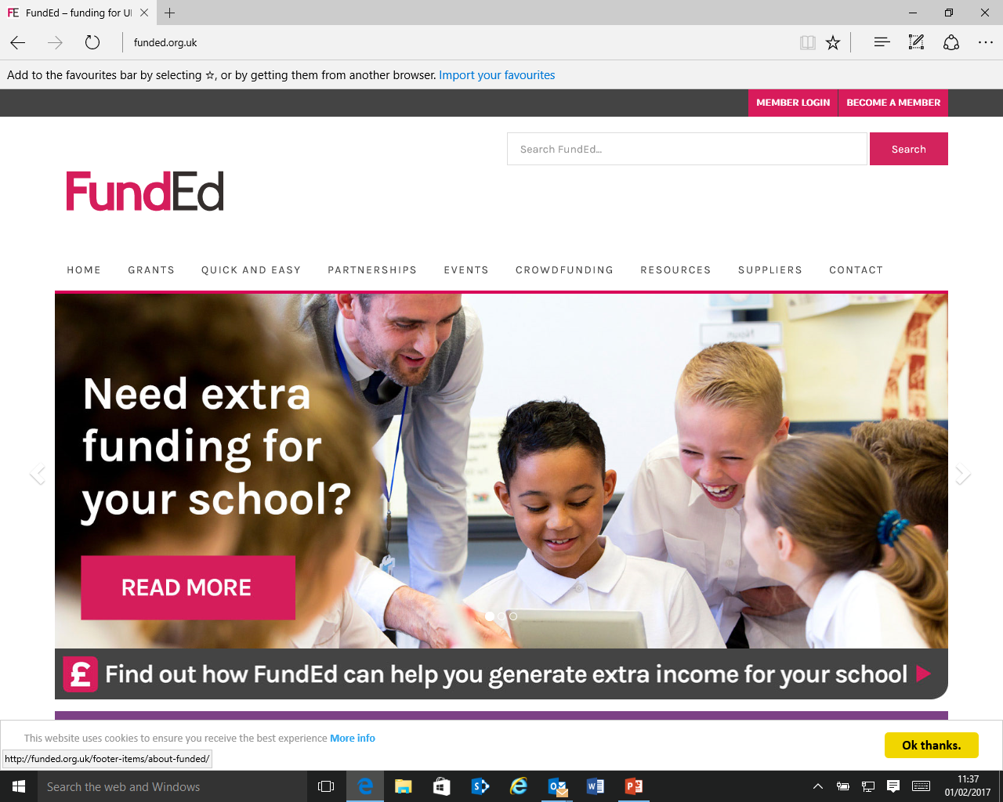
www.funded.org.uk

Slide 13
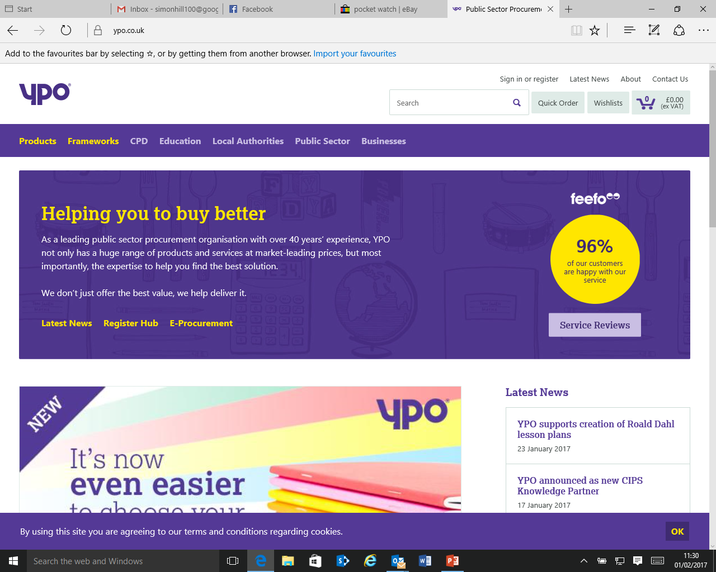
www.ypo.co.uk

Slide 14
Stay in touch
www.ypo.co.uk
@ypoinfo
linkedin.com/company/ypo

Slide 15
Set Your Goal
Key points to remember:
Talk to a PSBO
Use existing frameworks
Look for added value

Slide 16
Any questions?

