Slide 1





Pupils Mental Health
What do parents need?
Wendy Minhinnett
Tracy Bonarius
Teresa Day

Slide 2

A parents Journey
Rollercoaster Parent Support Group
Parental Involvement
Examples of good practice
Developing parent support and training in your setting
Pupils Mental Health
What do parents need?

Slide 3




Slide 4


2 parents
Camhs staff & support
A free room
Unlimited tea and coffee
Publicity leaflet
January 2015 the group began…
Notes:
Different approaches

Slide 5

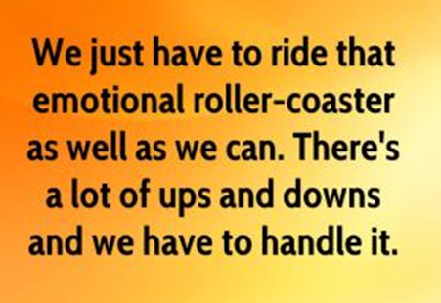
So why bother supporting parents/carers?
Parenting a child with emotional or mental health issues can be difficult…
Notes:
Different approaches

Slide 6

The feelings parents experience can be intense
Notes:
Different approaches

Slide 7




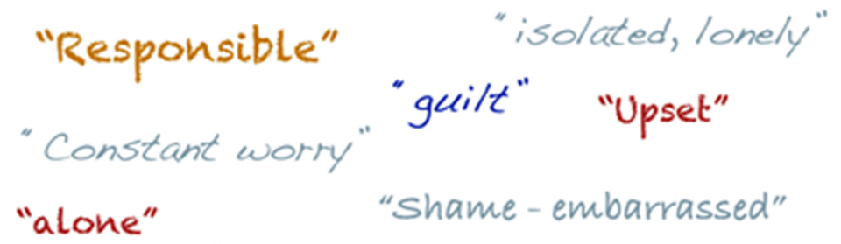


Notes:
Different approaches

Slide 8
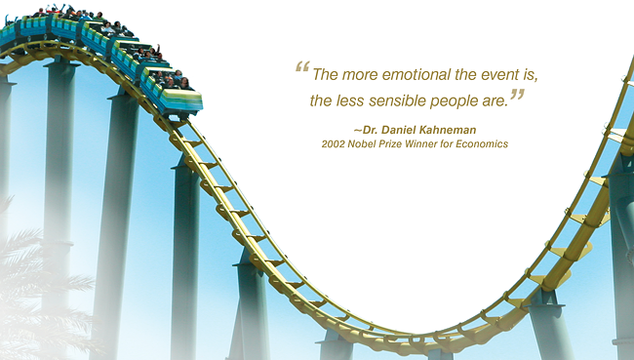
Notes:
Different approaches

Slide 9
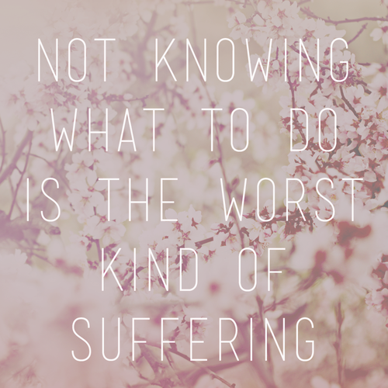

Slide 10

But Knowing that…
Can help
Notes:
Different approaches

Slide 11
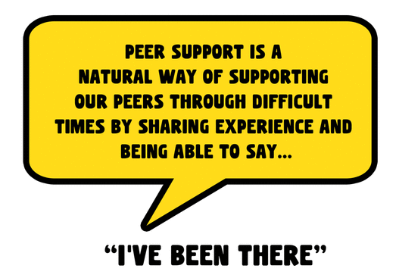

Notes:
Different approaches

Slide 12

Suicidal thoughts
Family relationships
Gender issues
Anorexia
Anger
sleep
Eating problems
Self-harm
ASD
Anxiety
Control issues
School refusal
Notes:
Different approaches

Slide 13




Mixed views and advice from different professionals
Repeating their story over and over again
Being left to deal with things alone
Professionals not doing what they said they would do
Impact on wider family members/siblings
When treatments or support is not explained
Notes:
Different approaches

Slide 14

Consistent advice
Inclusion in child’s care and care plans
Help to understand mental health and treatment options
Whole family support
Increased support after diagnosis and inpatient service
Support in crisis
Practical strategies, tips and hand outs
Notes:
Different approaches

Slide 15

“Found out about local services and was able to speak about my child and not feel like an alien”

Slide 16

“I am so glad I came and returned home feeling a little stronger knowing I wasn’t alone”
Notes:
Different approaches

Slide 17

“No matter what part of the rollercoaster I am on I always leave with the benefit and advice on how to improve things”

Slide 18

“The advice we have been given has helped-we are now happy about the future for our grandson-a big thank you to everyone”

Slide 19



Parents come along to:
Share experiences and sometimes,

Slide 20


Slide 21


Slide 22


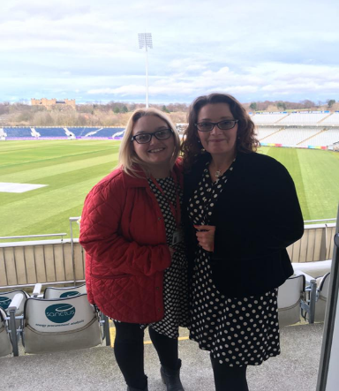

Notes:
Different approaches

Slide 23

Support Groups
E-Network & Social Media
Parent Peer Support Training
Parent Advisory Group

Slide 24

Parent Involvement
Interview panels
TEWV Recovery conference
County Durham Children and Young Peoples Emotional Wellbeing & Resilience Group
County Durham Suicide Prevention Group
LSCB Self Harm Group
Talks and information sessions-GP’s, EP, One Point,Police
TEWV Quality Assurance Group
Feedback NHS England
Notes:
Different approaches

Slide 25


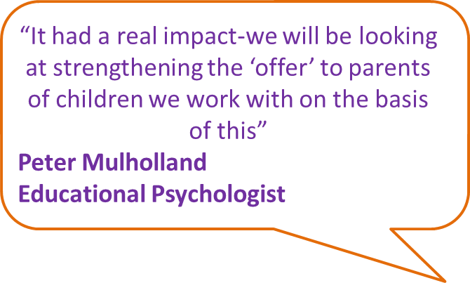
Parents voice
Notes:
Different approaches

Slide 26

Notes:
Different approaches

Slide 27
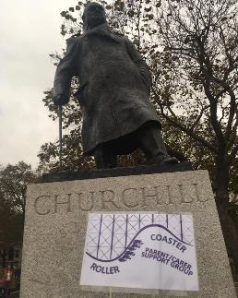
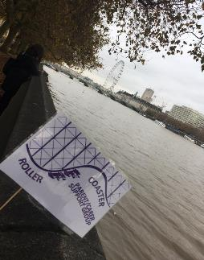
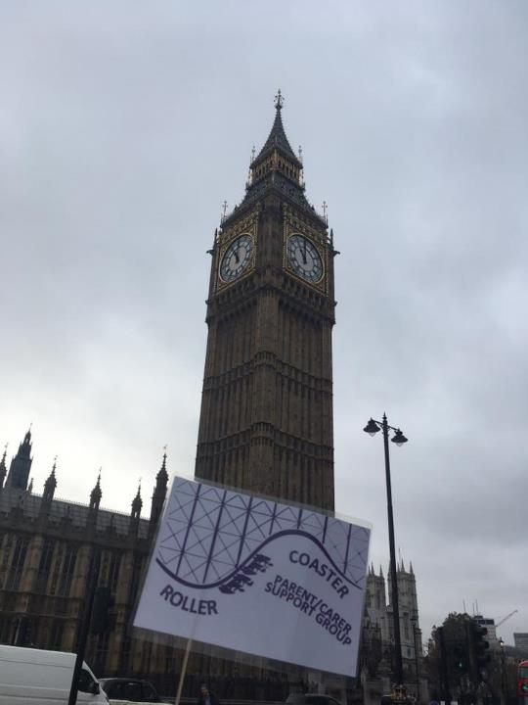
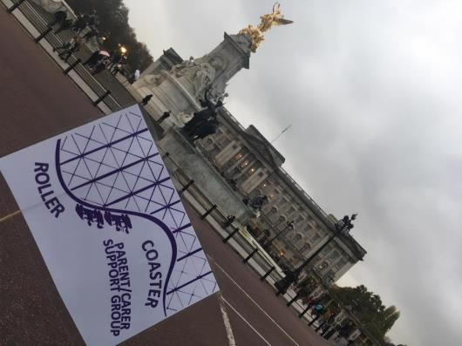
Being part of the Rollercoaster group at the meeting meant more to me than word's can really say.
After such an horrific ordeal during my son's mental health difficulties it is now a positive step for myself and the group to have our voices heard.
I can totally connect with other members I feel understood and not alone.

Slide 28




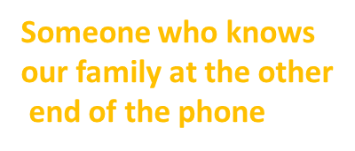


Having to repeat yourself when you see different people.
Too few appointments
available after work
Practical strategies, advice and information
Intensive support around high risk/suicide attempts/serious self-harm
Poor communication between inpatients/community CAMHS

Slide 29
Priority | Number of votes
Communication/supportive dialogue between CAMHS and school/education | 19
Training for parents on emotional and mental health issues | 18
Better communication between inpatients/community CAMHS | 14
Intensive support around high risk/suicide attempts/serious self-harm | 12
Support and advice while waiting for a diagnosis and after | 11

Slide 30
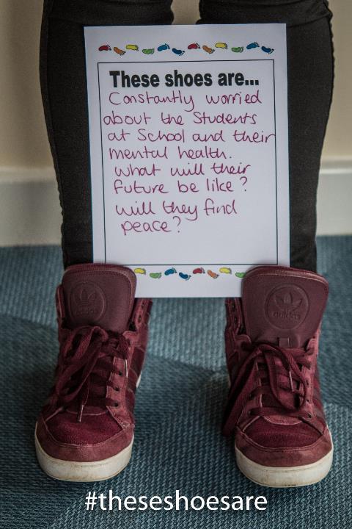
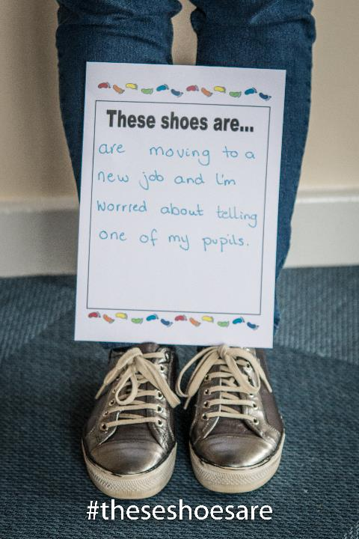
shoes

Slide 31


What are we doing?

Slide 32

Management showing an understanding
Appointed Key Person-time allocated
Training-e.g. CAMHS, Team Teach, Nurture Group-secretary to head teacher
Working with other professionals e.g. Resilience Nurses, behaviour support, PSA
Team Around Family Meetings
Early identification-observations, instinct, boxall profile
CWMT Book Club
County Durham Emotional Wellbeing Network
Working and communicating with parents every step of the way!

Slide 33

Be seen & listen
Siblings
Sharing practice leaflet
Jolly Jar
Jobs
Pegs
Relax Kids
Resources & services for parents
Working with parents
Stay & Play
Lego Club
Postcard home
Time to Talk
Check in

Slide 34



Mental Health Champions
Leadership and staff
Cluster training sessions
Whole school approach
Pupils, staff & parents
Youth Forum

Slide 35
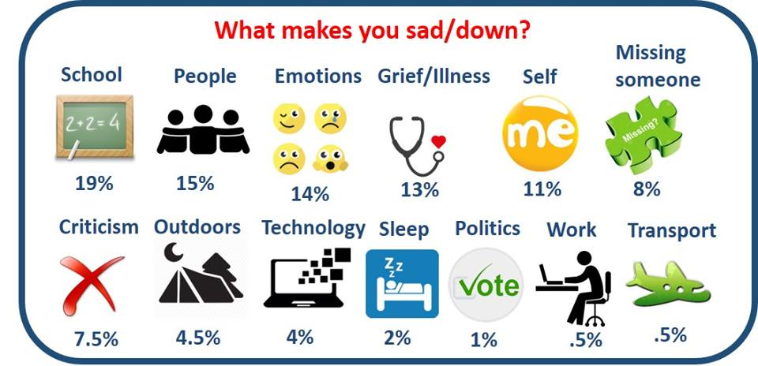

Slide 36


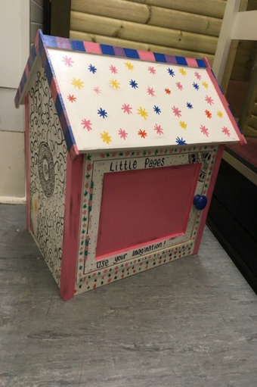
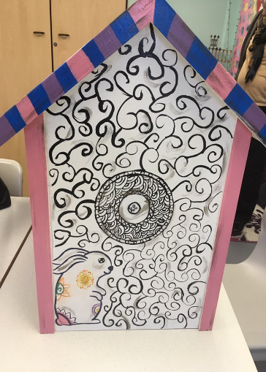
Mini library

Slide 37


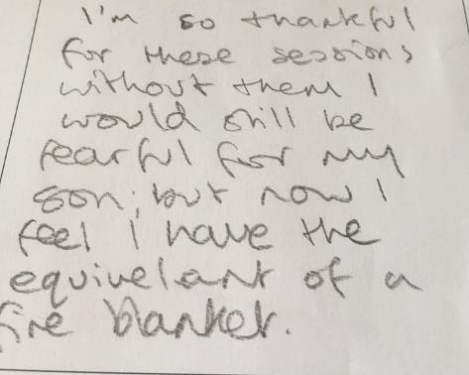

Parent Training
Self Harm
Overwhelming Emotions
Coping in a crisis

Slide 38

Listen, believe & try to understand
Be the bridge, help or get help
If you are the one parents talk to-do something
Takes time to build relationships-people are still scared to talk about mental health
Written plan/practical tips-(Sen Support Plan)
Explain why if you cant help or implement something-help parents see your point of view
If parents wont engage-don’t give up-there’s always a way
By working together we can make a difference

Slide 39


How we can help you
Developing Parent support in your setting
Groups
Training
Resources
cwmt.org.uk

Slide 40


wendy@success.coop
teresa.day@cwmt.org
Questions & Contacts
Rollercoaster parent support group (like page and closed group)
@RollercoasterPS
T
res<teresa.day@cwmt.org>

