Slide 1
It ain’t what you don’t know that gets you into trouble. It’s what you know for sure that just ain’t so.
Mark Twain – or not…
Kevan Collins kevan.collins@eefoundation.org.uk www.educationendowmentfoundation.org.uk
Notes:
Opening line from the big short
Me
Charity
Money
Numbers

Slide 2
It’s not broken - but it’s not working well enough for some…
My top three - today…
Early Years
Self regulation, language and communication, parental engagement
Teaching - best bets
Meta cognition, improving feedback, securing early literacy, going beyond academics
Post 16 and the ’forgotten 40%’
Tackling misconceptions, diagnostic assessment and planned learning programmes
Notes:
What are your top three today?
How much precision do we command
Early years is a great example – a bit more wont cut it and frankly isn’t worth the effort – health/education and families
We’ve got to spot them ad intervene at 3 particularly around language development
Tawney???
Schools – I’m simply not interested in structures. – the evidence is clear we’re dancing on pin heads when we try to prove otherwise
The emerging benefits of technology.. AR but more flops than hits
Post 16 – from school to work – must be about a place based solution because frankly this group aren’t / can’t go anywhere else
Section 106
Business rate rebate
Long term planning and economic prospects

Slide 3
Education and socio-economic disadvantage
It’s a global issue
England’s gap
Variation between and within schools
The 1:7 and 1:12
It’s both what you do and the way that you do it
Notes:
Lots of reasons social mobility has stalled – the 1950s. - 2000 might be the aberration
Pickett
Putnam
Sutton Trust
But schools have a contribution to make and it’s worth harvesting

Slide 5
The Attainment Gap
School readiness
at 5
Attainment
at 11
Attainment at 16
Notes:
The gap is already there at age 5. it doesn’t get sorted out at school. Early years sector has a really important role.

Slide 6
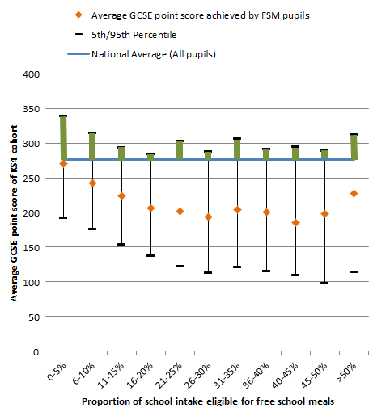
Variation between similar schools
There are 428 secondary schools (15% of our data set) in which the average GCSE point score of FSM pupils exceeds the national average for all pupils (276.7 points).
In the graph these are schools in green above the horizontal blue line.
These top performing schools come from across the spectrum of disadvantage
Note: this analysis excludes independent,
special and selective schools
Notes:
Every area, every community, every type of school and not just London

Slide 7
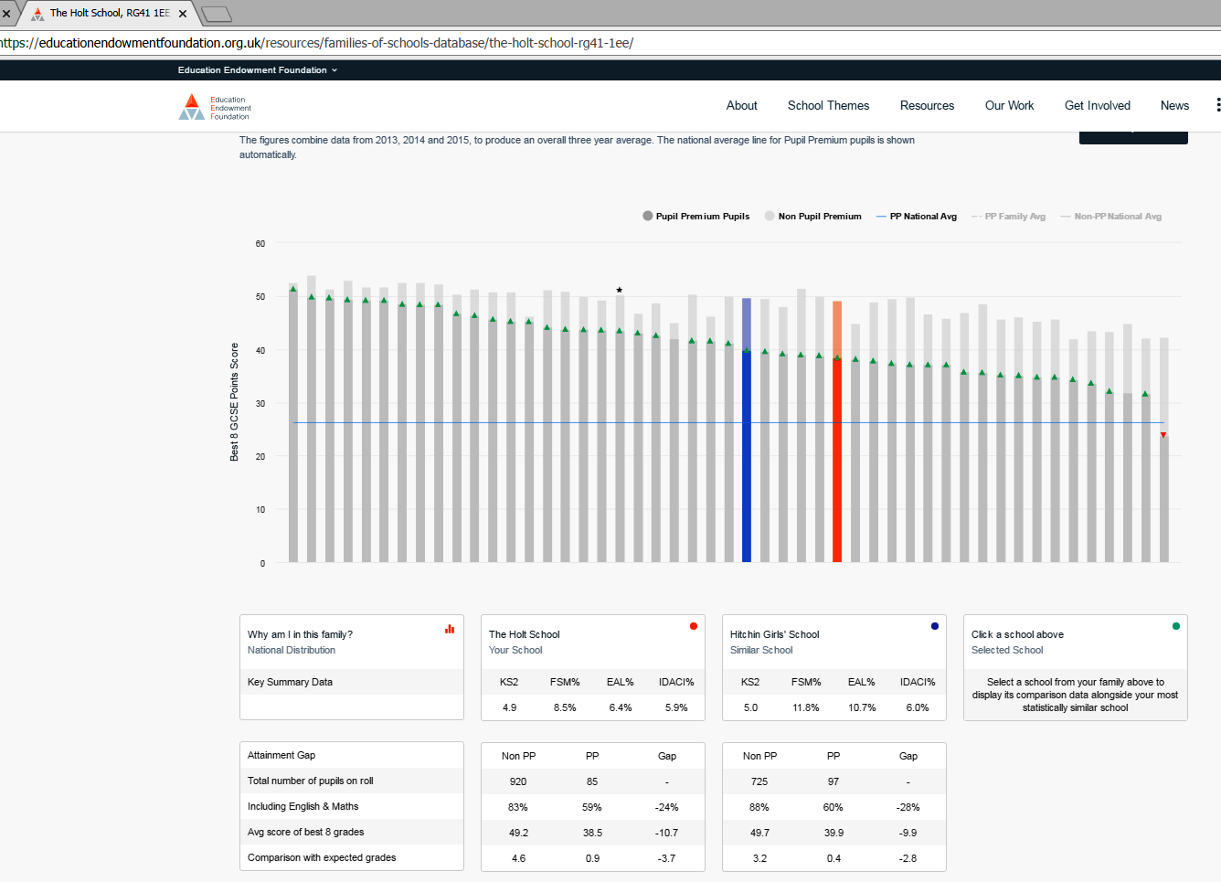
Notes:
5,000 hits a month

Slide 8
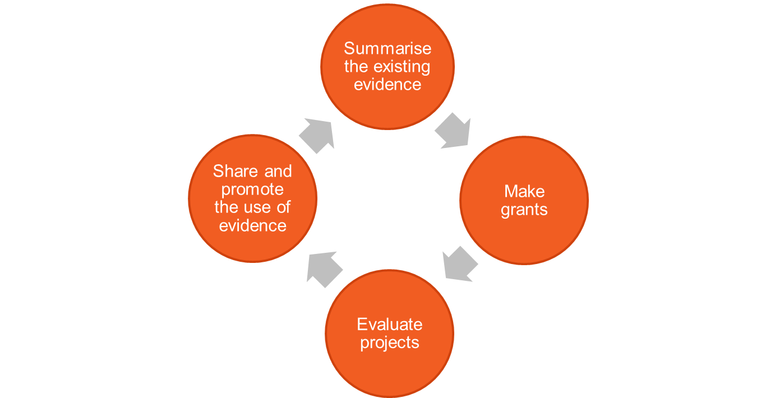
Towards an evidence informed system…
Notes:
Our modest but different contribution
Driven by a belief in reason and knowledge
Appreciation that what happens in schools matters and what happens in schools is the consequence of decision made in the building
And four mantras:
start from what we know
innovate with discipline
evaluate with rigour
Mobilise with intent

Slide 9
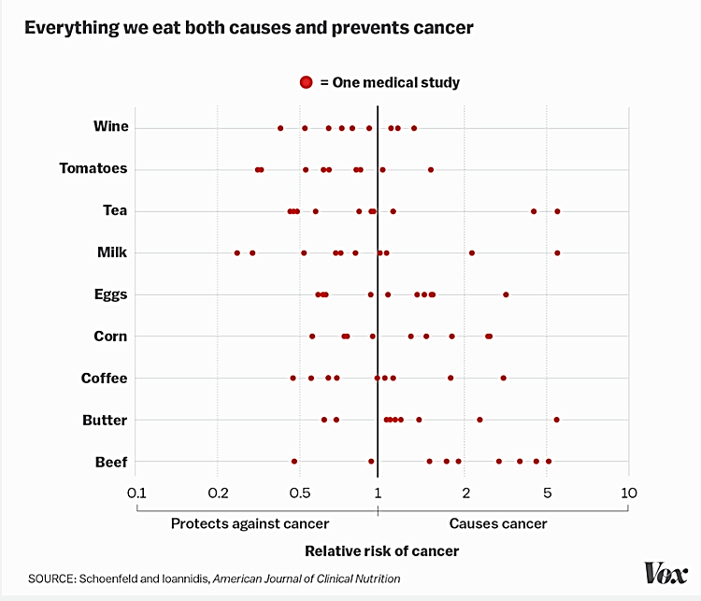
Associations between foods and cancer
Notes:
Why synthesis ?
Combining different pieces into a whole
Why
To make sense of current research (science is cumulative
Access to studies is haphazard and often biased
The quality of research is variable
Most studies are too small

Slide 10
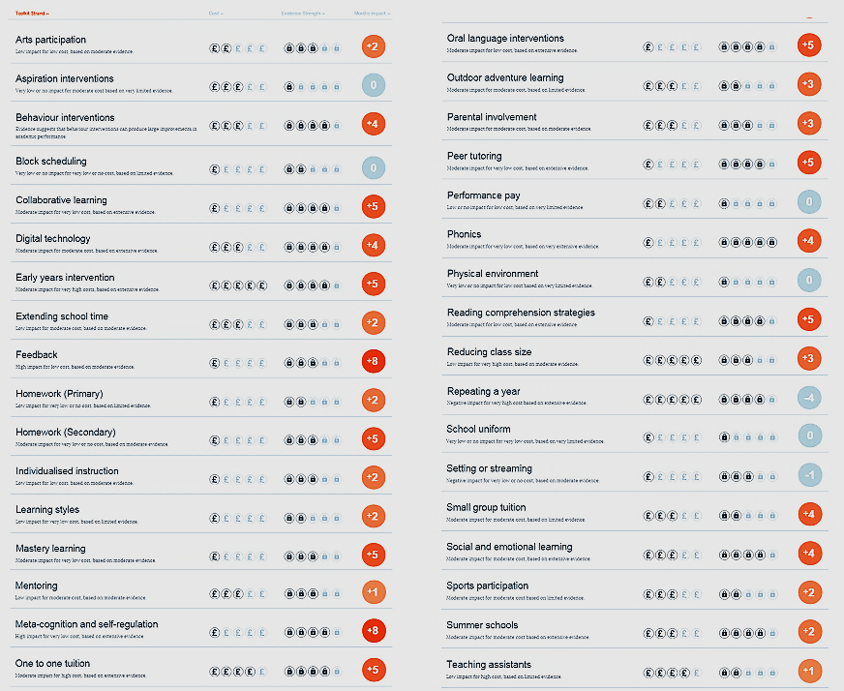
Teaching and Learning Toolkit

Slide 11
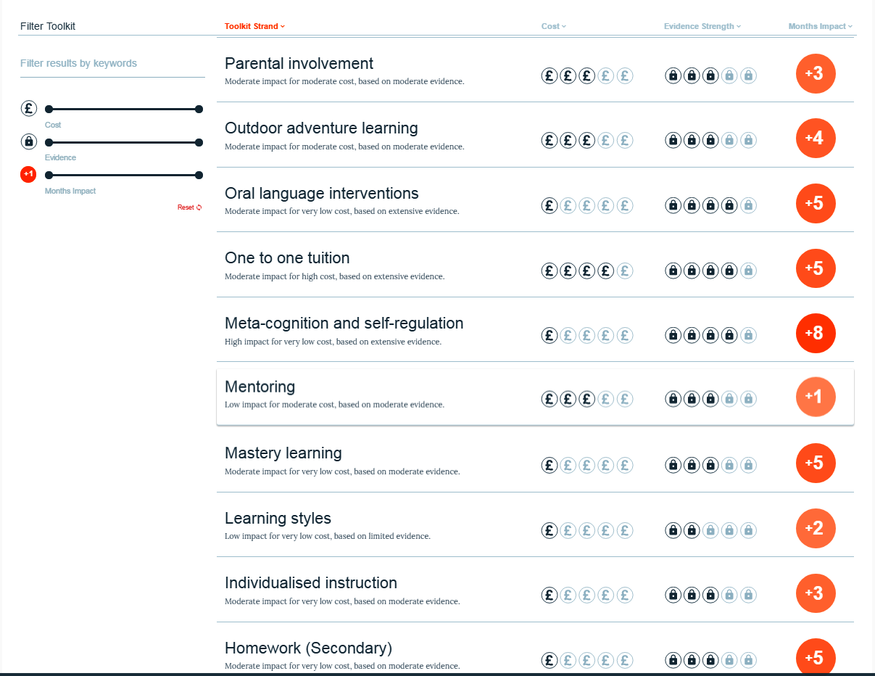
Teaching and Learning Toolkit

Slide 13
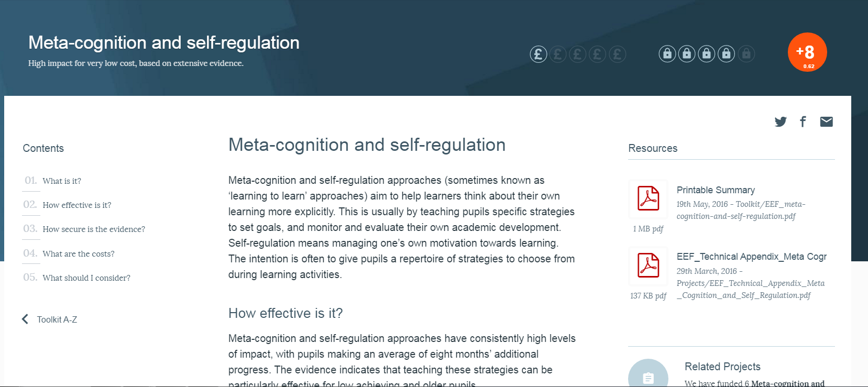
Inside the Meta-cognition Toolkit strand

Slide 14
Disciplined innovation
We are working to fund, develop and evaluate projects that:
  Build on existing evidence
  Improve outcomes for FSM pupils
  Generate significant new understanding of ‘what works’.
  Can be replicated cost effectively if proven to work.
Examples: Providing breakfast, increasing exercise in schools, addressing pupil well-being, starting the school day later, flipped learning
Notes:
But there are gaps – we are filling them in and getting more much detailed information about the types of things that are working

Slide 15
Innovations we’re trialling…
Family and wider community activities
Do financial incentives improve parental engagement?
Can texting improve attendance and achievement?
Does involvement in the Fire Brigade Cadets improve wider outcomes?
Does training parents to read with their children improve attainment?
Teaching and pedagogy
Can peer observation by teachers, improve practice?
Do hand held response devices increase the pace and quality of learning?
Does teaching children to play chess boost their attainment in Maths?
What are the best ways of grouping students, and what impact does this have on attainment?
School organisation
What are the best ways of training and supporting Teaching Assistants?
What impact, if any, does giving children breakfast in schools have?
Does delaying school start times for adolescents boost Key Stage 4 attainment?

Slide 16

Parenting Projects
Project | Summary | Age | Impact | Security
Parenting Academy | The Parent Academy was a series of classes for pupils’ parents, | Key Stage 2 | 0 months
Texting Parents | The project used school platforms and communications systems to send texts to parents | Key Stage 3 and 4 | +1 months
Supporting Parents on Kids’ Education in Schools (SPOKES) | A ten-week intervention that teaches parents strategies to support their children’s reading | Year 1 | 0 months
Mind the Gap | Teachers were trained to embed metacognitive approaches in their work, and to effectively and strategically involve parents. | Year 4 | -2 months

Slide 17

Teaching Assistants: promising results
Project | Summary | Age | Toolkit theme | Effect size | Padlocks and stage
Catch Up Literacy | One-to-one tailored TA support on phonics and comprehension. | Years 3-6 | Literacy/Phonics | +2 months
Catch Up Numeracy | One-to-one TA numeracy instruction for struggling learners | Years 2-6 | Numeracy | +3 months
Nuffield Early Language Intervention | Oral language intervention for nursery and reception pupils, delivered by TAs | EYFS | Communication and language approaches (Early Years toolkit) | +4 months
REACH | Language and comprehension intervention for struggling readers, delivered by TAs | Year 7 | Reading comprehension; Oral language | +4 months
Switch-on Reading | 10 week TA intervention drawing on Reading Recovery | Year 7 | Reading comprehension | +3 months
Talk for Literacy | Speaking and listening interventions delivered by TAs. | Year 7 | Oral language | +3 months
Notes:
Is anyone doing any of these Interventions?
We had a growing evidence base about how to deploy Tas in interventions.

Slide 18
Metacognition: some promising results
Project | Summary | Age | Effect size | Padlocks
Changing Mindsets | Developing pupils “growth mindset”, through structured workshops for pupils | Year 5 | + 2 months
Philosophy for Children | Weekly teacher-led pupil dialogues, focused on philosophical issues | Years 4 and 5 | + 2 months
Thinking, Doing, Talking Science | Training teachers to make science lessons more practical, creative and challenging | Year 5 | +3 months
Using Self-regulation to improve writing | Whole-class structured writing programme using memorable experiences as inspiration | Year 6 & 7 | +9 months
Dialogic teaching | Improving the quality of classroom talk to develop higher order thinking and articulacy. | Year 5 | + 2 months
Notes:
Add Robin Alexander
Dialogue teaching
2,500 pupils year 5
+2 English
+2 Science
3 padlocks
76 schools
35% FSM
£52 per child
3 days of training
Now going beyond academic outcomes to consider other skills that are important
Self efficacy
Social skills
Resilience
Self regulation

Slide 19
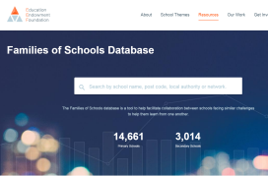
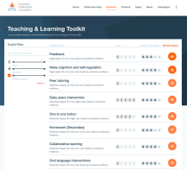
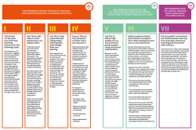

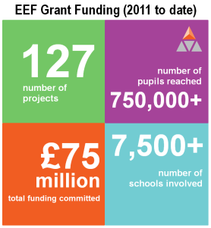
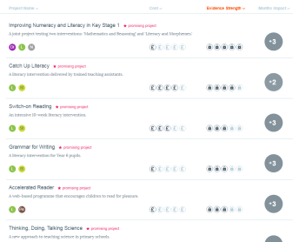
Towards an evidence informed education system
Using evidence
Generating evidence
Summarise existing evidence
Clear and actionable guidance for schools
Share and promote ‘what has worked’
Publish independent, rigorous evaluations
Fund innovative projects
Scale-up
evidence-based programmes
Practical
support to bring
evidence to life
10
Research Schools
60
reports
12
Advocate-partners
106
RCTs
Notes:
We need to work with you on both sides of the equation
Mobilising knowledge and suing the evidence particularly
We’re not going to recruit a field force we’re looking for partners and new emerging arrangements
TA guidance with training materials
183,000 downloads 87,000 unique users
Toolkit 67%
10,000 hits a month
Literacy guidance sent to all schools middle of the following week well over 25,000 downloads
We’ve spoken to more than 10,000 heads. - alone my running total is 6,000 or 1:4
There’s an appetite and opportunity

Slide 20
Applying evidence in practice
Step 1: Decide what you want to achieve
Identify school priorities using data and professional judgement.
Step 5: Securing and spreading change
Step 2: Identify possible solutions
Mobilise the knowledge and use the findings to inform the work of the school to grow or stop the intervention.
Consider a range of evidence summarised in the Toolkit to inform choices.
Step 4: Evaluating impact
Step 3: Giving the idea the best chance of success
Determine the impact of change and identify potential improvements for the future.
Identify and apply the ingredients of
effective implementation.

Slide 21


Conclusions
The new focus on evidence will support informed professional debate - it’s not a panacea
Education evidence is more accessible than ever before our professional obligation is to start from what we know and reject uninformed fads
Adopting an evidence led approach carries new obligations - informing and leading the professional debate
Delivering education’s contribution to drive social mobility demands the active engagement of local government and local stakeholders.
Enduring question - why is the education sector so weak at spreading and sharing lessons from disciplined and informed innovation?
Notes:
Model is moving to social care
My moan about Buttle
WW approach is in medicine, justice, aging well, economic regeneration
Frankly, if not evidence then what?
And it’s a global enterprise

Slide 22
How to get involved
Apply for funding
Our new general funding round opens this month.
Visit: http://educationendowmentfoundation.org.uk/apply-for-funding/
Volunteer to take part
We are always looking for schools to volunteer to take part in EEF-funded projects.
Visit: http://educationendowmentfoundation.org.uk/projects/how-can-i-get-involved/
Do it yourself
Our DIY Evaluation Guide, developed with Durham University, is a resource intended to help teachers and schools understand whether a particular intervention is effective within your own school context.
Visit: http://educationendowmentfoundation.org.uk/evaluation/diy-evaluation-guide/
Notes:
We think the EEF is part of the picture – we’re not the solution, but we aim to work with others to get there.

