Slide 1
East Cleveland Cooperative Learning Trust
Cross Phase Collaboration - Our Model

Slide 2
Our History
EAZ
EIP
GEL
SCIP
Informal collaboration

Slide 3
The Long and Winding Road
A School’s Company
Continue with informal collaboration
Break up of cluster?
Academisation? (some already there)
A Cooperative Trust!!

Slide 4
2013
Consultation – Change of Status for 12 Schools to Foundation Status
East Cleveland Cooperative Learning Trust – Legal Entity
12 Full Members and 6 Partner Schools/Academies
3 Secondary, 1 Special, 14 Primaries
Over 5000 Children
Nearly 1000 staff

Slide 5
Organisation
YEAR 1 (2014/15)
Full time seconded HT to set up COOP
YEAR 2(2015/16)
0.4 seconded HT to set up the teaching & learning infrastructure with admin support
YEAR 3 (2016/17)… still in draft?? Financial Commitment Made
2 seconded leaders
(0.2 Curriculum/ teaching & learning
0.2 Leadership/ standards)

Slide 6
THE R.A.B.
RAISING ACHIEVEMENT BOARD | Lead pre RAB: dates, members, agendas | Lead pre RAB & write pre RAB report | Work with HTs to collate ideas for the action plan | Write ELCCT action plan incl school to school support
PRE RAB data collation & analysis
RAB
Individual school stories
HT Reflection
on major needs in key areas
Decision
what we want
Action
Supportive & challenging networks
Celebrate best practice
Common language of sharing
Curriculum continuity
All cohorts in all schools at least good

Slide 7
What’s going on?
ANNUAL CALENDAR designed from emerging RAB issues and national initiatives
14 PRIMARIES | Termly RAB | Twilight events | Day events | Coaching | DFL | Peer Reviews | Networks | Moderation | Marketplace
Target audience | Heads | Teachers, TAs | Teachers | Teachers | Teachers | SLT | Teachers, TAs, Heads | Teachers | Teachers, TAs
Example | COOP data share & highlighting of strengths & key areas to improve | CPD e.g. FS, outdoor play | CPD eg spelling, reciprocal reading, ODD, boys, spelling, marking | Coaching across Schools | Succession planning, empowering our staff to become leaders | School to school support on focus teaching & learning elements | CPD eg NQTs, attendance, curriculum continuity, transition, EYFS | TnL 2017: WRITING | CPD e.g. Boys, reading stamina, booster classes, mental math's,

Slide 8
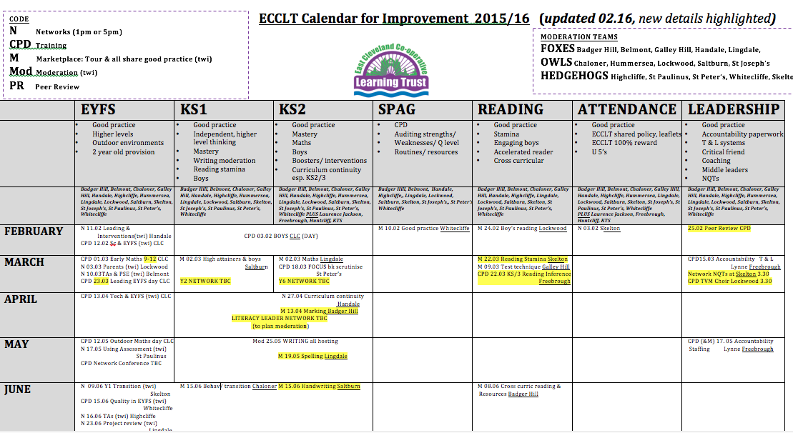

Slide 9
What does the future hold?

