Slide 1
Educating Character From Theory to Practice Dr Tom Harrison Director of Education Jubilee Centre for Character and Virtues, University of Birmingham
Notes:
Many thanks for the invite
2 session – overview and then primary focussed on practice
My role Director of Education – sit within theory and practice – the research that underpins the growing interest in Character education

Slide 2
The EPACT Model
Eudaimonia
Phronesis
Arete
Caught
Taught
Notes:
5 areas – called it the EPACT model – new for 2016 – first airing – so happy for feedback!

Slide 3
From theory to practice and back again
Virtue Ethics Theory
Character Education Practice
Notes:
Relationship between researchers and practitioners connected to the Centre to be reciprocal – naturalist position
virtue ethics theoretical foundation that underpins much of the Centre’s work has been soundly tested in the classroom
Role that JCCV can bring to the debate – which is in danger of running away – seen as new idea and fad
Proper intellectual research – foundation for practice
Sometimes – temper the debate – ie measurment etc

Slide 4
‘Tests of Life’ or
‘Life of Tests’?
Attainment or Character?
EUDAIMONIA
FLOURISHING
What is the Purpose of Education?
Individual and / or Societal Flourishing?
Notes:
Not get much time to stop, think and reflect on what is happing – to Question – what is the purpose of education – lost sight in last few years
Not on purpose – unintended consequence – push for testing and standarisation – for good reason – but what has been lost?
Pendulum swung too far?
Eudaimonia reminds us to question what matters?
Why are teachers leaving –profession does not match up to their desires / hopes / dreams – to be transformative
Important balance – individual and societal flourishing

Slide 5
The Call for Character Education
Parents
Policy Makers
Teachers
Children and Young People
Employers
Voluntary Sector
Notes:
Parents – populus poll – primary architect – not limp all this onto schools
Policy Makers – Nicky Morgan, Tristram Hunt, Lib Dems – cross party support – v important
Teachers – faremwork – buy into this
Children and young people – instrinctively important – they get it
Employers – Tim Peak tweet ‘Grades the interview, character the job
Vol sector - SUTS

Slide 6
Doing the ‘right’ thing…
…at the right time…
PHRONESIS
PRACTICAL WISDOM
…for the ‘right’ reasons…
…in the right place…
…with the right people…
Notes:
How we do Char Ed
Crucial – critically reflection – cognition (any non-cogniative)

Slide 7
Why Practical Wisdom?
Children and young peoples lives are complex
Critical reflection NOT indoctrination
Rules and duties are not enough
Consequences of actions are hard to calculate
Virtues often come into conflict
Notes:
The grey areas of people lives – narratives really work – as things are not always straight forward
Not indoctrinating – tools, resources, space, time, permission, inspiration etc – for young people to build their character
Different moral theories – don’t always work – not enough (The Internet)
Virtues come into conflict – not straightforward
Dilemmas – testing, trying out and experimenting – all important.

Slide 8
Arete : Virtue
Moral
Virtues
Intellectual
Virtues
Civic
Virtues
Performance Virtues
Practical Wisdom
Flourishing Individuals and Societies
Notes:
What is character – often opaque concept – the virtues are the building blocks (NOT soft skills)
4 types

Slide 9
How do we choose which Virtues to prioritise?
Are Virtues Universal?
Big Questions about Virtues
Is one group of Virtues more important?
Why call them Virtues?

Slide 10
Caught
Role Modelling
Cooperate
Staff recruitment
Teacher Education
Priority given by governors
SMSC
School Values
Volunteering opportunities
Behaviour Policy
Be kind
Teacher / Student Relationships
Ethos
Number of experimental learning opportunities
Culture
Attitude to assessment
Sport
Communication
Priority given by SMT
Peer to peer relationships
Posters
Assemblies
School Buildings
Links with community
Enrichment
Communication with parents
Notes:
How to do it
Caught – most important. Perhaps harder to take control of
We know a school ethos and culture – can feel it when we step inside
Schools place strong emphasis on values, on crearing a culture of character.

Slide 11
What Works: Caught
Teacher Recruitment, Training and CPD
Values Led School
Opportunities in and out the curriculum
Staff responsible for Character Education
Joint enterprise with Parents and Community
Notes:
Teachers character most important influence of students character – biggest shaper
Staff responsible – make it explicit, visibility, leadership – show it s a priority

Slide 12
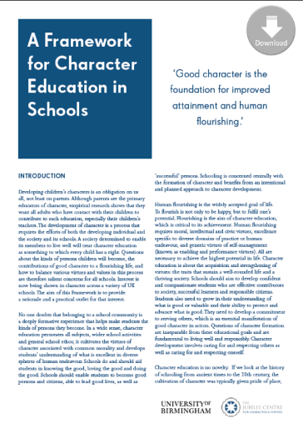
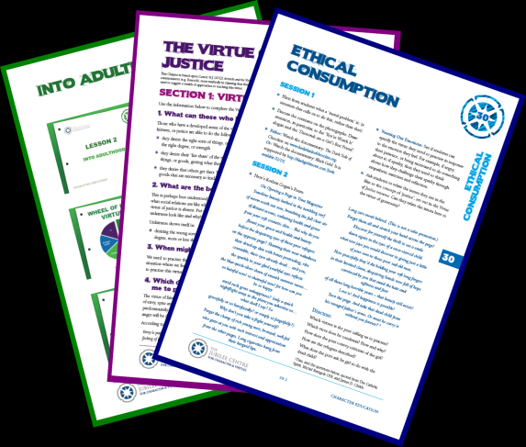
Character can be Taught
Notes:
Can be taught – not in class rooms and rows and rote learning
We have created resources based on philosophy above

Slide 13
Where?
Discrete
Across the Curriculum
Enrichment
Alongside community and Parents

Slide 14
Why Teach Character?
Virtue Literacy, Reasoning and Practice
Time and Space for critical reflection
Raises its importance – visibility
Can encompass much of what schools are asked to do into a single package

Slide 15
Big Questions we are working on…
Can and should we measure character?
What's the link between character education and attainment, behaviour, employability?
Is there a proven education model for character development?
What is the link with British Values?
What should the DfE and Ofsted's role be?

Slide 16
What Next?
Association of Character Education (ACE)
MOOC and worlds first M.A. in Character Education
Thank You Letter Awards
www.jubileecentre.ac.uk

