Slide 1




Achievement for All and Early Support in partnership
Kath Alley - Achievement Coach
Notes:
2012 Early Support became a partner of AfA.
Similar values and principles. Way of working 0-5 roll out 0-25 transition into adulthood
Partnership with the family; parental engagement Achievement, Aspiration and Access
Exciting journey working in partnership to support the integrated provision for children and families with SEND.
Short background to Es and Achievement for All
Activity around the ES principles gives you an insight into what these are
How AfA will be supporting schools where appropriate to access the extended offer of Early Support
Direct attention to ES booklet

Slide 2






Achievement for All Partners

Slide 3
Early Support
Early Support is a way of working, underpinned by 10 principles, that improves the delivery of services for disabled children, young people and their families.
Early Support is a core partner supporting the implementation of proposals in the Government Green Paper Support and Aspiration (2011).
It is not a programme or a service
Now for use 0-25.
Notes:
Way of working based on 10 principles
Coordinated and integrated provision involving the family
Enabled by ES central team based at NCB and regional facilitators working with education, health, social care, voluntary and private sector
Working together to support integrated provision and increase chances of children, young people and families SEND – ordinary lives

Slide 4
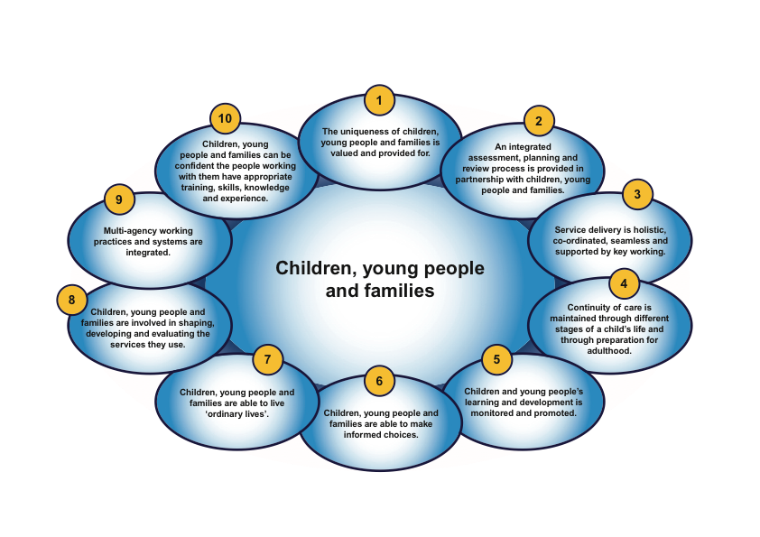
Early Support principles

Slide 5

Early Support approach
Joint planning and decision making with families
Shared information
Integrated delivery
key working
Single plan
Notes:
Green paper requires that there is a process between schools, families, health , social care particularly with children with more complex needs
2 way sharing of information
Joint planning and target setting
Joint assessment and integrated provision
Challenge
How many of your children is this appropriate for?
Don’t use early support what processes do you use?

Slide 6
AfA and Early Support
In 2012 Early Support became a partner of Achievement for All 3As. Achievement for All 3As leads on the work with schools, and with Early Support are able to offer this as an additional layer to the Achievement for All programme to further support schools, children, young people and parents, and bring together Early Support and Achievement for All principles, approaches, materials and training
This partnership supports the Charity’s desire to broaden and deepen the work that it does. Achievement for All and Early Support working in partnership offer a unique opportunity to address the challenges set out in the Government’s Support and Aspiration Green paper.

Slide 7
The challenge
To extend this way of working into the world of early years settings and schools as an integral part of SEND reform
To model it for children with different levels of additional support need at different ages as the mechanism to:
  improve the quality of engagement between schools and families
Notes:
Improving engagement with parents
ES way of working in partnership improving that engagement of families and services for those children with more complex needs
Supporting regular contact with the family, planning process and TAC
Support integrated assessment and provision
Those children with statements but also a larger no of children don’t have an integrated plan but way of working promotes increased engagement of families
MAPIT tool (Multiagency planning and improvement) application of the principles in partnership with families to shape services and ensure services are better targeted for both individual and group activity.
Gaps in school provision
Familiarise with the Early Support principles.
Groups of ¾ select one of the principles and consider what evidence do you have in your school to say that this is working well including through AfA ?
5 minutes then rotate (min of 2 x)
All Achievement for All coaches are being asked to use 2/3 principles identified appropriate for the school
MAPIT eg

Slide 8
The Early Support materials and resources
The Early Support materials are practical resources to drive and support the process of multi-agency service development at local level. Early Support’s resources and training help to bring service providers together with parent carers, children and young people. They ensure parent carers, children and young people remain at the centre of a holistic and integrated planning process.
Notes:
Range of resources available – interactive as that what families want; website Q reader for app (sacn symbol)
MAPIT tool
Training delivered regionally with multi agency - free of charge
Training for trainers – capacity to deliver
Resources 0-5 current website are being updated 0-25 Nov/Dec
APP and developmental journal
Information resources

Slide 9
The Early Support materials and resources
Available as ebooks online and via an Early Support app:
Information resources on specific conditions for parent carers and young people
Background information resources for parent carers and young people
‘Our family’ and ‘My life’ (both of which include a single Education, Health and Care Plan format)
Multi-agency Planning and Improvement Tool (MAPIT)
Informed choice resource
Developmental journals
Film materials
For current resources see the Early Support website at http://ncb.org.uk/early-support
Notes:
Range of resources available – interactive as that what families want; website Q reader for app (sacn symbol)
MAPIT tool
Training delivered regionally with multi agency - free of charge
Training for trainers – capacity to deliver
Resources 0-5 current website are being updated 0-25 Nov/Dec
APP and developmental journal
Information resources

Slide 10
The Early Support and Key Working Training
Early Support offer training for practitioners, managers, parents carers and young people:
MAPIT training – 1 day
Key working training – 2 days
Working in partnership through Early Support – 2 day course with day 1 being common to key working
Developmental journal training – 1 day
Using the single plan (online)
Early Support also offer a series of 5 workshops for parent carers and workshops for young people:
Notes:
Range of resources available – interactive as that what families want; website Q reader for app (sacn symbol)
MAPIT tool
Training delivered regionally with multi agency - free of charge
Training for trainers – capacity to deliver
Resources 0-5 current website are being updated 0-25 Nov/Dec
APP and developmental journal
Information resources

Slide 11
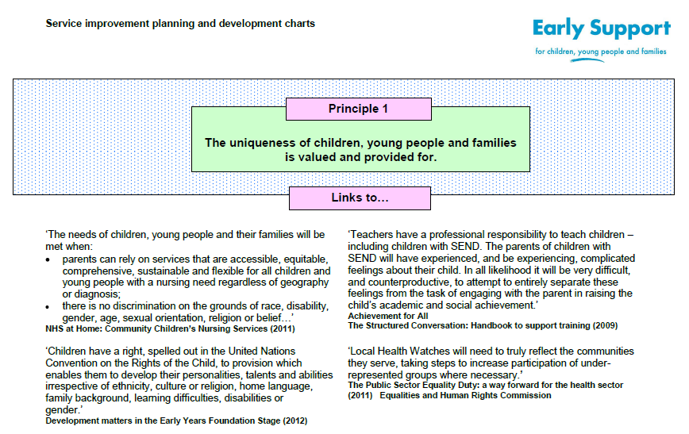
Early Support
Multi Agency Planning and Improvement Tool

Slide 12

Outcomes for children, young people and families
The focus of MAPIT is reviewing, planning and monitoring outcomes for and with children, young people and families so that:
Everyone is clear what is working and what is not
Service development and resources can be directed to what really makes a difference
The right information and support is provided in the most effective, efficient and empathetic way
Account is taken of the diversity of children, young people and families, their strengths, needs and wishes.

Slide 13
What can MAPIT do?
…be used to produce a comprehensive ‘snapshot’ of how services currently operate and to identify areas for priority action.
…be stand-alone or be used as part of more general service review and improvement cycles
…be used to concentrate discussion and planning on an individual or small number of principles
MAPIT can….
…help users focus on services for disabled children and young people and their families
…aid multiagency review and planning for service improvement
…facilitate introduction & use of Early Support as core element within joint planning & commissioning of services for disabled children and young people

Slide 14
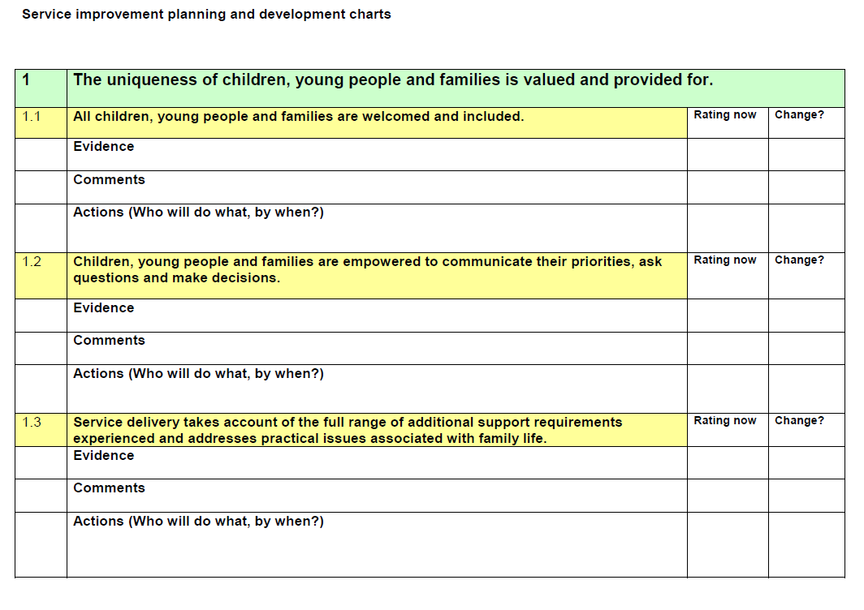

Slide 15

The Cedars Academy, Gateshead
The Cedars Academy is an all-age school for children and students aged 5 to 16 years. It is one of a number of Special Schools in Gateshead. It specialises in providing education for children and young people with physical and medical needs, speech and language disorders, some types of autism, and a wide range of other complex needs often associated with emotional vulnerability.
The Academy began the Achievement for All programme in September 2012.
The Needs Analysis identified a need to involve parents/carers more fully in all aspects of their child’s school experience. The school has an active parent group which is largely a social and fundraising body. The school wanted to explore ways to involve all parent/carers in the learning and progress of their children in a more meaningful way.

Slide 16
The bespoke plan
Key members of staff received training in the principles of AfA, Early Support and the Structured Conversation.
School staff began to undertake Structured Conversations with parents
The AfA Coach carried out a audit (based on the MAPIT tool) to gather parent and pupil views on the school’s service in relation to the 10 key principles.
The school champion and school AfA coach jointly planned a whole school CPD day
  Introduction to Achievement for All
  Structured Conversation Training with input from trained school staff
  Introduction to Early Support
  Exploration of Early Support Resources/training
  Key findings of AfA Needs Analysis and Early Support MAPIT exercise (parent and pupil views)
  Staff to explore and develop actions to address the areas for development.

Slide 17
Desired Outcomes
All staff have a clear understanding of the purpose and structure of the Achievement for All programme and their role in its implementation.
All staff understand the principles of the structured conversation and have enhanced their knowledge and skills.
All staff have an understanding of the Early Support approach and the key principles.
All staff have an awareness of the resources and training available through Early Support and how they may be used to improve outcomes for families.
All staff have an understanding of the key AfA areas for development as identified by senior staff and key Early Support findings from parents and pupils.
Staff will have shared and discussed ideas for development and begun to develop action plans.
The school will work more effectively with all families and outcome for all pupils/families will be improved.

Slide 18
Early Support/AfA
Do you feel that the Early Support principles have relevance in your school setting?
Do you think that there are ways in which the Achievement for All elements could enhance your ability to fulfil the 10 principles more effectively?

